Slide 1

Why Teach Spelling?
Center on Instruction – Reading Strand
Florida Center for Reading Research
Florida State University
May 2012
Notes:
Welcome to the introductory event for Why Teach Spelling.

Slide 2
The Center on Instruction is operated by RMC Research Corporation
in partnership with
the Florida Center for Reading Research at Florida State University;
Instructional Research Group;
the Texas Institute for Measurement, Evaluation, and Statistics at the University of Houston;
and The Meadows Center for Preventing Educational Risk at the University of Texas at Austin.
The contents of this PowerPoint were developed under cooperative agreement S283B050034 with
the U.S. Department of Education. However, these contents do not necessarily
represent the policy of the Department of Education, and you should not
assume endorsement by the Federal Government.
2012
The Center on Instruction requests that no changes be made to the content or appearance of this product.
To download a copy of this document, visit www.centeroninstruction.org
Notes:
Presented by the Center on Instruction, funded by the U.S. Department of Education.

Slide 3
www.centeroninstruction.org
Notes:
For more information about COI and our resources, visit our website.

Slide 4

Debby Houston Miller, Ph.D.
Deputy Director, Center on Instruction – Reading Strand
Notes:
I’m Debby Miller, Deputy Director for the Reading Strand for the Center on Instruction and your host for the webinar. I will be monitoring questions in the chat box and will answer questions as time allows.

Slide 5

Deborah K. Reed, Ph.D.
Assistant Professor, The University of Texas at El Paso
Notes:
I’m Deborah Reed from The University of Texas at El Paso and the author of the document. I will be your presenter today.

Slide 6
Goals
Build awareness of the content and tools included in Why Teach Spelling?
Provide opportunities to think about how to use the document in your work
Notes:
Here are our goals today.
It is important to note that our goal is to orient you to this document so that you can identify how it may be helpful in your work.

Slide 7

Think About It…
What kinds of instructional activities come to mind when you think of spelling?
Notes:
I’d like to get started by giving you a task. Consider this question and take several seconds to jot down what comes to your mind. Keep your notes handy because you’ll want to refer back to them during the presentation.
So, let’s get you oriented to the suite of materials that comprise Why Teach Spelling…

Slide 8
Included in the Booklet
Research background
Checklist for Evaluating Spelling Curriculum
Connections to the Common Core State Standards (CCSS)
Notes:
The pieces of the Why Teach Spelling? booklet were created to support state education agencies and technical assistance providers in their work with teachers in grades K-12. They follow the release of other Center on Instruction reports of research addressing the link between writing and reading development (Graham & Hebert, 2010) and the strategies found to improve the writing performance of older students (Graham & Perin, 2007) . Both previous works identified spelling as one of the critical skills.
The main document included here explains the importance of spelling to students’ reading abilities, models of spelling development, and common approaches to spelling instruction. In addition, it has supporting figures/diagrams as well as appendices with additional information and lists of resources helpful to practitioners.
Using the information from the main document, two companion resources were created for teachers and included in the booklet. One is a checklist for evaluating a spelling curriculum. The other is a set of tables that connect the information in the practice guide to the grade-level expectations outlined in the Common Core State Standards (CCSS).
To make appropriate use of the materials, it is recommended the background information be read first. Therefore, we will spend the majority of our time becoming familiar with its contents.

Slide 9
The State of Spelling Instruction
/f/
Fantastic
Phoneme
Puff
Rough
Notes:
Studies indicate that little instructional time is devoted to spelling. Unfortunately, many teachers perceive the spelling of English words to be irregular and unrelated to reading development. Unlike Finnish or Spanish, the letters of the English alphabet can produce multiple sounds, and one sound can be represented in multiple spellings. On the slide you see an example of this with four different ways that the sound /f/ can be spelled. This variety can mistakenly lead teachers and students to conclude that spelling is unpredictable and can only be accomplished with rote memorization.

Slide 10
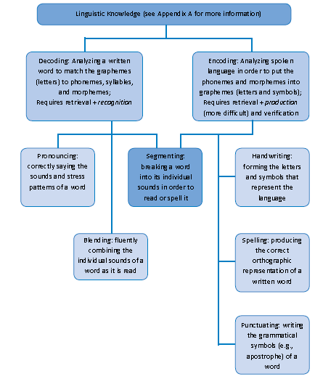

Relationship Between Encoding and Decoding
Notes:
Although spelling can be challenging, proficiency in spelling actually supports reading because it requires students to integrate phonological, orthographic, and morphological knowledge about words. Decoding (reading words) and encoding (spelling words) are mutually beneficial because each provides opportunities for students to practice common grapho-phonemic patterns of our language. Repeated exposures are necessary for readers and writers to develop automaticity in decoding and encoding words. As you see noted on this slide, an appendix is included that provides more thorough explanations and examples of the components of linguistic knowledge. If needed, you can refer to it as we proceed. It is on pages 31-33 of the booklet.

Slide 11
Spelling
Models of spelling development
  Developmental stages
  Connectionism
Approaches to spelling instruction
  Whole word (memorization)
  Phonemic
  Morphemic
Implications for teachers
Notes:
Having established the importance of spelling to students’ reading abilities, we will now turn to the ways that spelling develops and how those ways have influenced the kinds of instruction provided. This is a good time to revisit the responses you wrote a few minutes ago.
Activity: Take a moment to review your notes about the kinds of instructional activities that the word “spelling” brings to mind. Are any of your notes reflected in the major topics in the document? Perhaps you have some questions about whether the models or approaches listed on this slide are aligned with best practices in spelling or with the Common Core State Standards (CCSS). Hopefully these thoughts have you interested in learning more about the documents included in this booklet.

Slide 12
Stage Models of Spelling Development
Derivational Constancy
Syllable
Juncture
Within-word
Letter-name/
Alphabetic
Emergent
Notes:
Many qualitative spelling inventories are designed to evaluate how students’ spelling errors map onto a sequence of skills, such as what you see on the slide. These types of developmental sequences are referred to as “stage models” of spelling (Frith, 1985).

Slide 13
Stage Models of Spelling Development
Errors:
seling
funy
kised
Derivational Constancy
Syllable
Juncture
Spelling unaccented final syllables
Still stabilizing consonant doubling
Within-word
Letter-name/
Alphabetic
Emergent
Notes:
Stage models can help teachers understand that errors might be more than mistakes. Rather, the stages can help indicate whether or not a given error is developmentally appropriate to address. For example, look at the spelling errors in the box on this slide. A teacher would not address errors in the syllable juncture stage, such as spelling unaccented final syllables, if the child has not yet stabilized within-word patterns such as consonant doubling. Through error analysis, stage theory traces the patterns of orthographic growth that move from simple to complex.

Slide 14
Connectionist Models
Phonology
Word Frequency
Orthography
Notes:
The connectionist model, considers the interplay among phonology, orthography, and word frequency rather than viewing spelling ability solely as a result of sequential development.

Slide 15
Connectionist Models
Phonology
Word Frequency
Orthography
Correct:
fleas fleaz
Notes:
The correct example on this slide demonstrates a five-year-old’s ability to correctly spell the plural –s endings on words making a /z/ sound. This correct use of the –s by a young child occurred before he could have developed the morphological knowledge of inflectional endings. Because plural –s endings are encountered frequently, the student successfully replicated the pattern rather than spelling the word phonetically with a –z ending.

Slide 16
Connectionist Models
Phonology
Word Frequency
Orthography
Error:
runned
Notes:
The error on this slide shows how students might over-generalize the spelling of a word that does not follow expected patterns. Based on how frequently students might have encountered the past –ed ending, they might recall the orthographic features of similar words when attempting to spell and pronounce words with a similar purpose (or part of speech) but that do not conform to the pattern. As students have repeated encounters with reading and writing words that are and are not spelled or pronounced as expected, they will refine their understanding of the patterns.

Slide 17
Mastering English Orthography
Maps sound to print at different levels:
  Whole-word (cat)
  Phoneme (/c/ /a/ /t/)
  Grapheme (c-a-t)
  Sound spelling (c-at) patterns
Notes:
Different models of spelling contribute to different approaches to spelling instruction. However, regardless of the model of spelling development adopted, it is important to acknowledge that English orthography maps sound to print at the level of whole-word (cat), phoneme (/c/ /a/ /t/), grapheme (c-a-t), and sound spelling (c-at) patterns. All of these units must be learned to master English orthography.

Slide 18
What do you think?
Which model of spelling development do you think most influences current spelling instructional practices?
Spelling is irregular and unpredictable.
Spelling is based on developmental sequences or stages.
Spelling involves phonological and orthographic knowledge as well as word frequency.
Notes:
Before we begin discussing specific instructional approaches, I’d like you to think about this question. Place a check in the box by the description of spelling development that you think most influences current spelling instructional practices in your school.
I notice that most of you… (summarize responses)

Slide 19
Approaches to Spelling Instruction
Whole word
Phonemic
Morphemic
Notes:
There are three common approaches to instruction: whole-word, phonemic, and morphemic. Each approach involves classroom practices that might be reflective of one or more of the different beliefs about spelling. This booklet explains each approach and provides examples of the kinds of activities and lessons they might involve.

Slide 20
Whole Word Spelling Instruction
Thematic lists
Leveled or self-selected lists
Notes:
Whole word instruction is based on the idea that learning to spell is dependent upon rote memorization. When surveyed regarding the sources of their weekly spelling lists, first- through third-grade teachers reported using several sources often associated with whole-word memorization: basal readers, material students read, students’ compositions, and student self-selection (Graham et al., 2008). These sources fall into the two primary categories you see on this slide: 1) thematic lists; and 2) leveled or self-selected lists.

Slide 21
Whole Word Spelling Instruction: Thematic Lists
Native Americans
Education
Native
Shaman
Culture
Environment
Schlagal, 2007
Notes:
This is an example of a spelling list derived from a thematic unit in a basal text. It combines learning how to pronounce the words as well as read and define them in context at the same time students are learning to spell the words (Schlagal, 2007). The advantage of a thematic list is that it provides a meaningful context for students. However, learning all aspects of a word at once might be too cognitively challenging (Morris, Blanton, Blanton, Nowacek, & Perney, 1995). In addition, choosing spelling words based on the vocabulary students are learning does not emphasize phonemic or morphemic patterns. Instead, it tends to suggest that memorizing words is the primary means of learning to spell. That means instruction is usually implicit (Simonsen & Gunter, 2001). Students are not taught how to learn and remember the spellings of the words – other than to memorize them.

Slide 22
Whole Word Spelling Instruction: Leveled Lists
Grade 3
About
Blood
Rhythm
Thought
Weight
Notes:
Another source of spelling words in whole word instruction is using lists organized by difficulty. These are chosen based on word frequency counts so that younger children are given shorter words that appear in speech and print very often, and older students are given successively more complex and less frequently occurring words. That can result in lists, such as the one on this slide, that are organized by grade levels regardless of spelling patterns. This cannot be completely avoided due to the number of irregular words, or those that cannot be decoded using typical sound-symbol relationship rules.

Slide 23
Whole Word Spelling Instruction: Leveled Lists by Pattern
Annoy
Avoid
Coil
Loyal
Ploy
Poise
-oy
-oi
Notes:
A well-organized leveled list will draw students’ attention to particular patterns. For example, students can sort the words on this slide into contrasting categories by the –oi and –oy patterns. Then, students can be helped to articulate the observed rule that –oi comes in the middle of words or syllables, and –oy at the end of a word or syllable. This overlaps a bit with phonemic spelling instruction, which we will be addressing next.

Slide 24
Whole Word Spelling Instruction: Learning Strategies
Cover, Copy, Compare
Look at the spelling word (also referred to as the stimulus or target word).
Copy the spelling word while referring to the stimulus.
Cover both the stimulus and the copy produced in step 2.
Spell the word from memory.
Uncover the stimulus and compare it to the word spelled in step 4.
Fulk, 1996; Struthers, Bartlamay, Bell, & McLaughlin, 1994
Notes:
Generally, instruction for leveled lists has been implicit. However, some approaches successfully teach students a learning strategy. The Cover, Copy, Compare strategy on this slide is one example of a strategy that teaches students how to learn the word. Other strategies found successful in research are mentioned in the document. However, teachers may need additional assistance learning how to implement the strategies successfully.

Slide 25
What do you think?
Of the words on this page, circle the ones you believe will need to be taught with whole word strategies.
Picture
Garden
Today
Said
Myself
Once
Notes:
Here’s an exercise to get you thinking about the irregular words that will need to be taught as whole words. Draw a circle around the words that you would use a learning strategy to help students memorize because they do not follow expected patterns.
[May ask to explain answer in Chat Box depending on time. Irregular words: today, said, once.]
[Summarize responses.]

Slide 26
Phonemic Spelling Instruction
Alphabetic
Phonemic and syllable patterns
Notes:
Phonemic approaches to spelling are based on regular sound-symbol correspondences of individual letters or letter sequences. Although a common perception is that English spelling is irregular and unpredictable (Simonsen & Gunter, 2001), teaching alphabetic, phonemic, and syllable patterns makes spelling much more consistent and predictable.

Slide 27
Phonemic Spelling Instruction: Alphabetic Spelling
Sequence of easier to more difficult sound-symbol correspondences
Practice manipulating, building, reading, and writing words
Notes:
Initially, students learn to match individual letters to sounds in a left-to-right fashion as they spell phonetically regular words. Because consonants are much more predictable than vowels, instruction usually begins with these letters. In addition, knowing the consonants in a word increases the odds of spelling the vowels correctly. Students taught to use phoneme-grapheme correspondences made significantly greater gains on measures of phonemic decoding, fluency, and encoding compared to students who were taught to use letter names as cues to decoding.

Slide 28
Phonemic Spelling Instruction: Phonemic and Syllable Patterns
/k/
cat, corn, cup, clip
kelp, kiss, Kyle
Notes:
Although beginning readers and spellers fixate on each letter in a word, becoming a skilled reader or speller requires more efficient processing of larger and larger units (Goldstone, 1998). One example of a larger unit is a cluster of letters that have to appear in a consistent order based on how the English letters can be used (Joshi et al., 2008). On this slide we see the example of how the initial /k/ sound can be spelled. If an a, o, u, or consonant follows the /k/ sound, it is spelled with the letter c. If an e, i, or y follows the initial /k/ sound, it is spelled with the letter k.

Slide 29
Phonemic Spelling Instruction: Phonemic and Syllable Patterns
Syllable Types
Closed
Open
Silent-e
r-controlled
Vowel pair/team
Consonant-le
Notes:
Other pattern rules in phonemic spelling are based on syllables. Students who understand the salient features of syllables are better able to apply their knowledge flexibly to encode increasingly more complex words. For example, although open syllables are the most common representation of long vowel sounds, second-graders taught silent-e and vowel pairs/teams syllable types improved their ability to spell words with alternative representations of long vowel sounds (Brown & Morris, 2005). Learning the six syllable types also enables students to encode sounds, such as r-controlled vowels and consonant-le, that take more than individual letters to produce.

Slide 30
Phonemic Spelling Instruction: Phonemic and Syllable Patterns
Syllable Junctures
Rabbit Rule
Rab-bit
Ro-dent
Joshi, Treiman, Carreker, & Moats, 2008-09)
Notes:
Students who understand syllable patterns can be taught spelling rules associated with syllable junctures. One example is the “rabbit rule.” This concerns two-syllable words with a short vowel sound in the first syllable as in rabbit. These words have a double consonant in the middle of the word to preserve the first closed syllable: rab-bit. Otherwise, the syllable would be open as in ro-dent.

Slide 31
What do you think?
How familiar are teachers with the elements of phonemic spelling instruction?
Low
Medium
High
Notes:
Many teachers might be familiar with teaching letter-sound correspondences and syllable types for decoding instruction. It might not be as common to apply this to encoding instruction. To begin considering the kinds of support you may need to provide to teachers, read the question and answer it by placing a check along the continuum drawn on the slide.
[Summarize responses.]

Slide 32
Morphemic Spelling Instruction
Types of Morphemes
Roots and bases
Compound words (e.g., suntan)
Prefixes
Suffixes
  Inflectional (e.g, -s, -ing, -est)
  Derivational (e.g., -ly, -sion)
Notes:
Phonemic spelling is based on encoding units of sound. Morphemic spelling, on the other hand, involves the meaningful units of language: prefixes, roots, and suffixes. Knowledge of morphemes and how they function in words leads to better spelling accuracy than simply sounding out or memorizing words. Morphemic knowledge may also benefit English language learners because morphemes are important to spelling in other languages (Defior, Alegria, Titos, & Martos, 2008; Tsesmeli, Douvalis, & Kyrou, 2011). However, consistent use of morphological rules takes time to develop. For example, children acquire an understanding of inflectional endings, such as –s and –ed, before derivational endings, such as –ly and –er (Deacon, 2008; Steffler, 2004). The two elements of morphemic spelling instruction that help students improve their spelling are learning rules for adding morphemes to words and learning how morphemes are preserved in more complex and/or less frequently used words.

Slide 33
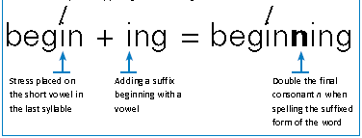
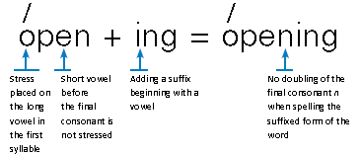
Morphemic Spelling Instruction: Rule-based Spelling
Doubling
Notes:
After mastering the basic vowel patterns in single-syllable words, students can begin transitioning to morphemic spelling rules. These will help students form plurals and join syllables. One example is the doubling rule. This applies to base words or final syllables ending in one consonant after an accented short vowel. When adding a suffix beginning with a vowel, the final consonant is doubled before the suffix. You can see this on the word beginning. Begin ends with an accented closed syllable, so the final n is doubled before adding –ing to the word. The other word on this slide, opening, shows when the doubling rule does not apply. In the word open, the accent is not on the final closed syllable, so the n is not doubled before adding –ing.

Slide 34
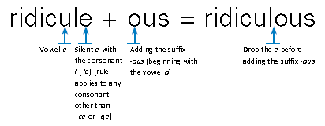
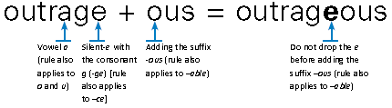
Morphemic Spelling Instruction: Rule-based Spelling
Dropping
Notes:
Students who have knowledge of the underlying structures of words, such as those taught in rule-based spelling, tend to be better spellers than students who rely on visual recognition of what “looks right” (Lennox & Siegel, 1996). This explains why the word outrageous is frequently misspelled as outragous. Students who misspell the word this way might be comparing it visually to a word such as ridiculous. The difference between the words requires a deeper understanding of the dropping rule, which concerns when a silent-e at the end of word is dropped before adding a suffix. In the word ridiculous, we see how the e is dropped before adding a suffix beginning with a vowel. However, the rule does not apply when adding the suffixes –able or –ous to a silent-e word when the vowels a, o, or u are followed by –ce or –ge. That is why the word outrageous retains the e before the suffix.

Slide 35
Morphemic Spelling Instruction: Morpheme Preservation
Division by syllables
scar’ci’ty
Division by morphemes
scarc/ity
Notes:
Many words that seem “irregular” based on phonemic spelling rules are actually formed to preserve the morphemes (Henry, 1993). Take, for example, the word scarcity. Dividing it by syllables would result in: scar’ci’ty. The first syllable, scar, is closed but unexpectedly pronounced with a long a sound. The second syllable is open, ci, but unexpectedly pronounced with a short i sound. Only the final open syllable, ty, is pronounced as expected.
Dividing the word by morphemes, however, would result in: scarc/ity. This reveals the root scarc, which means “plucked out” or rare. And the other morpheme is the abstract noun suffix –ity, which indicates state or position.

Slide 36
Morphemic Spelling Instruction: Morpheme Preservation
sign
signal
significance
signature
signify
Notes:
Morpheme preservation has also contributed to the use of some silent consonants as with the –g in the word sign. The –g is retained because it is actually pronounced in derived forms of the word: signal, signature, signify, significance. Although the silent consonant makes the spelling of the base word less predictable by sound-symbol correspondences, an awareness of the role it plays as part of a meaningful unit helps students make connections among words and perceive greater consistency in the written language.
Explicitly teaching morphological structure improves students’ spelling performance (Devonshire & Fluck, 2010). In addition, those improvements were maintained in research two months after instruction ended, and students were able to apply their knowledge to untaught words (Tsesmeli & Seymour, 2008).

Slide 37
What do you think?
Of the irregular words on this page, circle the ones you believe would lend themselves to morphemic spelling instruction.
Omniscient
Something
Carriage
Metamorphosis
Acquaintance
Autumn
Notes:
Take a minute to consider what we have discussed about morphemic spelling instruction. Of the irregular words I’ve listed on the screen, circle the ones to which rule-based spelling or morpheme preservation would most likely apply.
[Rule-based: carriage (changing rule). Morpheme preservation: autumn (silent consonant), omniscient (omni/science), metamorphosis (meta/morph/osis)]
We have provided a list of Suggestions for Further Reading at the end of the main document that include resources for identifying common morphemes as well as clear explanations and good examples of how to teach them.

Slide 38
Implications for Instruction
Letter-sound and syllable patterns: regular words
Morpheme patterns: underlying structure and derived forms
Explicit teaching of memory retrieval strategies: irregular words
Notes:
Although presented separately, teaching spelling does not require a choice of either whole word, or phonemic, or morphemic instruction. Rather, there seem to be valid reasons to integrate the approaches in order to address different aspects of English spelling and to help students learn to spell different kinds of words. Instruction should be organized to introduce letter-sound correspondences, syllable patterns, morpheme patterns, and strategies for long unfamiliar words.

Slide 39
Implications for Instruction: Leveraging Reading Instruction
/eer/
Sheer
Here
Fear
Pier
Weir
Notes:
The elements of spelling instruction also correspond to the elements of reading instruction. However, it is important to recognize that phoneme-grapheme and grapheme-phoneme mappings are not always comparable in English. For example, the word sheer is likely to cause fewer reading problems than spelling problems because of the multiple ways to write the /-eer/ pattern as shown with the example words on this slide. Thus, to enable their students to master the orthographic depth of English and be able to write words without effort, teachers need to enhance reading instruction with spelling instruction (Foorman, Fletcher & Breier, 2003).

Slide 40
Implications for Instruction: Selection of Words
Organized by spelling rules or patterns
50-85% accuracy at pre-test
Notes:
Earlier we discussed the problems with relying on thematic or leveled lists from the basal. So, how should words be selected for spelling instruction? Researchers recommend that students be taught using lists of words exemplifying targeted spelling rules or patterns and on which they scored 50 – 85% accuracy at pretest (Morris et al., 1995). Too little knowledge of lower level or easier spelling rules or patterns would lead to frustration, and too much existing knowledge of the words would not present enough challenge to foster new learning.

Slide 41
Implications for Instruction: Planning the Lessons
Test-teach-test
Practice with immediate error correction
Notes:
Selecting words based on students’ pre-test performance means that teachers will be following a test-teach-test sequence for spelling instruction. The “teach” step should include opportunities for cumulative review of words and spelling rules or patterns learned in order to retain their skills across time and build greater proficiency with them (Simonson & Gunter, 2001). As students practice, a synthesis of studies found that immediate error correction of misspellings led to better outcomes than writing words without any error correction or providing delayed error correction after all the words in the list had been written (Wanzek et al., 2006).

Slide 42
Implications for Instruction: Peer Support (Fulk & Stormont-Spurgin, 1995)
Step 1: State the rule.
Step 2: Demonstrate the correct spelling. Refer back to the rule on the portion of the word where your partner made the error.
Step 3: Spell the word orally in unison with your partner.
Step 4: Have your partner orally spell the word again on his/her own.
Step 5: Have your partner write the word on his/her own while orally spelling it.
Step 6: Put the word back into the list. Administer it again at some point during the activity.
Notes:
With students using different word lists tailored to their spelling abilities and needing immediate feedback as they practice writing each word on their lists, teachers will want to consider implementing peer tutoring to manage the instruction. Peers successfully have been taught to help each other learn, practice, and review spelling skills (Fulk, 1996; Graham & Freeman, 1985; Telecsan, Slaton, & Stevens, 1999). Here you see one example of a routine that peers might follow for correcting a partner’s spelling error and reinforcing the correct spelling.
Student tutors will likely need a key or guide to identify the spelling rule their partners are practicing in each word on the list. If it is not possible to pair a student with a more capable peer who can accurately articulate the rule for a spelling error, teachers might consider instituting small group instruction. In this way, the teacher can provide the immediate error correction and reinforcement while working with a few students who share similar spelling abilities.

Slide 43
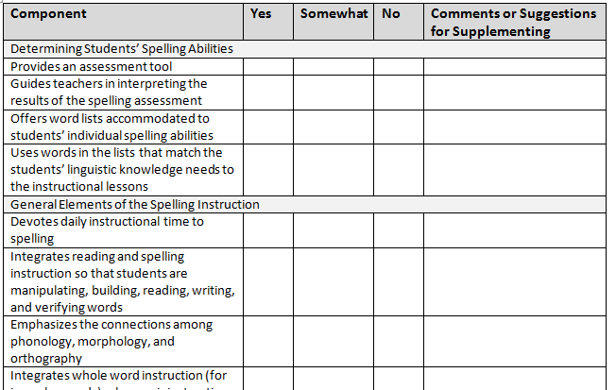
Checklist for Evaluating a Spelling Curriculum
Notes:
To help teachers select appropriate spelling instructional materials, we provide a checklist as a companion tool. The items are based on research outlined in the main document and offer a quick reference to the key elements for determining students’ spelling abilities and teaching basic to more complex skills.
The checklist is located on pages 36-38 of the booklet and is available as a separate Word document on the COI website.

Slide 44
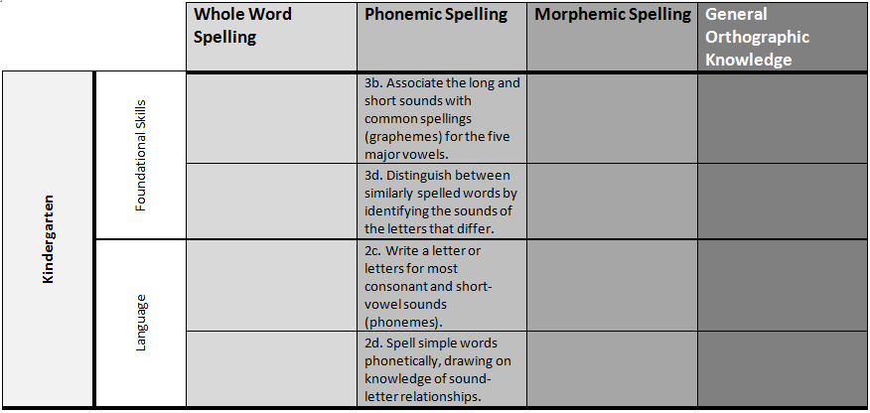
CCSS Links to Spelling
Notes:
The other tool included in the booklet is a series of tables that highlight the spelling skills apparent in the Common Core State Standards (CCSS). They are designed to help connect the information in the practice guide to the grade-level expectations outlined in the CCSS. These are not an official accompaniment to the CCSS. Rather, they represent our interpretation of the standards as they relate to our understanding of spelling instruction. An accompanying narrative explains how to read the tables. In addition, we offer caveats about the information. One such caution is to examine the tables in total to gain a better understanding of the progression of skills and to consider how that progression might be addressed for students who are “out of sequence” or whose current abilities do not align with the grade-level indicators.
We also recommend looking across not only the grade levels in the tables, but the spelling types. The column labels provide useful information on the conceptual origins of the standards, but they should not be considered as distinct choices to be made in spelling instruction. Connectionist models suggest teaching a mixture of these to strengthen students’ understanding. Similarly, a stage model approach to spelling would involve addressing the CCSS associated with the different spelling rule/pattern types as is developmentally appropriate.
The explanation of the CCSS Links begins on page 41 and the tables begin on page 43 of the booklet.

Slide 45
What do you think?
What level of support would most teachers need to implement the recommended spelling instructional practices in their classrooms?
Low
Medium
High
Notes:
Given the implications for instruction that I just described, pause for a moment to think about the support teachers will need to implement high quality spelling instruction. Place a check on the continuum to indicate your answer.
[Summarize responses.]

Slide 46
In Conclusion…
Models of spelling development
  Developmental stages
  Connectionism
Approaches to spelling instruction
  Whole word (memorization)
  Phonemic
  Morphemic
Implications for teachers
Notes:
To wrap up, I’ll remind you about the important features included in Why Teach Spelling? The main document starts by explaining the models of spelling development and then connects those models to common approaches to spelling instruction. Throughout, we emphasize that investing instructional time in spelling can be profitable if the English language is not treated as a haphazard writing system that can only be learned through rote memorization. Rather, students need to be taught how to learn and remember the spellings of the words. To that end, we include instructional recommendations as well as various tools, suggested resources, and companion tools to assist in planning appropriate lessons.

Slide 47
Think About It…
REVISIT
What kinds of instructional activities come to mind when you think of spelling?
Notes:
As we near the end of the webinar, I’d like you to find the notes you jotted down in answer to this question that was posed at the beginning of the webinar. Take a look to see if you believe the content of this document can support your work in helping improve spelling instruction.
47

Slide 48

To access materials and the
archive of this webinar
www.centeroninstruction.org
For questions or requests
for assistance
COI-Info@rmcres.com or
dhmiller@fcrr.org
Please complete the evaluation:
https://www.surveymonkey.com/s/RLSCDCL
Notes:
Address questions to COI
Access document PDF
Finally, please complete the brief webinar evaluation. This is very important to our work and helps us to continuously improve to provide better information and services. The link to the evaluation is in the chat box. Just click the link and you will leave the webinar and go directly to the evaluation.

