Slide 1
Organizing for the Success of English Language Learners
Nonie K. Lesaux, PhD
Associate Professor in Human Development and Urban Education Advancement
Harvard Graduate School of Education
Julie Russ, Ed.M.
Research Associate, Language Diversity and Literacy Development Group,
Harvard Graduate School of Education
Eastern SIG Regional Conference
Washington DC
April 14, 2011

Slide 2

The Center on Instruction is operated by RMC Research Corporation in partnership with
the Florida Center for Reading Research at Florida State University; Instructional Research Group;
the Texas Institute for Measurement, Evaluation, and Statistics at the University of Houston;
and The Meadows Center for Preventing Educational Risk at the University of Texas at Austin.
The contents of this PowerPoint were developed under cooperative agreement S283B050034 with
the U.S. Department of Education. However, these contents do not necessarily represent the policy of the Department of Education, and you should not assume endorsement by the Federal Government.
The Center on Instruction requests that no changes be made to the content or appearance of this product.
To download a copy of this document, visit www.centeroninstruction.org.
2011

Slide 3
Framework
The 21st Century America
Organizing For The Success Of ELLs
  Trends in ELs’ Reading Development
  Good instruction starts with good assessment systems
  Redefining the instructional focus to match the model to today’s students
Bringing It All Together

Slide 4
The 21st Century America
1 in 5 children is the child of an immigrant
Over 400 different native languages are represented
The immigrant population’s growth rate is 3 times as fast as that for the overall population
U.S. born children of Latino immigrants are the fastest growing segment of the school-aged population
  84% of Latino students are U.S. born
(Fry & Gonzales, 2008; NCES, 2006; US Census Bureau)

Slide 5
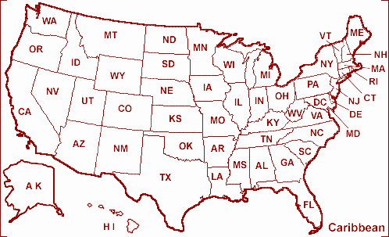

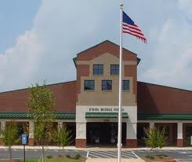

The 21st Century America
Cultural, linguistic, and economic diversity is a reality for the nation as a whole
  For all settings
  and all programs
  serving children

Slide 6
English Language Learners
Large gap in achievement between ELLs and their English-only peers
  50% of Latino fourth graders scored at the below-basic level in reading (NCES, 2007)
Almost twice as likely as their English-only peers to dropout
  Latinos account for nearly half (46%) of all high school dropouts (Snyder, Dillow, & Hoffman, 2007).
College remediation rates on the incline
Juxtaposed against family aspirations
  “Land of Opportunity”

Slide 7
Classrooms as a Setting for Development
Children and youth spend 15,000-20,000 hours of their lives in classrooms
  formal instruction occurs primarily in classrooms
For immigrant students and non-native speakers of English, the classroom is an especially important setting for cognitive, linguistic, and social-emotional development

Slide 8
Framework
The 21st Century America
Organizing For The Success Of ELLs
  Trends in ELs’ Reading Development
  Good instruction starts with good assessment systems
  Redefining the instructional focus to match the model to today’s students
Bringing It All Together

Slide 9
Prototype Case
In the Unified District, Rosa Parks is a K-8 School that serves 641 students from diverse ethnic and cultural backgrounds. 37.9% of students identify as Black, 58% Latino, 2.7% White, and 1.0% Asian. The great majority of children are U.S. born and enrolled at Rosa Parks in kindergarten. 80% of students receive free or reduced-price lunch. Classroom sizes are relatively small, the school culture is very positive, and at each grade level, teachers collect data on their students’ literacy skills. From K-3, the majority of students show significant progress in reading ability, but year-to-year about 50% of 3rd graders are in the needs improvement range. Rosa Parks’ middle-school students are not faring any better; only about 20% of 8th graders score in the proficient range while about 50% are in the needs improvement range and about 25% in the warning range. The feeder high school has just set up a summer remediation program to boost the reading skills of underprepared incoming 9th grade students. The district is working on a K-12 literacy plan.

Slide 10
How we think about “reading”
A Primer for today’s purposes
Accuracy
Letter Names & Letter Sounds
Phonological
Awareness
Word Reading
Efficiency
READING COMPREHENSION
Background Knowledge
Oral Language
Interest
Vocabulary
Motivation
Word Learning Strategies
Knowledge of word function or type
Metalinguistic Skills
Understanding of Purpose
Text Characteristics
Organizational structure
Sentence structure

Slide 11
Trends in ELLs’ Reading Development
What’s working:
On average, young ELLs develop proficient code-based skills with the same efficiency as their peers
  they are getting the “mechanics” of reading
ELLs tend to develop basic communication skills with ease

Slide 12
Trends in ELLs’ Reading Development (cont.)
What we still need to work on:
Many ELLs struggle to develop sophisticated oral language skills
  gets in the way of reading comprehension
More than an ELL issue
  Common profile for ELL and EO struggling readers in similar schools and classrooms.

Slide 13
Demonstration: The Gap Between Word Reading & Word Knowledge
Word Reading
National Average
Percentile Rank
Word Knowledge
Age 4.5 Age 8 Age 13

Slide 14
Demonstration: Gap between Reading Words & Comprehending Text
Crosson & Lesaux, 2010; Lesaux, Crosson, Kieffer & Pierce, 2010
Notes:
What data do you currently gather?
What would you do if these data represented your student population?
14

Slide 15
Implications for Schools and Classrooms
ELLs educated entirely in the U.S., reclassified ELLs, ELL newcomers, and their English-only peers…
…need the oral and written language abilities to learn content-knowledge and to communicate what they learned.
Academic Success
Reading to Learn
Having the language to understand what you’re reading

Slide 16
Framework
The 21st Century America
Organizing For The Success Of ELLs
  Trends in ELs’ Reading Development
  Good instruction starts with good assessment systems
  Redefining the instructional focus to match the model to today’s students
Bringing It All Together

Slide 17
The Link: Creating a Comprehensive Assessment Battery
Assessment tools…
have different capabilities
Understand score interpretations
serve different purposes
Understand relationship between type and function
even with outside benchmarks, measurements only provide a partial assessment of literacy skills
need measurements across areas
no one assessment is sufficient for screening or progress monitoring
Many skills go into what we call literacy

Slide 18
The Link: Creating a Comprehensive Assessment Battery
Preventing the gap between reading words & and understanding what is read
Word Reading
Word Knowledge
Assessment systems need to include a language component.

Slide 19
Assessments Can Create Instructional Imbalance
Relying on a single measure can “tip the scales.”
Code-related Measures
Meaning-related Measures
Instruction most often focuses on the domains and skills being measured.

Slide 20
An Ideal Literacy Battery
Thorough: Includes different types of assessments
Comprehensive: Measure across literacy domains

Slide 21

Discussion
What current literacy measures are you using at your school, in your district, or in your state? Any before the first state reading test (e.g., 3rd /4th grade)? Any measures of language development?

Slide 22
Framework
The 21st Century America
Organizing For The Success Of ELLs
  Trends in ELs’ Reading Development
  Good instruction starts with good assessment systems
  Redefining the instructional focus to match the model to today’s students
Bringing It All Together

Slide 23
What Many of Our Learners Need…
Accelerated academic vocabulary development
Background-knowledge building
Oral language, reading & writing practice
AND 50,000 words by the end of high school!
... designing instruction to meet those needs

Slide 24
Matching Instruction to Today’s Students:
The 21st Century Classroom
Treat diversity as characteristic of the K-12 population
  No longer feasible to rely on a specialist model (historically ineffective, anyway)
Need to infuse language and literacy instruction across the school day

Slide 25
Standard Practice, Elementary to High School
Teachers do most of the talking
Worksheets & textbooks
Reading/Language Arts; English Language Arts
  ~10-15% of time spent on writing
  ~10% of time spent on language and vocabulary
  Academic vocabulary is infrequently taught
In middle & high school, any vocabulary/reading instruction is fragmented over content areas

Slide 26
Discussion
Text Analysis

Slide 27
Academic Language (Oral & Written)
The language used in the classroom and workplace
  The language of text, assessments, & academic success
How is it different than conversational language?
Demands breadth and depth of vocabulary knowledge needed, including multiple meanings;
Includes vocabulary that appears far more often in text than in oral conversation;
Characterized by complex sentence structures;
Uses a more formal voice
(Scarcella, 2003; Snow & Uccelli, 2009)

Slide 28
What does it mean to know a word?
5 Levels of Word Knowledge:
Narrow-context bound knowledge
General sense
Enough knowledge to understand but not enough to recall and use appropriately
Rich, decontextualized knowledge of a word’s meaning, its relationship to other words, metaphorical use
Label
vs.
Concept
No
knowledge

Slide 29
Academic Words are Abstract Concepts
Located
Major
Period
Puzzle
Site
According to
Average
Expert
Foundation
Media
Nearly
Percent
Survey
Awareness/aware
Civil
Documentary
Image
Inspire
Anticipate
Constantly
Contribute
Convince
Effect
Expanse
Generate
Inspire
Image
Releasing
Region
Survive
Issue
Research
Social
Survive
Vision
Challenge
Focus
Incentive
Motivate
Communicate
Identity / Identify
Incidents
Legally
Method
Policy
Research
Require
Survey
Affect
Culture
Affect
Culture
Contribute
Establish
Ethnic/ethnicity
Residents
Welfare
Ancient
Complex
Integrated
Located
Major
Period
Puzzle
Site
Community
Discrimination
Distinctions
Evidence
Gender
Options
Regulations
Research
Respond
Topic
Collapse
Conduct
Contribute
Crucial
Research
Resource
Seeking
Establish

Slide 30
Degrees of Word Knowledge
Test your own Academic Vocabulary Knowledge!

Slide 31
So how do we teach vocabulary to promote literacy skills?
Targeting depth
of word knowledge
High utility
academic words
Multiple, planned
exposures
Anchored in text
Direct instruction & word-learning strategies

Slide 32
Key Elements of this Process
Engaging, rich text that features academic vocabulary and complex ideas
  Pushing on topics and questions that don’t have easy answers

Slide 33
Why Start with Print?
Source | Academic words per 1,000
Newspapers | 68.3
Adult books | 52.7
Comic books | 53.5
Children’s books | 30.9
Conversation between two college-educated adults | 17.3
Hayes & Ahrens (1998, p. 401)

Slide 34
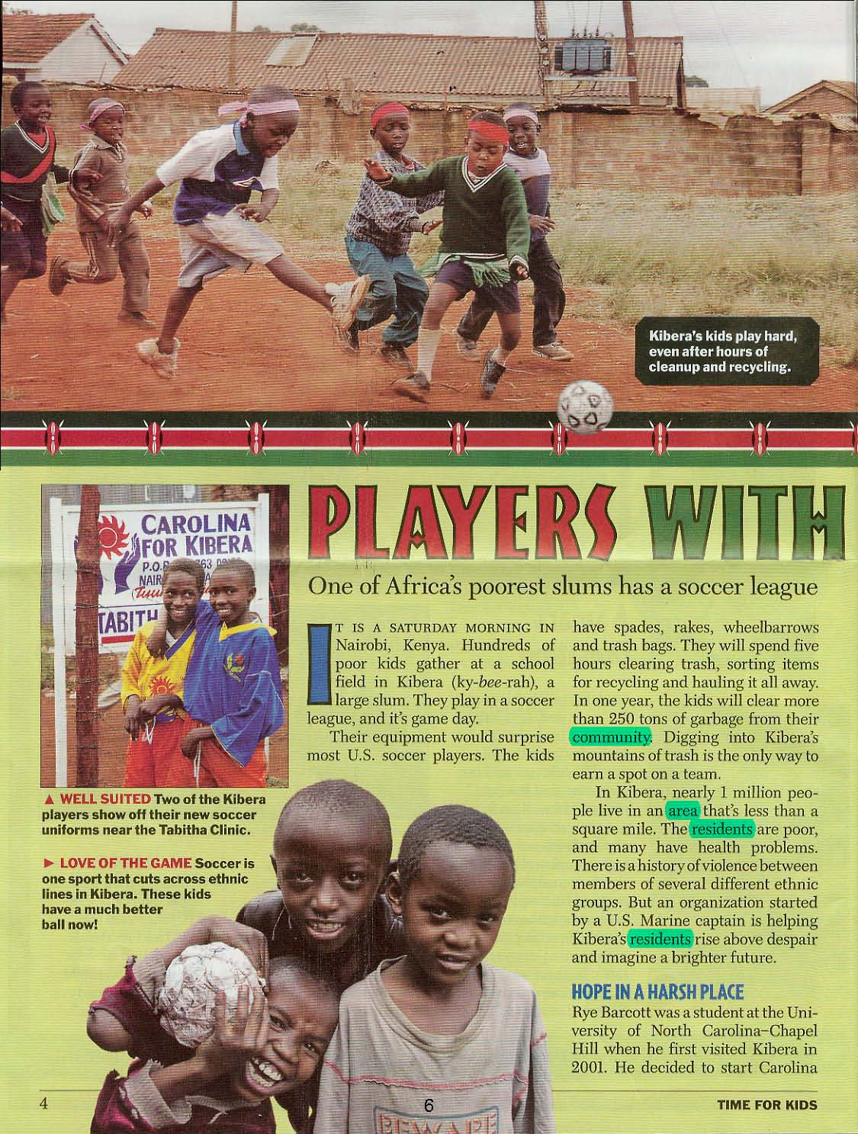
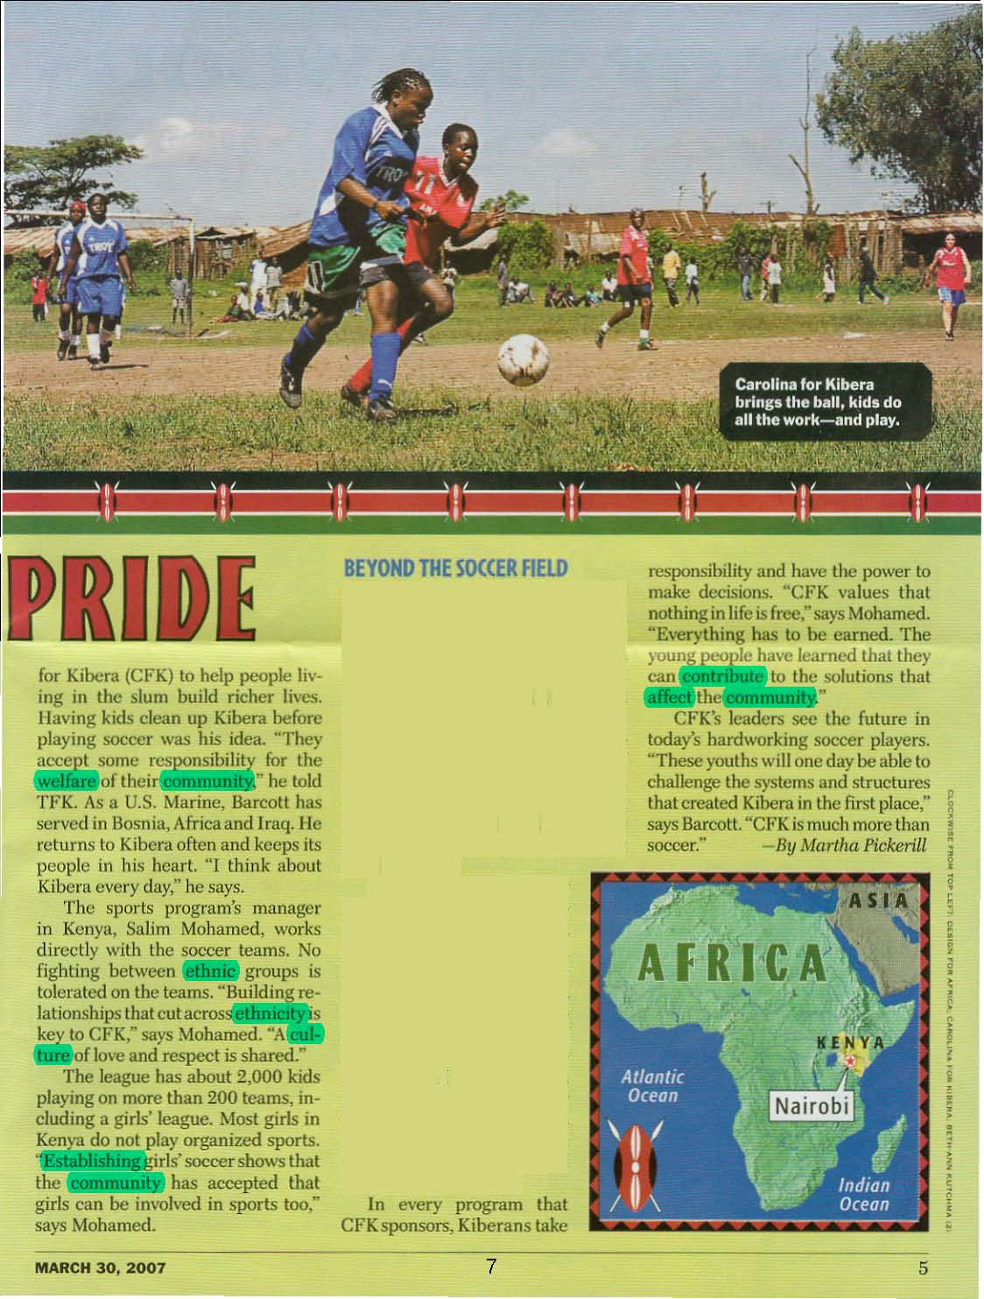


So, for example, Words in Context of Engaging Text
Platform for Discussing Big Concepts:
community service
tolerance
Target Words:
affect, community, contribute, culture, establish, ethnic, resident, welfare

Slide 35
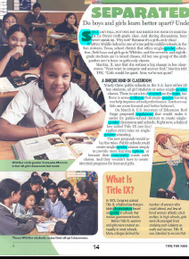
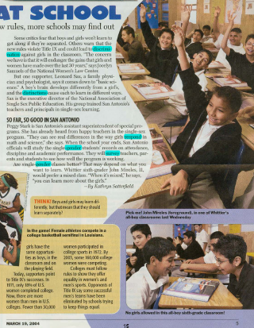


Words in the Context of another Engaging Text
Platform for Discussing Big Concepts:
segregation
ethical policies
Target Words:
discrimination, distinctions, evidence, gender, options, regulations, respond, topic
Notes:
Can start teaching complex topics at a more come-to-home level – perfect platform for connecting students to content.

Slide 36
Key Elements of this Process
Engaging, rich text that features academic vocabulary and complex ideas
  Pushing on topics and questions that don’t have easy answers
Multiple, meaningful opportunities for word learning

Slide 37
Multiple, meaningful opportunities for word learning
Talking
Example: Mock interview
Playing
Example: Pictionary
Example: Caption It
Contemplating

Slide 38
Key Elements of this Process
Engaging, rich text that features academic vocabulary and complex ideas
  Pushing on topics and questions that don’t have easy answers
Multiple, meaningful opportunities for word learning
  Student collaboration: contemplating, talking, and playing (with a purpose and a structure)
Teaching word-learning strategies
  word consciousness, parts, and transformations
Writing, debating, and discussing: Tools for reinforcing language development and critical thinking

Slide 39
Building academic language
discriminate
tion
Writing Prompt Question:
Write a letter to the school board arguing for or against single-gender classrooms in all the middle schools in your area. Provide three reasons that support your argument.
Discuss this question with your partner. Be sure to use the target words!
Plan your writing
Example: Mock interview
3. Promoting continued word learning through teaching word parts (e.g., suffixes and prefixes)
________________________________________________________________________________________________________________________________________________________________________________________
________________________________________________________________________________________________________________________________________________________________________________________
________________________________________________________________________________________________________________________________________________________________________________________
________________________________________________________________________________________________________________________________________________________________________________________
________________________________________________________________________________________________________________________________________________________________________________________
1. Start with a meaty text (high utility academic words + big ideas)
2. Targeting depth of word knowledge through multiple, planned opportunities to discuss the words and concepts
4. reinforcing language development and critical thinking through writing, debating, and continued reading

Slide 40
Discussion Questions
What is the current approach to vocabulary and oral language instruction in the elementary settings?
  content-based? academic in nature? extended over time?
What are standard practices in the middle and high school ELA classrooms?
  informational text? extended writing? debate?
Is there a plan in the works and a professional agenda set to enact PK-12 content-based literacy instruction?

Slide 41
Framework
The 21st Century America
Organizing For The Success Of ELLs
  Trends in ELs’ Reading Development
  Good instruction starts with good assessment systems
  Redefining the instructional focus to match the model to today’s students
Bringing It All Together

Slide 42
Summing Up
Linguistic diversity is characteristic of the K-12 population
Many ELs develop proficient word-reading skills but need significant support to develop vocabulary knowledge.
What does this mean for K-12?
  Implement a comprehensive and thorough assessment system
  Build students’ academic language using rich texts and discussions, word play and study, and writing

Slide 43
Summing Up: Key Considerations
Knowledge based literacy instruction
  content goals
  knowledge gaps rather than skills gaps
  professional development plans
PK-12th grade assessment systems
  include a significant focus on oral language
Formal plan for continued support for reclassified ELLs
  universal design for learning

