Slide 1
Double-dose Algebra as a Strategy for Improving Mathematics Achievement of Struggling Students: Evidence from Chicago Public Schools
Takako Nomi

Slide 2
Context
Effort to universalize algebra in 9th-grade or earlier
Common Core Standards to strengthen an academic curriculum across the board
Question
How to assist struggling students to catch up on foundational skills needed to master algebra?
Notes:
Double-dose Algebra can be considered as a Tier 1 intervention because it tries to prevent future failure by offering preventative, proactive support for struggling students who are identified as needing additional supports.

Slide 3
Presentation Overview
Double-dose Algebra implemented in Chicago in 2003, targeting a broad range of struggling 9th graders
How are students identified as needing additional supports?
What are the key programing features?
What worked, or did not work, and why?
Unintended consequences, resulting from increased ability grouping
Key findings:
Students in double-dose algebra received more demanding instruction and more frequent use of student-centered pedagogy
But they had lower-ability classmates with more behavior problems
Test scores improved substantially, and pass rates improved slightly
Students with disabilities did not benefit as much
Notes:
Double-dose Algebra can be considered as a Tier 1 intervention because it tries to prevent future failure by offering preventative, proactive support for struggling students who are identified as needing additional supports.

Slide 4
Doubled Algebra instruction is a popular strategy nation-wide
Half of urban districts use double-period classes to support struggling students
Block-scheduled classes
Separate support course, in addition to Algebra I
Chicago Public Schools
3rd largest district in the nation with 80% low income and minority
Many students enter high schools with math skills well below grade level
Nearly 20 % receive special education services
By this time, all 9th graders were required to take Algebra I
Many students struggled to pass Algebra

Slide 5
Designing Double-dose Algebra in Chicago
Key concerns when designing the policy:
Who needs the intervention?
How to assure consistency between the two algebra classes
Monitoring student progress and providing adequate supports
How to use extra instructional time effectively
Many teachers were unsure about how to use 90 min. of instructional time
Teachers were worried about student’s disengagement from class

Slide 6
Designing Double-dose Algebra in Chicago
Identification of students: Use of standardized test
Double-dose algebra was required for all 9th-graders who scored below the national norm on the 8th-grade math test (ITBS)
Resources
Two curricular options with stand-alone lessen plans
Agile mind and Cognitive Tutor
PD around how to use two periods of instruction effectively
Programing
Back-to-back classes, same teacher, & same classmates
But some schools experienced scheduling difficulty
This unintentionally intensified homogenous grouping
Double-dose algebra for below-norm students
Regular algebra for above-norm students
Notes:
Given that students were just entering high school, the identification can be difficult (schools and teachers might have limited information about students—test scores and grades)

Slide 7
Algebra Classes Were More Strongly Divided by Ability Level after the Policy
Algebra Classroom Peer Ability Levels
by students’ own incoming ability
Both program effects and peer effects are important
Notes:
FIX “MIDIUM”

Slide 8
How did the policy affect instruction?

Slide 9
Policy effects on instruction (1): District reports
Extended time and PD allowed:
Greater focuses on foundational algebra skills
fractions, decimals, and positive and negative numbers
More flexibility in pacing & the order of content coverage
Greater content coverage
More engaging instructional practices, minimizing time for lecture
More open-ended questions, small group activities, discussions, and student’s explaining to each other

Slide 10
Policy effects on instruction (2): CCSR Study
Below-norm students’ responses on the survey about their classes:
More demanding
More frequent use of student-centered instructional activities
But homogenous grouping concentrated students with behavior problems
More peers with high absences and discipline issues

Slide 11
How did the policy affect achievement of below-norm students?

Slide 12
Policy Effects on Student’s Achievement
Test scores improved substantially
This occurred despite declines in peer skill levels and increases in classroom behavior problems
Additional time, greater resources, and student-centered instruction seemed to work
Failure rates declined only slightly
This decline resulted from changes in relative skills: “fish pond effects”
Students are more likely to fail if they are at the bottom of their class
Below-norm students’ relative standings improved post-policy due to ability grouping
Failure rates did not improve as much partly because they had more peers with behavior problems
Attendance & behavior is more important for passing the class than skill mastery
Algebra attendance rates were the same as pre-policy

Slide 13
Double-dose Algebra was less effective for the most struggling students
Students with entering math skills below the 25th percentile:
Test scores did not improve as much
Failure rates increased
Most of them were students with disabilities:
The district did not offer specific guidelines or intensified supports
Many teachers did not know/have experiences with how to instruct students with disabilities
Students with disabilities took Algebra in a smaller and more homogenous class pre-policy
For them, double-dose algebra meant larger and heterogeneous classes where they had very low skills compared to their classroom peers.

Slide 14
Unintended Consequences on Above-norm Students
Improvements in peer skill levels led to:
Greater academic demand
Fewer peers with behavior problems
The effects on academic outcomes:
Test scores improved due to increased academic demand and better peers
Failure rates increased due to changes in relative skill levels
More students ranked at the bottom of their classes & they were more likely to struggle

Slide 15
Summary
Double-dose strategy in Chicago seemed to work in improving test scores for many struggling students
PD was helpful for promoting student-centered instruction
It is important to keep students engaged in class
More focused intervention is needed for students with the weakest math skills
Increase supports for teachers to improve monitoring and supporting students with disabilities
Possibility of scaling up the intervention for this population (e.g., pull out programs)
To improve pass rates, schools/teachers need to pay attention to attendance

Slide 16
Summary
Comments on homogenous grouping:
For below-norm students:
It can benefit student learning as long as supports are provided to students & their teachers
But we need to focus on classroom management in addition to instructional supports
For above-norm students:
Having higher-performing peers promotes their learning
Students at the bottom of their classes are likely to struggle even when their incoming skill levels are at the national average

Slide 17
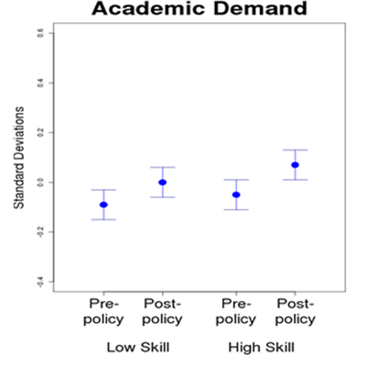
Policy Affects on Academic Demand
Below-norm
Above-norm

Slide 18
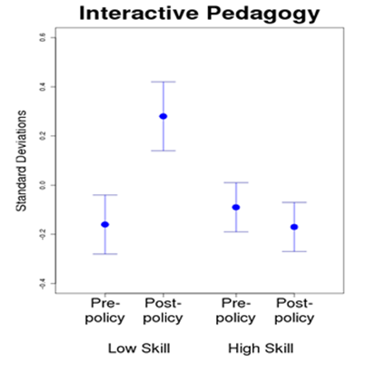
Policy Affects on Pedagogy
Below-norm
Above-norm

Slide 19
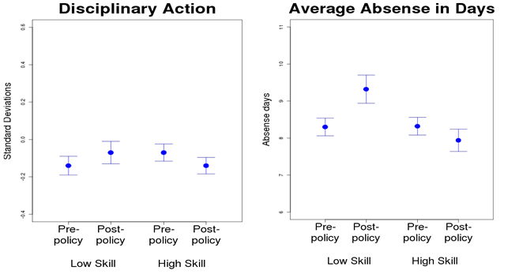
Policy Affects on Peer Behavior
Below-norm
Above-norm
Below-norm
Above-norm

Slide 20
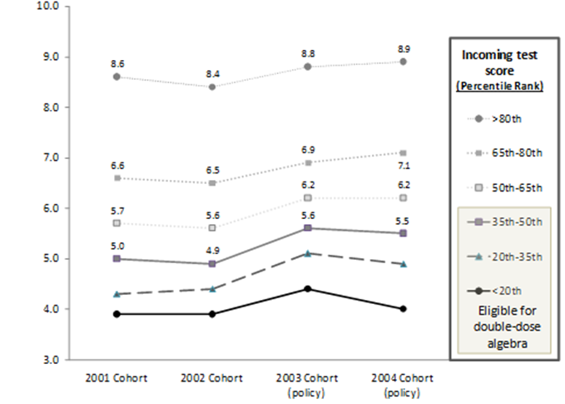
Policy Affects on Algebra Test Scores
Algebra scores
Policy implementation

Slide 21
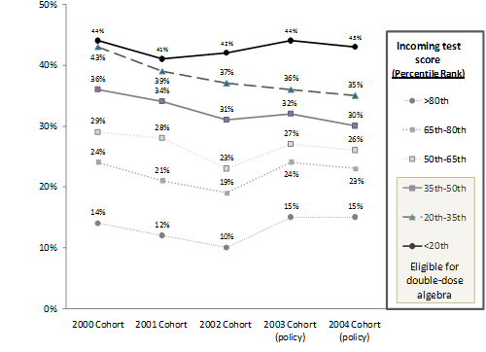
Policy Affects on Algebra Failure Rate
% failed algebra
Policy implementation

