Slide 1
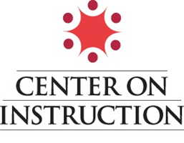
Center on Instruction Webinar September 10, 2012 STEM: CATALYZING CHANGE AMID THE CONFUSION

Slide 2
The Center on Instruction is operated by RMC Research Corporation in partnership with the Florida Center for Reading Research at Florida State University; Instructional Research Group; Lawrence Hall of Science at the University of California-Berkeley; the Texas Institute for Measurement, Evaluation, and Statistics at the University of Houston; and The Meadows Center for Preventing Educational Risk at the University of Texas at Austin. The contents of this PowerPoint were developed under cooperative agreement S283B050034 with the U.S. Department of Education. However, these contents do not necessarily represent the policy of the Department of Education, and you should not assume endorsement by the Federal Government. The Center on Instruction requests that no changes be made to the content or appearance of this product. To download a copy of this PowerPoint presentation, visit www.centeroninstruction.org.
2012

Slide 3
STEM CATALYZING CHANGE AMID THE CONFUSION Lynn Barakos Vanessa Lujan Craig Strang from the Lawrence Hall of Science University of California at Berkeley

Slide 4
A Brief Overview…
A Brief Overview…
Key factors that have led to the current focus on STEM:
increasing economic pressures
competition in the global marketplace
recognition of the importance of STEM for innovation and development

Slide 5
Critical Questions to Consider
What are the goals of the STEM education program?
Which methods and approaches to STEM are the most effective for these particular goals?
How can schools and districts make strategic decisions about designing STEM education programs while considering various approaches?

Slide 6
Two predominant goals for enhancing STEM instruction?
Preparing a 21st century workforce
Increasing STEM literacy of all citizens

Slide 7
Various definitions and approaches to STEM
an interdisciplinary approach to instruction
focus on practical applications & solving problems
STEM as a “meta-discipline”

Slide 8
Interdisciplinary Approach:
“STEM refers to the areas of science, technology, engineering, and mathematics. STEM initiatives started as a way to promote education in these related areas so that students would be prepared to study STEM fields in college and pursue STEM-related careers. Schools with a strong emphasis on STEM education often integrate science, technology, engineering, and mathematics into the entire curriculum.”.”

Slide 9
Practical applications and problem solving:
“STEM teaching and learning focuses on authentic content and problems, using hands-on, technological tools, equipment, and procedures in innovative ways to help solve human wants and needs.”
(Merrill, 2009)

Slide 10
STEM as a meta-discipline:
“a standards-based, meta-discipline residing at the school level where all teachers, especially science, technology, engineering, and mathematics (STEM) teachers, teach an integrated approach to teaching and learning, where discipline-specific content is not divided, but addressed and treated as one dynamic, fluid study.”
(Brown, et al., 2011)

Slide 11
Examples of types of STEM education programs
STEM focused high schools
STEM networks & collaboratives
STEM Project Based Learning initiatives

Slide 12
What content should STEM instruction include?

Slide 13
A Continuum of Approaches to STEM Curriculum
Notes:
.

Slide 14
Guidance for developing effective STEM approaches:
A Framework for K-12 Science Education
(National Research Council, 2011)

Slide 15
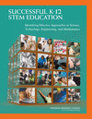
Guidance for developing effective STEM approaches
Successful K–12 STEM Education: Identifying Effective Approaches in Science,
Technology, Engineering, and Mathematics
(National Research Council, 2011)

Slide 16
STEM approaches and alignment with State Standards movement
Common Core State Standards
Next Generation Science Standards
Framework for 21st Century Learning

Slide 17
Acknowledging potential barriers to implementing effective STEM Initiatives
What are some factors influencing the success of STEM programs?

Slide 18
Critical Questions to Consider
What are the goals of the STEM education program?
Which methods and approaches to STEM are the most effective for these particular goals?
How can schools and districts make strategic decisions about designing STEM education programs while considering various approaches?

Slide 19
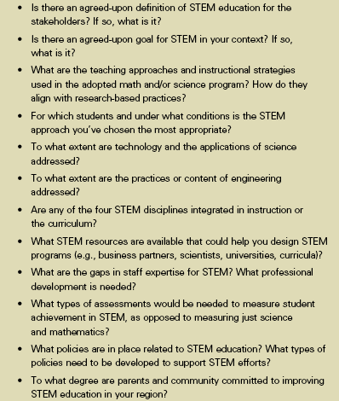
Offer some Additional questions:

Slide 20
Questions /Comments? You can raise your hand and ask a question verbally or type your questions in the Chat Box Thank you for your time today! Please take our survey at https://www.surveymonkey.com/s/X2H29N7 This will only take about 5 minutes of your time, and it is important to us. Click on the link available now in the Chat Box from Ruth Dober.

