Slide 1
Optimizing Teaching and
Learning of Comprehension in the Elementary Setting
Sheryl Turner, Research Associate
Center on Instruction
May 25, 2011
Notes:
Good Afternoon and welcome to the breakout session, “Optimizing Teaching and Learning of Comprehension in the Elementary Setting.”

Slide 2


The Center on Instruction is operated by RMC Research Corporation in partnership with
the Florida Center for Reading Research at Florida State University; Instructional Research Group; the Texas Institute for Measurement, Evaluation, and Statistics at the University of Houston; and The Meadows Center for Preventing Educational Risk at the University of Texas at Austin.
The contents of this PowerPoint were developed under cooperative agreement S283B050034 with the U.S. Department of Education. However, these contents do not necessarily represent the policy of the Department of Education, and you should not assume endorsement by the Federal Government.
The Center on Instruction requests that no changes be made to the content or appearance of this product.
To download a copy of this document, visit www.centeroninstruction.org.
2011

Slide 3
Agenda
Introduce Research-Based Recommendations for Optimizing Teaching and Learning of Comprehension in Elementary Grades
Discussion of the Application within Your Specific Districts and Schools
 Handouts

Slide 4
Critical Elements of an Effective
Reading Program (K-5)
Consistently implemented, high quality initial classroom instruction and follow-up small-group instruction that is well-differentiated according to student needs.
Use of student performance data to guide instruction and allocate instructional resources.
Resources to provide interventions for struggling readers.

Slide 5
Improving Reading Comprehension K-3
What Works Clearinghouse Practice Guides
http://ies.ed.gov/ncee/wwc/publications/practiceguides/

Slide 6
U.S. Department of Education IES Practice Guides
Experts examine research to identify effective practices
Make evidence-based recommendations
Rate strength of evidence
Explain how to implement recommendations
Raise potential roadblocks and solutions
6
Notes:
6

Slide 7
Recommendation 1
Teach students how to use reading comprehension strategies.
  Teach students how to use several research-based reading comprehension strategies.
  Teach reading comprehension strategies individually or in combination.
  Teach reading comprehension strategies by using a gradual release of responsibility.

Slide 8
Gradual Release of Responsibility Model
I do it.
I do it.
You help.
You do it.
I help.
You do it.
This graphic is based on work by Pearson and Gallagher (1983). In a later study, Fielding and Pearson (1994) identified four components of instruction that follow the path of the gradual release of responsibility model:
Teacher Modeling
Guided Practice
Independent Practice
Application
Teacher Responsibility
Student Responsibility
8
Notes:
8

Slide 9
Roadblocks | Solutions
1.1 Multiple-strategy approaches are more complex and harder to implement correctly | More PD, opportunities to see examples and try them with feedback, guides to follow
1.2 Assessments emphasize comprehensions skills, not strategies | Teaching strategies should help students learn the skills
1.3 Students need different levels of strategy instruction | Targeted small group instruction and scaffolding
9
Notes:
9

Slide 10
10
Notes:
10

Slide 11
11
Notes:
11

Slide 12
Recommendation 2
Teach students to identify and use the text’s organizational structure to comprehend, learn, and remember content
  Explain how to identify and connect the parts of narrative texts.
  Provide instruction on common structures of informational texts.

Slide 13
Roadblocks | Solutions
2.1 Lack of teacher time to analyze texts for structure and how learning that structure will help comprehension | Common lesson-planning time to collaborate on developing lists of text examples and how to teach them
2.2 Students don’t transfer using text structure knowledge to comprehend text learned in the reading block to other reading assignments | Remind students before all reading assignments of the value of identifying the text structure. Encourage students to bring you texts whose structure they can’t figure out and use it as additional teaching/learning opportunity
13
Notes:
13

Slide 14
Recommendation 3
Guide students through focused, high-quality discussion on the meaning of text.
  Structure the discussion to complement the text, the instructional purpose, and the readers’ ability and grade level.
  Develop discussion questions that require students to think deeply about text.
  Ask follow-up questions to encourage and facilitate discussion.
  Have students lead structured small-group
  discussions.

Slide 15
Blueprint for Successful Discussions
The right text
Higher order thinking questions
Follow up questions that sustain discussion
Peer-led small group discussions
15
Notes:
15

Slide 16
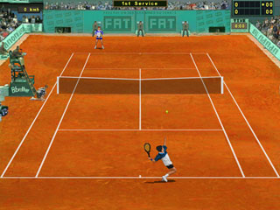
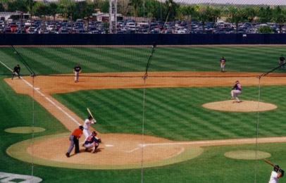
Tennis vs. Baseball
16
Notes:
16

Slide 17
Roadblocks | Solutions
3.1 Teachers may not feel “in control” of student-led discussions | Teacher provides discussion guides, structure, teaches kids how to discuss, and monitors
3.2 Students don’t know how to conduct productive text discussions with others | Teacher models, children observe and practice, use gradual release of responsibility model
3.3 Finding time to prepare for discussions | Teachers collaborate to develop questions and discussion guides
3.4 Finding time for discussions in the school day | Combine it with strategy instruction and prepare ahead of time
17
Notes:
17

Slide 18
Recommendation 4
Select texts purposefully to support comprehension development.
  Teach reading comprehension with multiple genres of text.
  Choose texts of high quality with richness and depth of ideas and information.
  Choose texts with word recognition and comprehension difficulty appropriate for the students’ reading ability and the instructional activity.
  Use texts that support the purpose of
  instruction.

Slide 19
Roadblocks | Solutions
4.1 Perception that core programs preclude using choice for teaching comprehension | Often adjustments or supplements are appropriate. Check with administrator. Also content area materials can be used to teach comprehension.
4.2 Wide range of reading levels within classrooms make text selection difficult | Texts at different levels of complexity can be found that teach comparable content. Text selection can vary depending on skill level, purpose, and interest of the reader.
4.3 Where to start when many texts are available | Building a classroom library of appropriate texts over time, consulting with colleagues, using lists of award-winning books
19
Notes:
19

Slide 20
Recommendation 5
Establish an engaging and motivating context in which to teach reading comprehension.
  Help students discover the purpose and benefits of reading.
  Create opportunities for students to see themselves as successful readers.
  Give students reading choices.
  Give students the opportunity to learn by collaborating with their peers.

Slide 21
Teachers create an engaging, motivating context by . . .
Clearly conveying the purpose of lessons
Explaining how strategies help students learn
Showing students they control reading success
21
Notes:
21

Slide 22
Roadblocks | Solutions
5.1 Students in learning groups can get off task | Clear tasks and expectations, gradual release of control, assign student to remind group about staying on task
5.2 Students who won’t engage in classroom comprehension activities | Add motivational supports, provide feedback, look for underlying reasons, consult colleagues
5.3 Few resources for offering choices; believe that standards preclude choices | Vary how students read, use online teacher-developed resources, supplement standards lesson with choice of other texts/activities
5.4 Students who choose books too hard or easy for them | Provide selections for groups or for individuals by reading level, teach kids how to select right reading levels
22
Notes:
22

Slide 23
Reading Instruction Beyond 3rd Grade
Reading instruction must not stop after 3rd grade
The focus of this instruction is typically different than for the early grades
It is critical that reading instruction continue in order to ensure that students are adequately prepared for the complex reading challenges they will face after they leave elementary school

Slide 24
Reading Instruction Beyond 3rd Grade
Instruction should focus primarily on building the broad knowledge, thinking skills, and reading strategies required for comprehending complex text.
Literacy instruction should extend into, and be part of, instruction in the content areas of science, history, social studies, literature, etc.

Slide 25
Reading Instruction Beyond 3rd Grade
Effective Instructional Strategies:
  Instruction in a variety of strategies for improving and monitoring comprehension
  Extended discussions of a text’s meaning.
  Systematic and explicit instruction in essential vocabulary.
  Creating a learning environment in which students are motivated to understand and learn from the text.

Slide 26
Resources

Slide 27
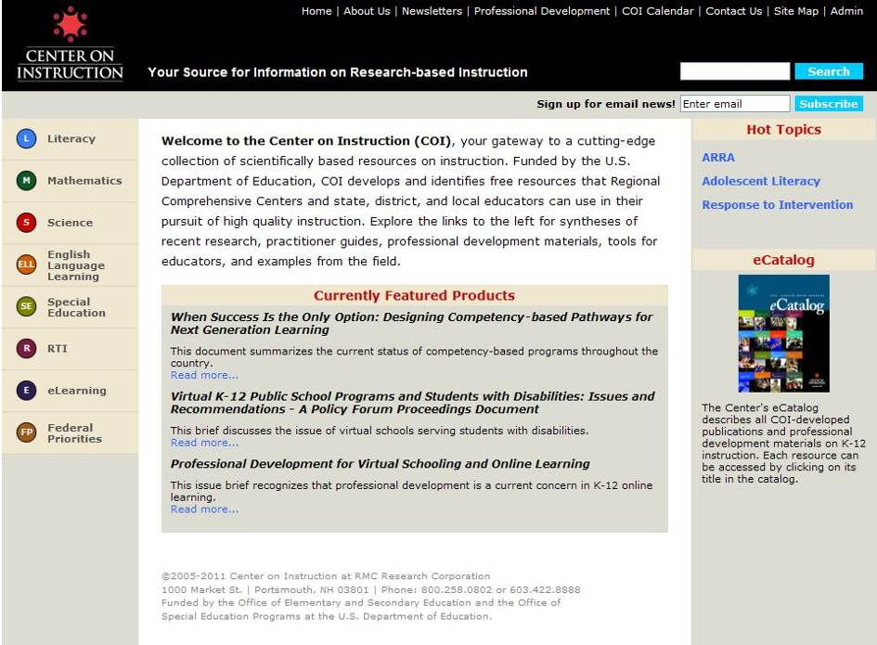
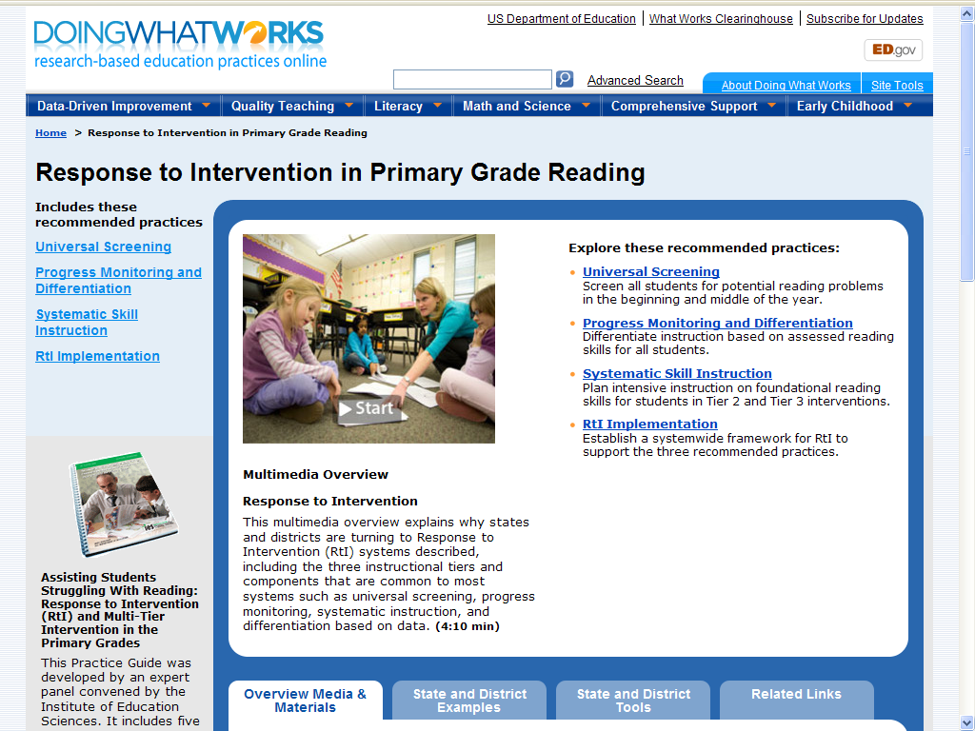
Resources
Notes:
You will also find many more evidence-based resources within these websites:
Center on Instruction Resources include:
Research summaries
Research-based guidance
Tools (e.g., principal reading walkthrough, Secondary principals guide)
PD (Reviewing a Reading Program, DWW/COI Adolescent Literacy Module, webinars from national experts)
DWW Resources include practitioner oriented information and tools for:
Vocabulary instruction
Comprehension strategies
Engaging text discussion
Intensive interventions and RtI
Literacy for English Language Learners
Other topics: (e.g., Data-Driven Improvement & Quality Teaching)

Slide 28
Contact: Center on Instruction
COI-Info@rmcres.com
Website Address:
http://centeroninstruction.org

