Slide 1
Summary of “Tiered Interventions in High Schools: Using Preliminary ‘Lessons Learned’ to Guide Ongoing Discussions”

Slide 2
Disclaimer
The National High School Center and the National Center on Response to Intervention are operated by American Institutes for Research. The Center on Instruction is operated by RMC Research Corporation in partnership with the Florida Center for Reading Research at Florida State University; Instructional Research Group; Lawrence Hall of Science at the University of California, Berkeley; the Texas Institute for Measurement, Evaluation, and Statistics at the University of Houston; and The Meadows Center for Preventing Educational Risk at The University of Texas at Austin.
This presentation and related document were developed under cooperative agreements S283B050028, H326E070004, and S283B050034 with the U.S. Department of Education. However, the content does not necessarily represent positions or policies of the Department of Education, and you should not assume endorsement by the federal government.

Slide 3
About This Presentation
Summarizes what the High School Tiered Interventions Initiative (HSTII) collaborative has learned about tiered intervention implementation in high schools
Advances the ongoing discussion about effective tiered intervention implementation in high schools
Provides information grounded in available research (as of spring of 2010) and professional wisdom of researchers and practitioners
Notes:
In May 2010, the High School Tiered Interventions Initiative (HSTII) published and disseminated Tiered Interventions in High Schools: Using Preliminary ‘Lessons Learned’ to Guide Ongoing Discussions. To further disseminate this work and support educators wishing to understand the essential components of Response to Intervention (RTI) and apply them in high school, HSTII has developed this presentation, based on the published document. This presentation summarizes what the collaborative has learned thus far about tiered intervention implementation in high schools.
The goal of this presentation is to advance the ongoing discussion about effective tiered intervention implementation in high schools. This presentation is not an implementation guide and does not provide concrete steps or tools for implementing RTI; rather, it provides information grounded in available research (as of the spring of 2010) and the professional wisdom of researchers and practitioners.
Note to Presenter: A supplemental handout on the contextual factors of implementation is included as part of this presentation and can be used during a participant activity on Slide 55.

Slide 4
Session Overview
High School Tiered Interventions Initiative
Response to Intervention
Applying the RTI Framework in High Schools
High School Contextual Factors That Affect Tiered Intervention Implementation
Notes:
This presentation is divided into the following four sections:
High School Tiered Interventions Initiative, which describes HSTII, why it was formed, and its approach for this project
Response to Intervention, which provides a brief description of the RTI framework and the essential components of RTI
Applying the RTI Framework in High Schools, which illustrates how eight schools that HSTII visited implemented the essential components of RTI and identifies factors that support implementation and common implementation challenges
High School Contextual Factors That Affect Tiered Intervention Implementation, which examines several contextual factors and how they can affect school-level implementation of tiered interventions

Slide 5
Participant Objectives
Learn how some high schools implement the essential components of RTI
Learn about and discuss how contextual factors unique to high schools affect school-level implementation of tiered interventions
Notes:
<Read and discuss the objectives on the slide.>

Slide 6
About HSTII
Collaboration among three national technical assistance centers:
National Center on Response to Intervention
National High School Center
Center on Instruction (Special Education Strand)
Goal to enhance the understanding of how tiered intervention models are emerging in high schools
Notes:
HSTII is a collaboration among the National Center on Response to Intervention, the National High School Center, and the Center on Instruction to enhance understanding of how tiered intervention models are emerging in high schools across the country. The National High School Center and the Center on Instruction—jointly funded by the Office of Elementary and Secondary Education (OESE) and the Office of Special Education Programs (OSEP)—are two of five national content centers that support the network of regional comprehensive centers (RCCs). The National Center on Response to Intervention is a national technical assistance center funded by OSEP.
The goal of the HSTII is to enhance the understanding of how tiered intervention models are emerging in high schools. Research on RTI, or tiered interventions, in high school is still emerging. In the interim, however, high school practitioners need information to guide planning and implementation and to inform and evaluate practice. A rich source of this knowledge is the experiences of high schools that have implemented RTI. These information resources typically take the form of anecdotal reports, case studies, or professional wisdom, and although they are not a substitute for more rigorous forms of inquiry, they can provide insight into the challenges that high schools implementing RTI face, the strategies they use to respond to the challenges, and their success in overcoming obstacles to effective implementation.

Slide 7
HSTII Approach
Identified high schools implementing tiered interventions, based on recommendations from regional comprehensive centers, regional resource centers, and state education agencies
Contacted 51 high schools
Interviewed 20 high school administrators
Convened technical advisory group
Conducted eight site visits
Notes:
To increase the understanding of how RTI is implemented at the high school level, the HSTII team asked the network of RCCs and regional resource centers, as well as select state education agency personnel, to nominate high schools implementing some form of tiered interventions.
Of the 51 schools identified and contacted, 20 indicated willingness to participate in 45-minute phone interviews. This sample included schools that had been implementing RTI for varying durations (1 to 8-plus years); using tiered interventions in academics, behavior, or both; and implementing the standard treatment protocol, problem-solving, or a hybrid of models to select and design interventions. The sample also included schools with variations in demographics (suburban/urban/rural, percentage of students served in the National School Lunch Program [free and reduced-price lunch], percentage of English language learners [ELLs], etc.), student population size, and structural elements such as schedule. All interviewed schools had the opportunity to review and provide feedback on written summaries of the interviews; HSTII modified the interviews, based on this feedback. Based on the information gleaned from those conversations, HSTII selected eight schools for site visits to learn more about the schools’ frameworks and to gather any RTI-related artifacts.
Next, HSTII convened a technical advisory group (TAG) to deepen the team’s understanding of tiered interventions in high schools. The TAG consisted of practitioners and leading researchers in a variety of content areas. During a face-to-face meeting, the TAG guided the development of protocols for site visits and provided input on HSTII deliverables.
HSTII was not interested in identifying exemplars but, rather, in finding examples of schools that self-identified as delivering tiered interventions.

Slide 8
RESPONSE TO INTERVENTION

Slide 9
Defining RTI
“RTI integrates assessment and intervention within a multilevel prevention system to maximize student achievement and to reduce behavior problems.”
— National Center on Response to Intervention (NCRTI), 2010
Notes:
RTI is a framework that extends a public health prevention model (Caplan, 1964) to the prevention of academic and behavior difficulties (Vaughn, Wanzek, & Fletcher, 2007). Like the public health prevention model, RTI addresses the needs of most students through primary instruction, providing secondary interventions for students who do not meet criteria and reserving tertiary interventions for students with the most significant instructional needs.
The National Center on Response to Intervention’s definition of RTI is the following.
<Read and discuss the definition on the slide.>

Slide 10
Conceptualizing the Framework
Tertiary Prevention (e.g., Tier III):
Individualized intervention(s) of increased intensity for students who show minimal response to secondary prevention
≈ 5%
Secondary Prevention (e.g., Tier II):
Evidence-based intervention(s) of moderate intensity that address the learning or behavior challenges of most at-risk students
≈ 15%
Primary Prevention (e.g., Tier I):
High-quality core instruction that meets the needs of most students
≈ 80% of Students
NCRTI, 2010
© 2011 NHSC, NCRTI, and COI
10
Notes:
10
Various models of RTI exist; however, they all are based on the same conceptual framework. RTI is not a specific curriculum or program; rather, it is a framework for promoting access to high-quality core instruction and providing increasingly intensive educational interventions in a timely manner for students who struggle in core instruction. RTI provides systematic measures of student progress that yield data educators can use to make important decisions (Batsche et al., 2006). RTI provides states, districts, and schools with a framework for allocating instructional services and resources in response to students’ needs.
Implicit in this prevention framework is the idea that the least intense (or primary) level of services addresses the needs of most learners through high-quality instruction that is culturally and linguistically responsive to the student population. For students who demonstrate the need for additional support, more intensive, targeted services are available. Educators frequently and consistently monitor the effectiveness of those supports to determine whether (a) the intervention works and is no longer needed, (b) the intervention works and should be continued, or (c) the intervention does not work and therefore a different (and perhaps more intensive) intervention should be implemented. Educators use data to guide these decisions. Interventions are commensurate to a student’s demonstrated need and are changed or intensified if they are found to be ineffective.

Slide 11
RTI and High Schools: Assumptions
Most of the research on RTI focuses on elementary schools; a few studies target middle schools.
The essential components of RTI may be the same for elementary schools and high schools.
Translation of the framework and essential components into effective practice in high schools may differ from elementary schools due to structural and organizational differences.
Notes:
The majority of the existing research on RTI examines its use in improving reading outcomes for struggling students in elementary schools; this research does not account for the structural and organizational aspects particular to high schools.
HSTII’s work is grounded in the assumption that implementation of tiered interventions in high schools includes the same set of essential components as the RTI framework commonly implemented in elementary schools but that actual strategies for implementation may look very different due to a high school’s unique culture, structure, and organization (Duffy, 2007).

Slide 12
Principles Key to RTI Implementation
1. Research-driven instructional (academic and/or behavioral) practices within core, or Tier I, instruction meet the majority of students’ educational needs.
2. Educators screen students to identify those in need of more intensive instruction, provided in the form of interventions.
3. Progress monitoring yields data to assess students’ learning and academic performance and to determine whether a specific intervention is effective for a particular student.
4. Interventions increase in intensity in proportion to students’ instructional needs, and educators monitor interventions to ensure that they are delivered with high levels of fidelity.
5. Schools can use data from screening and progress-monitoring measures to assess students’ responses and interventions’ effectiveness. Schools can also use these data in the special education eligibility process.
Notes:
The HSTII team considers the following principles to be key to RTI implementation in any academic or behavioral domain and at any grade level.
<Read and discuss the principles on the slide.>

Slide 13
Key Components of RTI
High-quality Tier I/core instruction
Universal screening
Ongoing progress monitoring
Tiered interventions
Data-based decision making
Notes:
For the purposes of this presentation, the key components of RTI will be defined as the following.
<Read and discuss the components on the slide.>
We now will present some examples of how high schools implement these components.
For more information on the essential components of RTI, see the National Center on Response to Intervention’s Essential Components of RTI—A Closer Look at Response to Intervention (www.rti4success.org/images/stories/pdfs/rtiessentialcomponents_042710.pdf).

Slide 14
Applying the RTI framework in high schools
Notes:
This section briefly describes how the observed high schools implemented a system of tiered interventions, including the key components of the RTI framework. For a full description of each school’s implementation, see Appendix B: School Profiles of Tiered Interventions in High Schools: Using Preliminary ‘Lessons Learned’ to Guide Ongoing Discussion. Additional resources for implementation are listed in Appendix C: Supplemental Resources.

Slide 15
Scope and Focus of Tiered Interventions: Observations Across Eight Sites
Overarching purpose: Improve student achievement
Framework: Three or four tiers of intervention
Primary focus: 9th- and 10th-graders, English and/or mathematics
Various goals:
Reducing Ds and Fs
Strengthening existing initiative to reduce tardies
Reducing behavior referrals
Increasing graduation rate
Notes:
The primary purpose of implementing tiered interventions at the high schools HSTII visited was to improve student achievement; identifying students with specific learning disabilities was not a focus at any of the schools, as is sometimes the case in elementary schools. Frequently, a school implementation team or district or state instructional leaders determine the scope and focus of a high school’s tiered intervention initiative. All high schools observed indicated that they implemented a three- or four-tiered framework in response to too many students failing multiple classes and state-mandated tests and/or dropping out. Several schools reported a specific RTI focus, such as increasing attendance or literacy, or improving grades or test scores. Only one school identified decreasing referrals to special education as an explicit purpose of its initiative.
Within these common purposes, HSTII observed multiple variations in targeted grade levels, content areas, behavior modifications, and skill development. Most schools focused their tiered intervention frameworks on 9th and/or 10th grades in English and/or mathematics. Several schools also provided explicit interventions for ELLs.
Several of the observed schools implemented a Positive Behavior Interventions and Supports (PBIS) framework, in addition to academic supports and interventions. These schools created a positive learning environment by posting behavioral expectations throughout the school and explicitly teaching these strategies to students. For Tier I instruction, one school highlighted a few key schoolwide rules at monthly assemblies. Often, students with high numbers of office referrals were provided with individualized interventions. Students whose behavior improved (as measured by number of referrals and grades) were rewarded with enrollment in a study hall period that allowed for peer interaction and the use of technology.
It is important to keep in mind unique school contextual factors and their influence on the development of a tiered intervention framework. In other words, the implementation methods that one school selects may not be suitable for another school, even if the demographic makeup of the schools is similar. For example, schools that readily embrace innovation may take a different approach to implementation from schools that are more resistant to change.

Slide 16
Primary Prevention
Examples from site visits:
Explicit, research-based instruction
Culturally responsive instruction
Standards-aligned instruction
Scaffolding
Differentiated instruction
Academic literacy
Formative assessment
Clear behavior expectations schoolwide
All students receive explicit, research-based instruction.
≈ 5%
≈ 15%
Primary Prevention (e.g., Tier I):
High-quality core instruction that meets the needs of most students
(NCRTI, 2010)
≈ 80% of Students
© 2011 NHSC, NCRTI, and COI
16
Notes:
Primary prevention (designated as Tier I in many schools) is high-quality, evidence-based primary, or core, classroom instruction provided to all students.
In the elementary school context, an abundance of research exists to guide the development of a strong core curriculum in most content areas, especially in reading. At the high school level, however, the development of a strong Tier I is challenging, given the paucity of research in content areas other than adolescent reading.
What does evidence-based instruction look like in algebra, biology, or economics? In the absence of systematic research in these areas, practitioners are drawing guidance from research on school improvement, alignment, and features of effective instruction and applying this knowledge across all content areas.
In its visits, HSTII found that several schools emphasized the alignment of instruction with state standards. This is a useful strategy, considering that research indicates a positive relationship between this alignment and student achievement (Kurz, Elliot, Wehby, & Smithson, 2009).
In addition, content area teachers were taught how to weave research-based instructional strategies, such as scaffolding, differentiated instruction, and ongoing formative assessment, into their instruction.
Finally, several schools embedded literacy strategies (e.g., the use of graphic organizers and summarization strategy instruction) in all content area classrooms.

Slide 17
Universal Screening
Brief assessments for predicting which students will develop learning or behavioral problems and need intensive interventions
Examples From Site Visits
Area of focus | Measure | Frequency
Reading | Maze curriculum-based measure (CBM) | Conducted at the end of eighth grade for students attending feeder middle schools; guidance department administered for new students within 6 weeks
Grades | Failure of one or more content area classes | Guidance department conducted review three times a year
Exit exams | Failure to pass a state exit exam on its first administration | Guidance department conducted review at the end of each school year
Behavior | Number of office discipline referrals | Guidance department conducted review in December and May
17
Notes:
Universal screening is brief assessments that are valid, reliable, and demonstrate diagnostic accuracy for predicting which students will develop learning or behavioral problems and, therefore, need intensive intervention to supplement primary prevention (NCRTI, 2010).
Although substantial research indicates that screening and progress monitoring are effective in elementary schools (e.g., Fuchs & Fuchs, 1986; Fuchs & Fuchs, 2002; Shapiro & Ager, 1992; Thurber, Shinn, & Smolkowski, 2002; VanDerHeyden & Burns, 2005), studies examining these practices for high schools are only now emerging. Despite the lack of empirical evidence, professional guidance and wisdom continue to emphasize the importance of ongoing data collection to overall school improvement (e.g., National Association of State Boards of Education, 2006; National High School Center, 2008; Reschly & Wood-Garnett, 2009).
Several visited schools used measures (such as state tests or other standardized achievement measures in reading and/or mathematics) given at the end of eighth grade to place students into an appropriate level of intervention at the beginning of ninth grade. These schools used additional testing (standardized achievement measures or curriculum-based measures [CBMs]) at the beginning of ninth grade to verify student placement.
Another method schools used was to examine “multiple failures”—that is, to identify students who failed one or more English and/or algebra class. Although this approach differs substantially from traditional screening methods in elementary schools, high school completion data indicate that passing grade 9 algebra and English classes places students on a positive trajectory and that not passing these classes significantly correlates with dropping out (Christenson et al., 2008; Jimerson, Reschly, & Hess, 2008). In lieu of more sophisticated screening measures developed specifically for high school use, this method has the potential to be effective.
17

Slide 18
Ongoing Progress Monitoring
Yields data to assess students’ learning and academic performance and to determine whether a specific intervention is effective for a particular student
Examples From Site Visits
Level of instruction | Measure | Frequency
Primary | Ongoing formative assessment Common mathematics assessment Common writing prompts Grades Attendance | Daily Monthly Monthly Semester/quarter First 20 days of school, quarterly
Secondary | Teacher-developed algebra CBM Maze passage D/F reports Time-sampling for behavior | Every other week Every other week Weekly Weekly
Tertiary | Measures embedded in intervention program Behavior tracking sheets | Daily Daily
18
Notes:
Progress monitoring yields data to assess students’ learning and academic performance and to determine whether a specific intervention is effective for a particular student.
Progress monitoring varied among the observed schools. Schools used a wide range of measures, including diagnostic measures (such as the Scholastic Reading Inventory), CBMs (such as maze passages), overall class grades, class quizzes and tests, and high school graduation tests (including practice or benchmark tests given throughout the year).
Selection of the most appropriate measure or combination of measures for each school was dependent on (a) the school’s RTI scope and focus and (b) available resources—staff members, budgeted funds, and other resources such as technology. The frequency of progress monitoring varied due to similar contextual factors (such as staff availability) but, overall, occurred at least twice a month in secondary and tertiary interventions, using CBMs and standardized progress-monitoring measures. Schools typically administered diagnostic tools less frequently (e.g., once a semester) in intensive interventions to examine general cognitive processes and inform instruction.
18

Slide 19
Secondary and Tertiary Prevention
Tertiary Prevention (e.g., Tier III):
Individualized intervention(s) of increased intensity for students who show minimal response to secondary prevention
(NCRTI, 2010)
≈ 5%
Secondary Prevention (e.g., Tier II):
Evidence-based intervention(s) of moderate intensity that address the learning or behavior challenges of most at-risk students (NCRTI, 2010)
≈ 15%
Provided in addition to primary prevention (core)
Very small-group (1:3) or 1:1 instruction
Ongoing progress monitoring and appropriate diagnostic assessment as needed (more frequent)
More intense instruction (increased time, reduced group size, more explicit and systematic instruction, increased feedback)
Provided in addition to primary prevention (core)
Teacher-led, small-group instruction
Ongoing progress monitoring and appropriate diagnostic assessment as needed
≈ 80% of Students
© 2011 NHSC, NCRTI, and COI
19
Notes:
Secondary prevention (sometimes implemented in Tier II of an RTI framework) consists of evidence-based intervention(s) of moderate intensity that address the learning or behavior challenges of most at-risk students (NRCTI, 2010). Tertiary prevention (sometimes implemented in Tier III of an RTI framework) consists of individualized intervention(s) of increased intensity for students who show minimal response to secondary prevention (NCRTI, 2010).
All observed high schools used tiered interventions to address skill deficiencies preventing students from independently mastering the core content knowledge. Most schools implemented tiered interventions in reading, English/language arts, and mathematics, and some schools provided interventions to ELLs (e.g., using explicit vocabulary-building strategies linked to authentic text reading and writing). One school was at the beginning stages of implementing an intervention for science classes.

Slide 20
Secondary Prevention: Examples From Site Visits
 | English/language arts | Algebra | Behavior
Time in intervention | 55-minute periods, 5 days a week, 1 semester | 55-minute periods, 5 days a week, 1 semester | 40-minute period, 1 day a week during advisory, 1 semester
Instructional content | Vocabulary, comprehension strategy instruction, fundamentals of writing (organization), study skills | Preteaching and reteaching concepts from core curriculum | Example: Check and Connect
Instructional delivery | Large groups divided into small groups/pairs, explicit and systematic instruction, frequent feedback, scaffolding, differentiated instruction | Large groups divided into small groups/pairs, explicit and systematic instruction, frequent feedback, progress monitoring to ensure mastery | Positive learning environment, posted behavioral expectations, explicit teaching of strategies
Assessment | Ongoing formative assessment, journal checks (writing samples), CBM (maze passages) | Teacher-developed CBM organized around state standards | Office discipline referral and grade monitoring for particular students
Notes:
Roughly half of the schools provided Tier II and Tier III interventions during separate class periods, commonly scheduled in lieu of electives. When scheduled in this manner, students received the intervention for an entire semester to receive proper course credit. However, some intervention teachers reported that if a student had mastered all intervention content before the semester was over, the teacher would gather other instructional materials and teach directly to the student’s skill level until the student could exit the intervention in the next semester. To distinguish interventions from traditional tracking, several of the visited schools ensured that when students mastered the content, they exited interventions during semester breaks.
Other schools provided tiered interventions through mechanisms already built in to the master schedule, such as co-lab classes, seminars, or other academic supports available to students.
The chart on this slide shows the ways that several schools implemented secondary, or Tier II, interventions in various content areas. For more details on each school’s implementation, see Appendix B: School Profiles of Tiered Interventions in High Schools: Using Preliminary ‘Lessons Learned’ to Guide Ongoing Discussion.

Slide 21
Tertiary Prevention: Examples From Site Visits
 | Reading | Behavior
Student need | More than two grade levels behind, struggling with decoding and reading connected text | Consistent poor behavior that interferes significantly with learning
Instructional content | Phonics, fluency, comprehension via a published intervention program | Social skills intervention
Instructional delivery | Small, teacher-led groups within large class; special education teachers and teacher aids; explicit; systematic; fast-paced | Behavior specialist delivered in a full class period
Assessment | Program-based assessment, diagnostic testing twice per semester | Functional behavior assessment
Notes:
Tier II interventions differed from Tier III interventions in (a) the number of students receiving instruction at one time and (b) the instructional focus. Schools frequently provided Tier II through large-group instruction or smaller groups within a larger intervention classroom; a specialized teacher usually provided Tier III interventions to small groups or individual students.
Tier III interventions observed at various schools addressed more basic skills than the Tier II interventions. For instance, a Tier III reading intervention focused predominantly on phonics and decoding, and a Tier II intervention in English/language arts concentrated on vocabulary, comprehension, and study skills. Observed Tier III interventions frequently used published intervention programs.
The chart on this slide provides some examples of how schools implemented tertiary, or Tier III, interventions in reading and behavior. For more details on each school’s implementation see Appendix B: School Profiles in Tiered Interventions in High Schools: Using Preliminary ‘Lessons Learned’ to Guide Ongoing Discussion.

Slide 22
Data-Based Decision Making
Using data from screening and progress-monitoring measures to assess students’ responses to instruction and/or intervention and making instructional adjustments to maximize student response
Examples From Site Visits
Delivered differentiated instruction
Used data from screening and progress monitoring to determine placement in interventions
Made decisions during data meetings with various stakeholders
Solicited student input on problem solving and intervention design
Notes:
Data-based decision making involves using screening and progress-monitoring measures to asses students’ responses to instruction/intervention and making instructional adjustments (e.g., moving to various interventions, reducing group size, increasing time in intervention, making instruction more explicit and systematic) to maximize student response.
The observed schools initially used data from screening and progress monitoring to determine student placement in the tiered instructional system (e.g., Tier I only, Tier I plus Tier II). Later, the schools used these data to determine whether to move students to a more intense level of intervention or withdraw them from the intervention altogether. This decision making typically took place in data meetings with a range of stakeholders, including teachers, instructional coaches, and administrators.
Several schools asked students to participate in problem-solving meetings and solicited students’ input on intervention design. This direct student participation can increase motivation, leading to better intervention design and greater commitment to implementation (Reschly & Wood-Garnett, 2009). Such student participation illustrates one key difference between RTI implementation in elementary schools and that in high schools.
Some schools examined progress-monitoring data to differentiate instruction within the intervention class itself. For example, one algebra intervention class included approximately 30 students who all demonstrated a need for intervention. These students were further divided into smaller groups, based on how quickly they mastered the curriculum. One group of students moved to a new chapter, while another group reviewed a previously taught skill, and yet another group received a teacher-generated CBM to check for mastery of skills. These groups were fluid, constantly changing on the basis of progress-monitoring data.

Slide 23
Factors That Support Implementation of the Essential Components
Leadership
Professional Development and Coaching
Intervention Providers
Evaluation
Notes:
During interviews and site visits, several common factors emerged that support implementation of the key components of RTI or other systems of tiered interventions. These factors included leadership, intervention providers, professional development (PD) and coaching, and evaluation.
For more information on the science of implementation, visit the National Implementation Research Network website (www.fpg.unc.edu/~nirn).

Slide 24
Leadership
Created staff consensus
Delivered professional development (PD)
Implemented evaluation procedures
Allocated resources
Made data-based decisions
Created sustainable processes
Notes:
Leadership teams at the observed high schools included a variety of stakeholders, including administrative personnel (e.g., principals, assistant principals, disciplinary deans), content leads (e.g., department chairs, coaches, specialists), school psychologists, social workers, and special and general education teachers. The purpose of a high school’s RTI model often drives the membership of leadership teams, which typically include members of stakeholder groups that support that purpose. For example, a school that identifies dropout prevention as a key outcome of its RTI implementation should include on its leadership team individuals directly involved with students at risk for dropout.
Leadership teams at the observed schools took on duties such as creating staff consensus, delivering PD, implementing evaluation procedures, allocating resources, making data-based decisions, and creating sustainable processes. Leadership teams also promoted the potential of RTI as an “umbrella” for coordinating, managing, and evaluating other school-level initiatives.

Slide 25
Intervention Providers
Varied considerably due to focus of each school’s framework and contextual factors
Mostly 9th- and 10th-grade teachers were involved
Interventionists provided support outside of general education classroom and core instruction
Interventionists collected progress-monitoring data
Notes:
Regardless of which teachers implement RTI, schools may need to devote time and resources to obtaining staff consensus for the overall framework and to teaching effective teacher collaboration strategies. Teacher preparation is crucial to the success of any framework’s implementation (Reschly & Wood-Garnett, 2009).
The staff members who implemented the tiered interventions varied considerably among the observed schools. This variation was due to the focus of each school’s framework and contextual factors, including available resources and the master schedule. Because most schools targeted their system of tiered interventions toward 9th and/or 10th grade, the 9th- and 10th-grade content teachers primarily implemented tiered interventions. Interventions typically did not occur within the general education classrooms; rather, interventionists or specialists provided interventions outside of regular core instruction duties. In two schools, however, general education teachers provided the interventions during a seminar period. Typically, the provider of the intervention also was responsible for collecting progress-monitoring data.

Slide 26
PD and Coaching
Wide range of PD:
RTI framework
Research-based instructional strategies
Evidence-based intervention strategies
Offered to entire staff or to teachers delivering tiered instruction (e.g., ninth-grade teachers)
Specialists coached and modeled strategies
Universities, state education agencies, or regions/districts assisted
Notes:
Research supports the need for authentic, embedded, and sustained PD, including teacher coaching and modeling, to increase students’ overall progress (Vaughn et al., 2007). Therefore, district and school administrators should consider the type of support teachers need after their introduction to RTI.
A wide range of PD occurred at the observed high schools. Most schools conducted PD on the RTI framework, research-based instructional strategies, and specific intervention strategies for each tier of support. Schools offered this PD to the entire staff or to the teachers involved in the tiered instructional delivery. Coaching and modeling of instructional strategies was common. Typically, a content or behavior specialist provided this coaching to teachers. Universities assisted some of the schools, including providing PD. Other schools received PD from their state education agency or regional PD organization.

Slide 27
Evaluation
All schools were still in the beginning stages
Schools intended to evaluate effectiveness of intervention implementation, programs, and procedures
Notes:
Data are useful not only for making student-level decisions, but also for program-level information. By linking data to the purpose of the RTI framework and aggregating data across students over time, school officials can make decisions about what works, for whom, and under what circumstances. For instance, for a school focusing on dropout prevention, collecting and charting data (e.g., line graphs with each data point representing a group average) on graduation and attendance for participating students would provide a useful heuristic for identifying trends and making informed decisions.
At the visited sites, staff members collected data to evaluate the effectiveness of intervention implementation and the programs and procedures that accompanied it.

Slide 28
Common Implementation Challenges
Staff Capacity
Scheduling
Resources
Fidelity
Notes:
The observed high schools also noted several common challenges, including staff capacity, scheduling, resources, and measuring fidelity of implementation.

Slide 29
Staff Capacity
Challenging to do the following:
Build teacher knowledge
Support implementation attempts
Provide teachers time to problem solve, consult with colleagues, provide/receive coaching
Professional wisdom:
Gain insight, improve/evaluate practice, identify areas of need
Provide follow-up training
Notes:
Building staff capacity is a multifaceted task that involves helping teachers to recognize the need for change and to embrace RTI as an effective framework for all students. Building capacity also includes developing teachers’ knowledge of RTI and research-based instructional strategies that enhance the effectiveness of Tier I and supporting their implementation attempts. School-level systems and supports are critical in this respect. Providing teachers with time to problem solve, consult with colleagues, and deliver or receive structured training and coaching is important. PD on the overall framework, as well as the individual components and evidence-based practices, must be ongoing.
Almost all visited schools reported struggling with building adequate staff capacity. At least one participant pointed out that RTI, at its most basic level, involves ongoing learning: using information to gain insight, improve and evaluate practice, and identify areas in need of additional planning and work. Administrators and teachers at several schools commented that follow-up training on the overall RTI framework was beneficial in terms of building and maintaining adequate staff capacity.

Slide 30
Scheduling
Challenging to do the following:
Find time to analyze and discuss student data and plan instruction and intervention
Create flexible schedules and be creative in adapting master schedule
Professional wisdom:
Identify problem areas in master schedules
Develop and implement modified schedule
Monitor impact
Refine, revise, or redevelop new schedule as necessary
Notes:
Schoolwide (or departmentwide) scheduling of instruction and intervention are common challenges in elementary schools, so it is not surprising that secondary schools also struggle, given the far greater complexity that characterizes a typical day in high schools. These complexities may not be of magnitude only—they may also differ qualitatively. In other words, “solutions” at the secondary level may involve more than merely scaling up what worked for elementary schools facing similar difficulties.
Visited schools noted a lack of time for analyzing and discussing student data and for planning instruction and intervention. Schools also recognized the complexity of creating flexible schedules to allow for student movement across tiers. The key, according to several of the visited sites, was to acknowledge these challenges and to be creative in adapting the master schedule to meet student and staff needs. Observed schools also addressed scheduling challenges by identifying the problem areas in their master schedules; developing and implementing modified schedules; monitoring their impact; and refining, revising, or redeveloping a new schedule as necessary.

Slide 31
Resources
Challenging to do the following:
Work with limited funds
Make fiscal decisions
Professional wisdom: Find creative ways to leverage resources for maximum educational impact
Invest more in PD than in supplies
Integrate existing resources committed to other initiatives and programs
Notes:
Although resources may first appear limited, schools can often find creative ways to leverage resources for maximum educational impact. For some schools, this leveraging may include making decisions about how to allocate funds—investing more money in ongoing staff development, for instance, than in supplies. Schools can often integrate existing resources already committed to other initiatives (e.g., Advancement Via Individual Determination [AVID] and programs geared toward reaching overage students) into their RTI model, reducing the need to add work to what is already in place. This integration may be particularly important, given the large number of initiatives on many campuses. Overall, implementing RTI provides a unique opportunity for schools to effectively allocate and integrate resources and develop a systematic method for providing the most effective instruction for all students.
Despite the use of existing resources, all of the observed schools reported challenges with accessing appropriate and adequate resources (assessment, intervention, and fiscal).

Slide 32
Fidelity of Implementation
Challenging to do the following:
Find appropriate assessment and instructional tools and materials
Develop domain-specific knowledge of assessor
Coordinate all components of RTI
Professional wisdom: Can use observational and formative assessment data in lieu of rigorous fidelity assessment methods
For many visited schools, rigorous fidelity measuring was a goal for coming years
Notes:
Not only is there a lack of tools available for use in high schools to assess fidelity (accuracy and consistency of the implementation of all aspects of RTI as intended), but also the domain-specific knowledge required of the assessor is significant. The coordination of the numerous components of RTI implementation is especially complex for high schools and thus lends itself to lower fidelity of implementation, making careful observation of instruction and communication among staff members nonnegotiable.
All observed high schools identified the measurement of fidelity of implementation as a challenge. One principal acknowledged his reliance on observational and formative assessment data to measure fidelity in lieu of more rigorous fidelity assessment methods. Principals at schools in the early stages of implementation noted that the demands of beginning implementation often were so great that monitoring and evaluating fidelity was a goal for the coming years.

Slide 33
High School Contextual Factors That Affect Tiered Intervention Implementation

Slide 34
Prerequisite Guiding Questions
What do student achievement and behavior “look like” in the school?
How does the school use data to identify needed supports?
What is the staff capacity for subject area and special education needs?
In what ways are students involved in their own academic progress?
How do parents and other stakeholders support instructional and extracurricular activities?
What aspects of the school organization would support the implementation of tiered interventions? What aspects could potentially undermine implementation?
What aspects of school culture would support or undermine implementation?
Notes:
Before examining contextual factors, staff members must consider their current capacity and how trends in student achievement and behavior can inform the design of their tiered framework. Schools must take stock of what is in place and identify gaps before developing a plan. To do so, schools can ask the following questions.
Note to Presenter: School staff members should be encouraged to select and prioritize these questions, with the eventual goal of addressing each one. While reading and discussing the questions on the slide, it may be helpful to use the following subquestions/probes.
What do student achievement and behavior “look like” in the school? Grades? State assessments? Accumulated credits? Graduation rates? Attendance? Disciplinary referrals? Where do students experience the greatest challenges?
How does the school use data to identify needed supports? What types of data? (Formative? Summative?) How are they used? (To inform instruction? To make decisions about interventions? To develop school policy? To identify PD needs?)
What is the staff capacity for subject area and special education needs? Who is certified in multiple areas? Are they willing to provide instruction in multiple areas?
In what ways are students involved in their own academic progress? Choosing courses? Identifying areas of strength/weakness? Planning for college/career?
How do parents and other stakeholders support instructional and extracurricular activities? What resources do they provide? (Volunteered time? Grants and other financial support?)
What aspects of the school organization would support the implementation of tiered interventions? What aspects could potentially undermine implementation? Leadership? Student support teams? Learning and behavioral practices? Master schedule?
What aspects of school culture would support or undermine implementation? Teachers/parents’ expectations for students? Community’s expectations for schooling?

Slide 35
Contextual Factors Unique to Tiered Interventions in High Schools
Focus
School culture
Implementation and alignment
Instructional organization
Staff roles
Student involvement
Graduation requirements
Stakeholder engagement
Instruction and assessment resources
Notes:
Through HSTII’s conversations with practitioners during phone interviews and site visits, several contextual factors specific to high schools emerged: focus, school culture, instructional organization, staff roles, student involvement, graduation requirements, stakeholder engagement, implementation and alignment, and instruction and assessment resources. These issues all affect one another; for example, staff roles and structure affect the focus of a school’s implementation of tiered interventions.
This section of the presentation describes the unique challenges that each issue presents for high schools and offers several questions that high schools might consider regarding each issue. These considerations represent a sample of questions that schools, districts, and states may choose to ask themselves prior to or during RTI implementation. This section of the presentation also provides some examples of how the observed schools addressed these contextual factors.

Slide 36
Focus: Guiding Questions
What is the purpose and scope of tiered interventions in the school?
How do existing initiatives fit into the tiered interventions framework?
How do current special education and instructional support practices align with tiered interventions?
Do other initiatives hinder the implementation of tiered interventions?
If the school is structured using academies, how do the academies affect the focus of the tiered interventions framework?
Notes:
The design and implementation of all the key components of RTI are dependent on a school’s focus for tiered interventions. Tiered interventions in high schools may not always include all students or all content areas, as is often the case in elementary RTI frameworks. Each school needs to determine its purpose and scope of tiered interventions, keeping in mind that no standard application of the framework exists for high schools. Schools may already have in place some initiatives that support tiered intervention implementation.
To clarify their focus, high schools can ask the following questions.
<Read and discuss the questions on the slide.>

Slide 37
Focus: Examples From Site Visits
Primary goal of improving student achievement
Targeted strategies based on data, including the following:
Reducing Ds and Fs
Reducing tardies
Notes:
All observed schools identified improving student achievement as the primary goal of RTI implementation.
Schools also used data to identify instructional strategies. One school’s data indicated that too many students received Ds and Fs, so the school decided to focus its RTI framework on reducing this number. Another school’s data indicated a growing number of tardies, resulting in lost learning time and drained resources in processing these students. So, that school focused on reducing tardies. Whatever focus a school chooses, it should be based on data.

Slide 38
School Culture: Guiding Questions
In what ways do current practices, beliefs, and behaviors align with the goals and purposes for the tiered intervention framework?
Where did the motivation for adopting the framework originate, and how might that affect staff buy-in?
How do current prevention efforts map onto a tiered framework?
What changes might be required for staff members to collaborate, examine student data, and act on what they learn from those data?
What changes might be required to ensure that the needs of all students are addressed?
Notes:
School culture plays an integral role in the adoption and implementation of any new initiative. A school’s culture provides implicit (and sometimes explicit) guidance about beliefs, behaviors, and what is acceptable. Adopting a tiered framework may require a significant shift in a high school’s culture. For example, staff members may need to collaborate in new ways, examine data together regularly and think about implications for instructional practice, and agree that the success of all students is the responsibility of all staff members.
To develop a school culture that that aligns with tiered interventions, schools can ask the following questions.
<Read and discuss the questions on the slide.>

Slide 39
School Culture: Examples From Site Visits
Synergy between current beliefs and RTI
Small learning communities to facilitate connections among students and between students and teachers
Notes:
Through the site visits, HSTII observed how the high schools viewed their own culture. For example, teachers from one school explained that the RTI framework appealed to them because of a synergy between their beliefs and RTI. Teachers said that RTI provided a holistic approach to improve their current practices. In another example, a large school emphasized small learning communities to facilitate and strengthen connections among students and between students and staff members. Staff members reported that these connections moved the tiered framework forward.

Slide 40
Implementation and Alignment: Guiding Questions
What current or planned instructional and student support initiatives does the school integrate to support the focus of tiered interventions?
How do those efforts align with the tiered interventions, especially in Tiers II and III?
What options exist for scaling up tiered interventions over time to broaden the number of students, content areas, and/or interventions?
How does the school leverage existing human and fiscal resources to facilitate the implementation and scaling up of tiered interventions?
How are district departments (Curriculum and Instruction, Title I, etc.) involved in school-level implementation of tiered interventions?
Notes:
Because of the numerous initiatives and activities that high schools implement simultaneously, it is critical to align efforts that can support and accelerate the implementation of tiered interventions. A detailed scaling-up plan may be useful for incrementally expanding the focus and scope of the framework.
To align and implement other initiatives and activities with tiered interventions, schools can ask the following questions.
<Read and discuss the questions on the slide.>

Slide 41
Implementation and Alignment: Examples From Site Visits
Coordinated initiatives:
Positive Behavior Interventions and Supports (PBIS)
Advancement Via Individual Determination (AVID)
Check and Connect
Other schoolwide programs
Notes:
Coordinated initiatives can improve universal instruction, or the instruction that all students receive.
Some of the observed schools that initially focused their tiered interventions on an academic aspect began implementing and integrating PBIS to address behavior issues. In another example, after successfully creating schoolwide expectations for behavior, a school that initially focused RTI on behavioral issues improved and expanded its framework to address academic concerns. Another school leveraged its existing AVID and Check and Connect programs to strengthen its tiered intervention framework. In fact, all of the visited schools leveraged schoolwide programs to bolster RTI.

Slide 42
Implementation and Alignment: Examples From Site Visits (cont.)
Leveraged resources:
Staff roles (literacy coach, school psychologist, security staff, counselor, etc.)
Prioritization (existing PD, time, staff meetings, classroom space, etc.)
Notes:
All of the schools that HSTII visited said that leveraging resources such as staff roles was important. The schools chose people to lead the direction of the overall framework based on their primary focus for RTI. For example, schools that focused their framework on literacy provided sufficient time for literacy coaches to be involved at the highest levels of planning and linked the process to literacy data. Schools focusing on behavior gave much of the leadership responsibility to school psychologists. The school that sought to reduce the number of tardies had its security staff sweep the hallways 5 minutes before class began. These schools used staff members creatively to fill new roles.
The visited schools frequently mentioned the importance of prioritization, particularly to ensure that PD supported the focus of the framework. The schools also had to prioritize their limited time with students. One school even opened late to allow data team meetings before students arrived. Other schools identified time to collaborate. Almost all of the observed schools said they had changed their staff meetings. Several schools mentioned that they now handled some administrative duties online that previously were addressed during staff meetings, reserving the meetings for data analysis and staff development.
Observed schools also mentioned prioritizing classroom space. One school that needed more space for small-group instruction used a conference room previously reserved for parent meetings.

Slide 43
Instructional Organization: Guiding Questions
How does the staff create and/or adapt a master schedule that addresses the needs of the students and the school?
How do single class periods, block scheduling, or a combination of the two best support the focus and delivery of tiered interventions?
Does the current infrastructure present obstacles?
Does the school provide additional instructional interventions through extended days, Saturdays, and summer programs?
How does the school support teachers in designating time to collaboratively make data-based decisions?
Notes:
The instructional organization, or schedule, of high schools can create challenges and require flexibility in delivering interventions and providing collaborative time for teachers. Single-period and block (extended or double-period) schedules require different strategies for delivering tiered interventions within a classroom or in concurrent classrooms. HSTII observed both kinds of schedules at the visited high schools.
When developing the master schedule and school calendar, educators should address considerations for tiered intervention implementation, including student access to tiered supports, time for teachers to collaborate, time for teachers to discuss data, and students’ movement between the tiers.
To appropriately address these considerations and organize the schedule, schools can ask the following questions.
<Read and discuss the questions on the slide.>

Slide 44
Instructional Organization: Examples From Site Visits
One administrator designated as a “master scheduler”
4-by-4 block schedules with 90 minutes of seminar time every other day
Traditional six to eight periods:
Guided study hall
Interventions during elective time
Notes:
The schools that HSTII visited used different types of schedules. Many of the schools designated one person to be in charge of the master schedule, usually a principal, vice principal, or assistant principal. This “master scheduler” tried to keep track of scheduling complications and solutions.
Some schools used 4-by-4 block schedules with 90 minutes of seminar every other day. Most additional instructional support occurred during seminar, which varied, depending on the school’s focus. Some schools had students check in and then work in small groups with teachers, pulling students from across the school for different activities.
Schools with traditional six- to eight-period days often had guided study halls. Rather than having students work only independently, these schools used study hall to provide additional instructional support. One school created a larger study hall room with many students and three content area teachers. These teachers had access to student work, generally through a database or online, and could record notes about areas in which students struggled. Other schools provided small-group instruction during study halls.
Some schools used elective time to provide interventions. Students at these schools received instruction in all of the core content areas but missed some elective classes.
The six- to eight-period and block schedules have advantages and challenges in terms of tiered interventions. Choosing the schedule that allows the most flexibility is important. One staff member said that the most important thing to her was knowing a schedule well enough to manipulate it to accommodate the supports she wanted to implement.

Slide 45
Staff Roles: Guiding Questions
Who provides the additional interventions? How does the school support this role?
How do special education, ELL, and/or behavioral specialists support the implementation of tiered interventions?
If tiered interventions are implemented in more than one content area, how does the school support content teachers in becoming more than “teachers of content?”
What supports, if any, do teachers need to deliver Tier I, II, or III instruction?
Notes:
High school teachers often view themselves as teachers of content and not necessarily equipped to teach struggling students, students with disabilities, or ELLs. Small schools may have less access to instructional specialists. Determining which staff member is best qualified to deliver additional interventions and how to train teachers to deliver high-quality instruction in all of the tiers depends on a school’s available staff members and its purpose for implementing tiered interventions.
To determine appropriate staff roles, schools can ask the following questions.
<Read and discuss the questions on the slide.>

Slide 46
Staff Roles: Examples From Site Visits
Intervention/classroom instruction: Co-teaching classes
Data team members:
Content teachers
Special education teachers
Administrators
Paraprofessionals
Literacy coaches
School psychologists
Integrated program staff members
Notes:
The observed high schools leveraged staff roles to provide interventions and classroom instruction. In many schools, teachers co-taught classes, typically one teacher with content expertise and one teacher with expertise in making the content accessible. In most schools, this content accessibility expert was a special education teacher.
In one school, special education teachers said their role had changed for the better within the tiered framework. These teachers said they had become more like consultants, noting that they now attended department meetings and visited classes as a coach to model effective instruction. They said they felt more a part of the process, rather than alone in helping struggling students. These special education teachers also said they appreciated serving more students under different levels of support.
All of the observed schools had a data team that included some combination of content teachers, special education teachers, administrators, paraprofessionals, literacy coaches, school psychologists, and integrated program staff members. All visited sites included both a special education teacher and a content teacher on the data team.

Slide 47
Student Involvement: Guiding Questions
How are students involved in the implementation of tiered interventions?
How do students monitor their own progress?
What role do students play in determining movement between tiers?
How do students learn about the tiered interventions framework?
Notes:
In high school, it is essential for students to feel involved in their own education. With assistance, high school students could select appropriate interventions and monitor their own progress.
To involve students in their own learning, schools can ask the following questions.
<Read and discuss the questions on the slide.>

Slide 48
Student Involvement: Examples From Site Visits
Student-centered problem-solving approach: Collaborative decision-making process
Student data tracking: Graphic representations
Notes:
Many of the schools that HSTII visited involved students in creating their own instructional plan.
One observed school used a student-centered problem-solving approach. This school developed a collaborative decision-making process to determine what worked and in what areas students needed assistance. Each student attended all of his or her meetings, and the school asked for and valued the students’ opinions and possible solutions to problems.
Most schools involved students in tracking data. Some schools involved students in tracking class progress. These schools publicly displayed the data, so they did not include student-specific information. Several schools used file folders for students to track their own progress. These graphic representations of progress motivated and engaged students in their learning.

Slide 49
Graduation Requirements: Guiding Questions
How do the additional tiered interventions affect graduation requirements?
What credit do students receive for the intervention classes?
How does the tiered interventions framework support career and postsecondary education pathways?
Notes:
A goal of all high schools is for students to graduate and successfully pursue postsecondary education and career opportunities. High schools have the unique concern of how to credit interventions on transcripts. High schools must consider how transcripts look to postsecondary institutions.
To ensure that credits align with graduation requirements, schools can ask the following questions.
<Read and discuss the questions on the slide.>

Slide 50
Graduation Requirements: Examples From Site Visits
Credits received depended on schedule modifications:
No credit for additional interventions in lieu of study hall or a seminar block
Elective credit for additional interventions in lieu of electives
Notes:
In the schools that HSTII visited, the credit students received depended on where and when the school provided the additional interventions. If the school provided the extra support during study hall or a seminar block, students did not receive credit. For interventions that replaced electives, students received elective credit.
High schools must decide not only which classes will award credit, but also the name of the credit that will appear on students’ transcripts.

Slide 51
Stakeholder Engagement: Guiding Questions
How does the school involve stakeholders in the design and implementation of tiered interventions?
How does the school disseminate information and communicate with stakeholders about the implementation of the tiered intervention framework?
How does the school engage the appropriate stakeholders early enough to ensure buy-in for the tiered interventions framework?
Do in-school and wraparound services for at-risk students and students with disabilities align and coordinate with one another?
What types of training and support are needed to effectively engage and prepare stakeholders?
Notes:
High schools frequently engage a variety of external stakeholders, including parents and family members, community and business partners, tutors, and volunteers, in supporting instructional and extracurricular activities. Some students also receive “wraparound” services from social service agencies. These various stakeholders can provide valuable support for a school’s tiered interventions framework.
To effectively engage stakeholders in the tiered interventions process, schools can ask the following questions.
<Read and discuss the questions on the slide.>

Slide 52
Stakeholder Engagement: Examples From Site Visits
For external stakeholders:
Parents invited to problem-solving meetings
Existing initiatives leveraged to increase involvement
For staff members, training and support included PD on the following:
Overall RTI framework
Individual interventions
Small learning communities
Notes:
To engage stakeholders, the schools that HSTII visited disseminated information and involved parents. Several schools invited parents to problem–solving meetings. Other schools devoted a section of their website to their tiered intervention framework. Some of the schools leveraged existing initiatives to share information through sources such as newsletters and open house nights. Some of the visited schools were considering adding information on tiered interventions to their parent-teacher conferences.
For staff members, schools provided additional training and support, including PD on the overall RTI framework, individual interventions, and small learning communities.

Slide 53
Instruction and Assessment Resources: Guiding Questions
How do school leaders and teachers determine the quality of instruction delivered in Tier I?
How do school leaders select interventions?
What data support the use of these interventions?
What evidence informs the selection of data sources for screening and progress monitoring?
How does the school determine whether selected measures are reliable and valid?
How is educational technology used in assessment of interventions?
Notes:
Scant research exists on the efficacy of core, supplemental, and intensive instruction with struggling learners in grades 9 to 12. Additionally, few measures appropriate for screening or progress monitoring have been validated for use with high school students. Therefore, school leaders must use innovative methods to decide how to provide appropriate instruction and assessment.
To guide a discussion about choosing instruction and assessment resources, schools can ask the following questions.
<Read and discuss the questions on the slide.>

Slide 54
Instruction and Assessment Resources: Examples From Site Visits
Professional learning communities:
Focused on using student data to make instructional decisions
Helped teachers to grow professionally and learn new teaching styles
Intervention and data source selection:
Used data from students’ previous school
Intervention programs of feeder middle schools provided data and guidance for avoiding the duplication of instruction
Notes:
Several of the observed schools set up professional learning communities. These communities often focused on student data and the resulting decision making: how to change instruction; what to reteach; and, based on their different teaching styles, who would teach. These learning communities also helped teachers to grow and learn new teaching styles.
Many of the observed schools were creative in identifying data sources to select interventions. Some of the schools used data from eighth-grade assessments as a universal screener and established a cut score, or data point below which a student was flagged for additional screening.
Teachers from some of the observed high schools benefited from their feeder middle schools also using a tiered framework. These feeder middle schools provided not only student data, but also information about what interventions had been successful. One school selected its intervention program based on what students received in middle school, so that students would not repeat the same program. Staff members at several of the observed schools said they wanted to avoid duplicating interventions that were used previously.
Note to Presenter: The activity on the following slide is most effective with school district or building-level leadership teams considering or involved in RTI implementation, including members with authority over policy, data analysis, staffing, class and support structures, and resource generation and allocation.

Slide 55
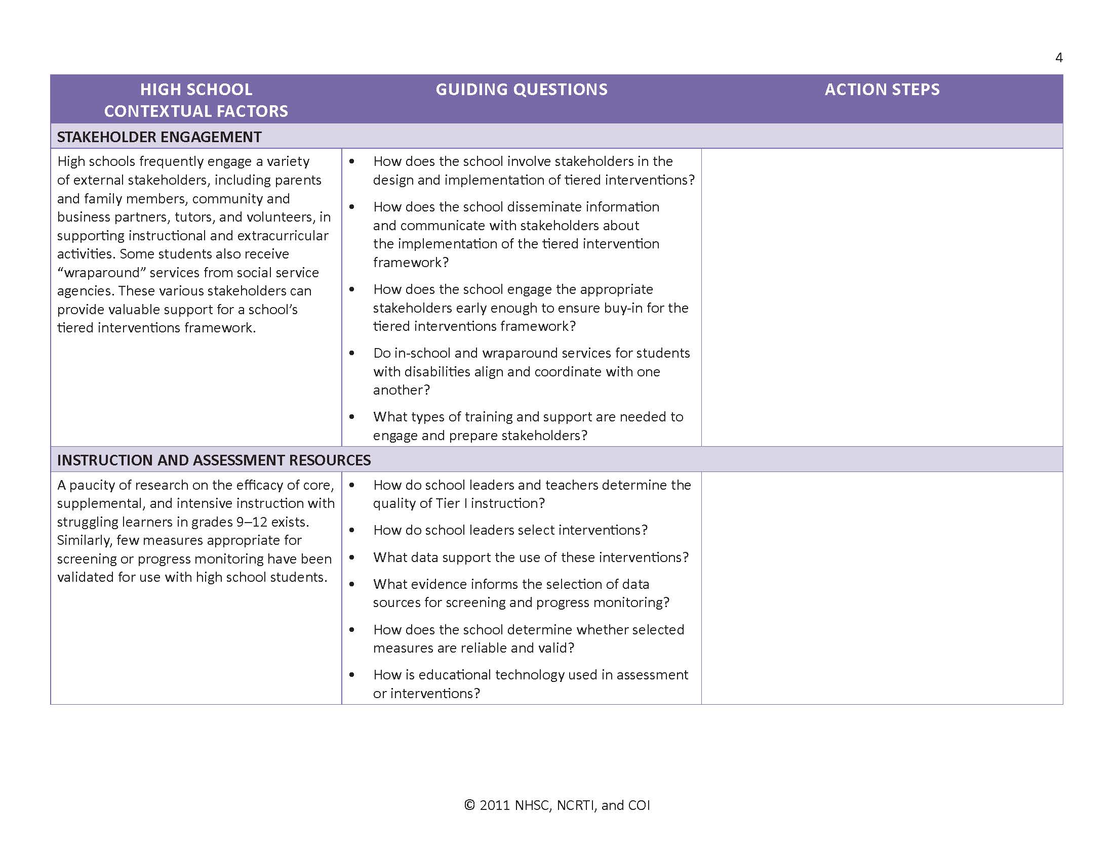
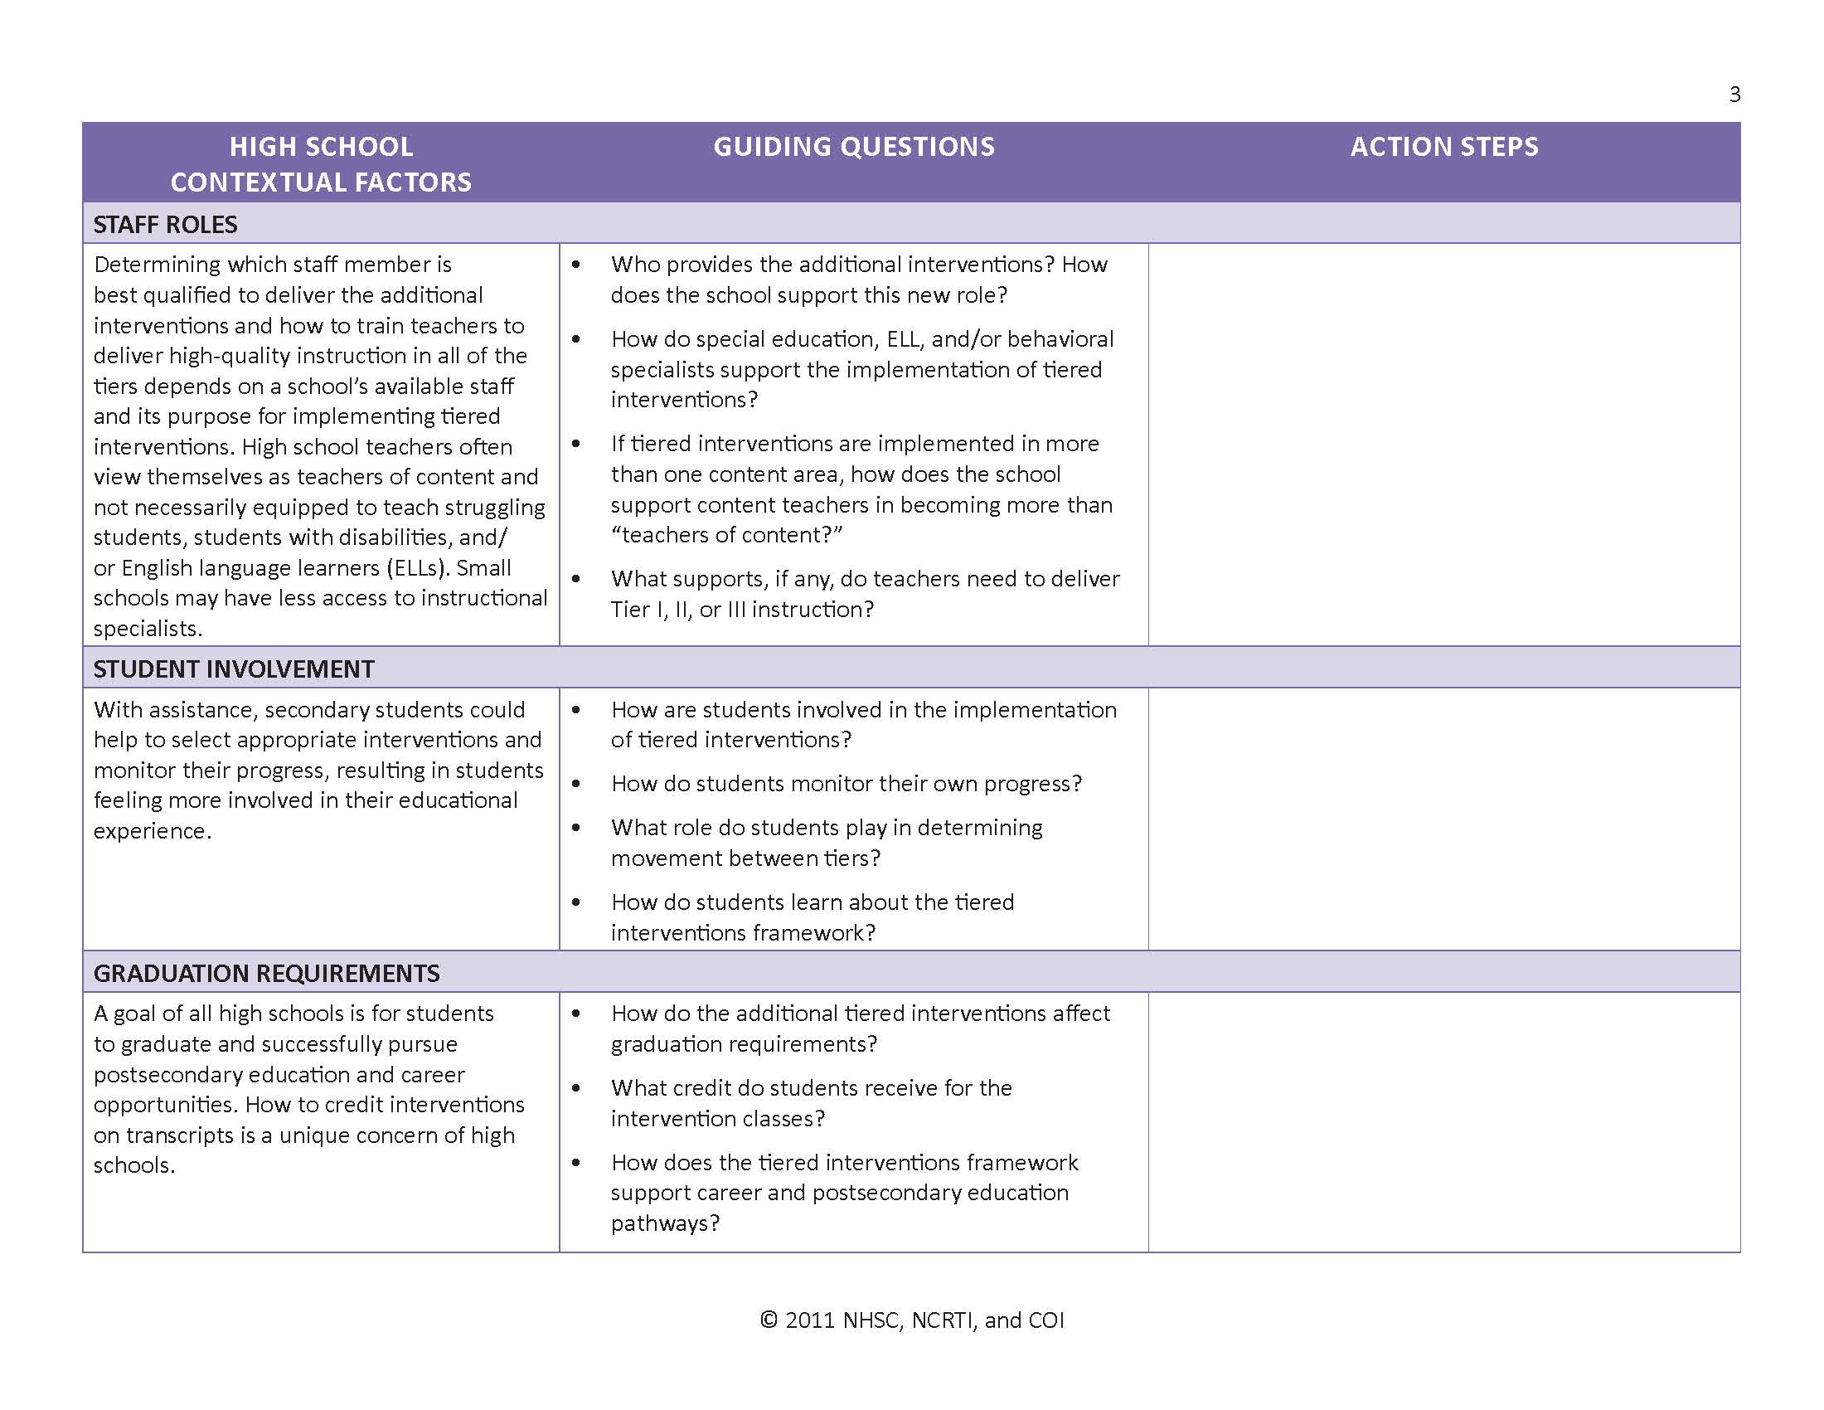
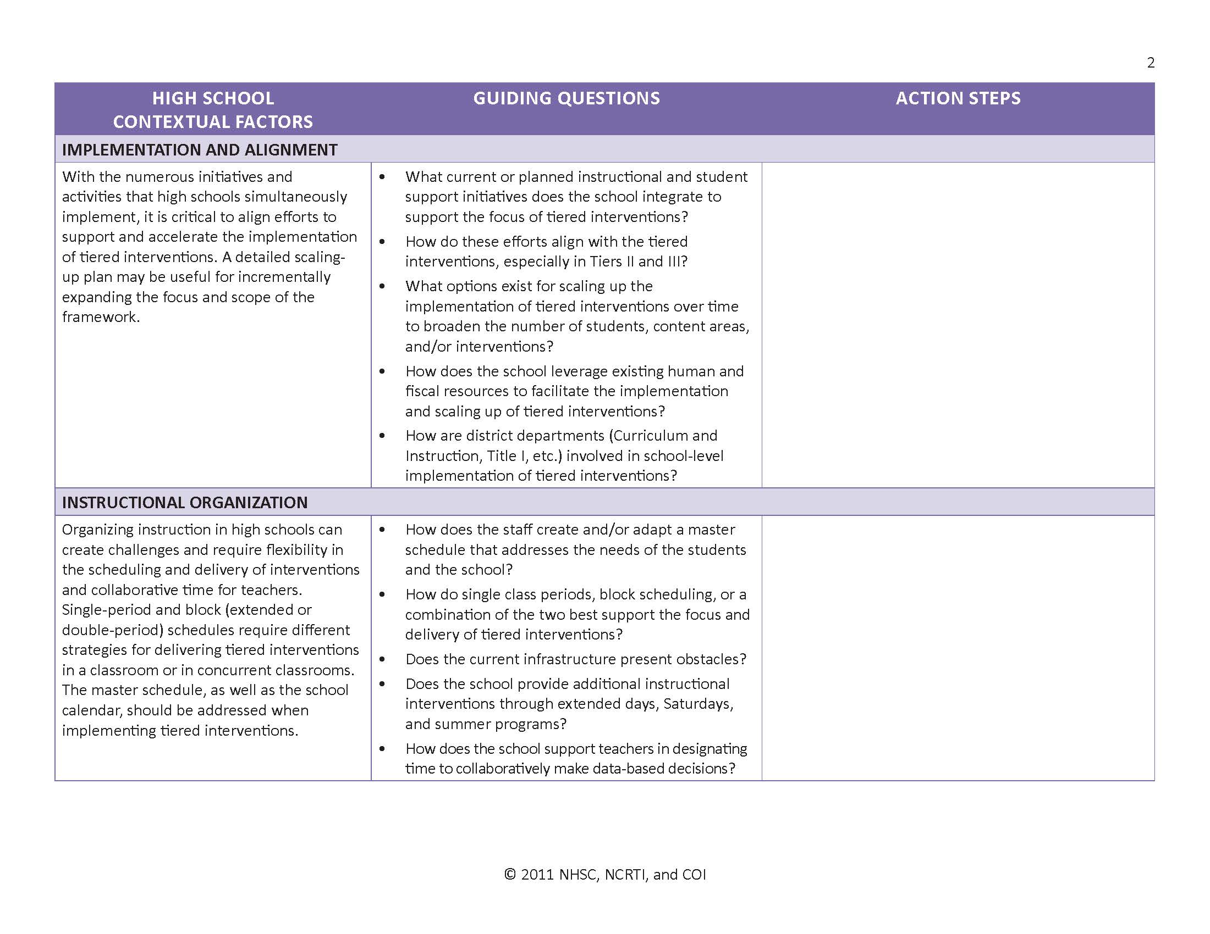
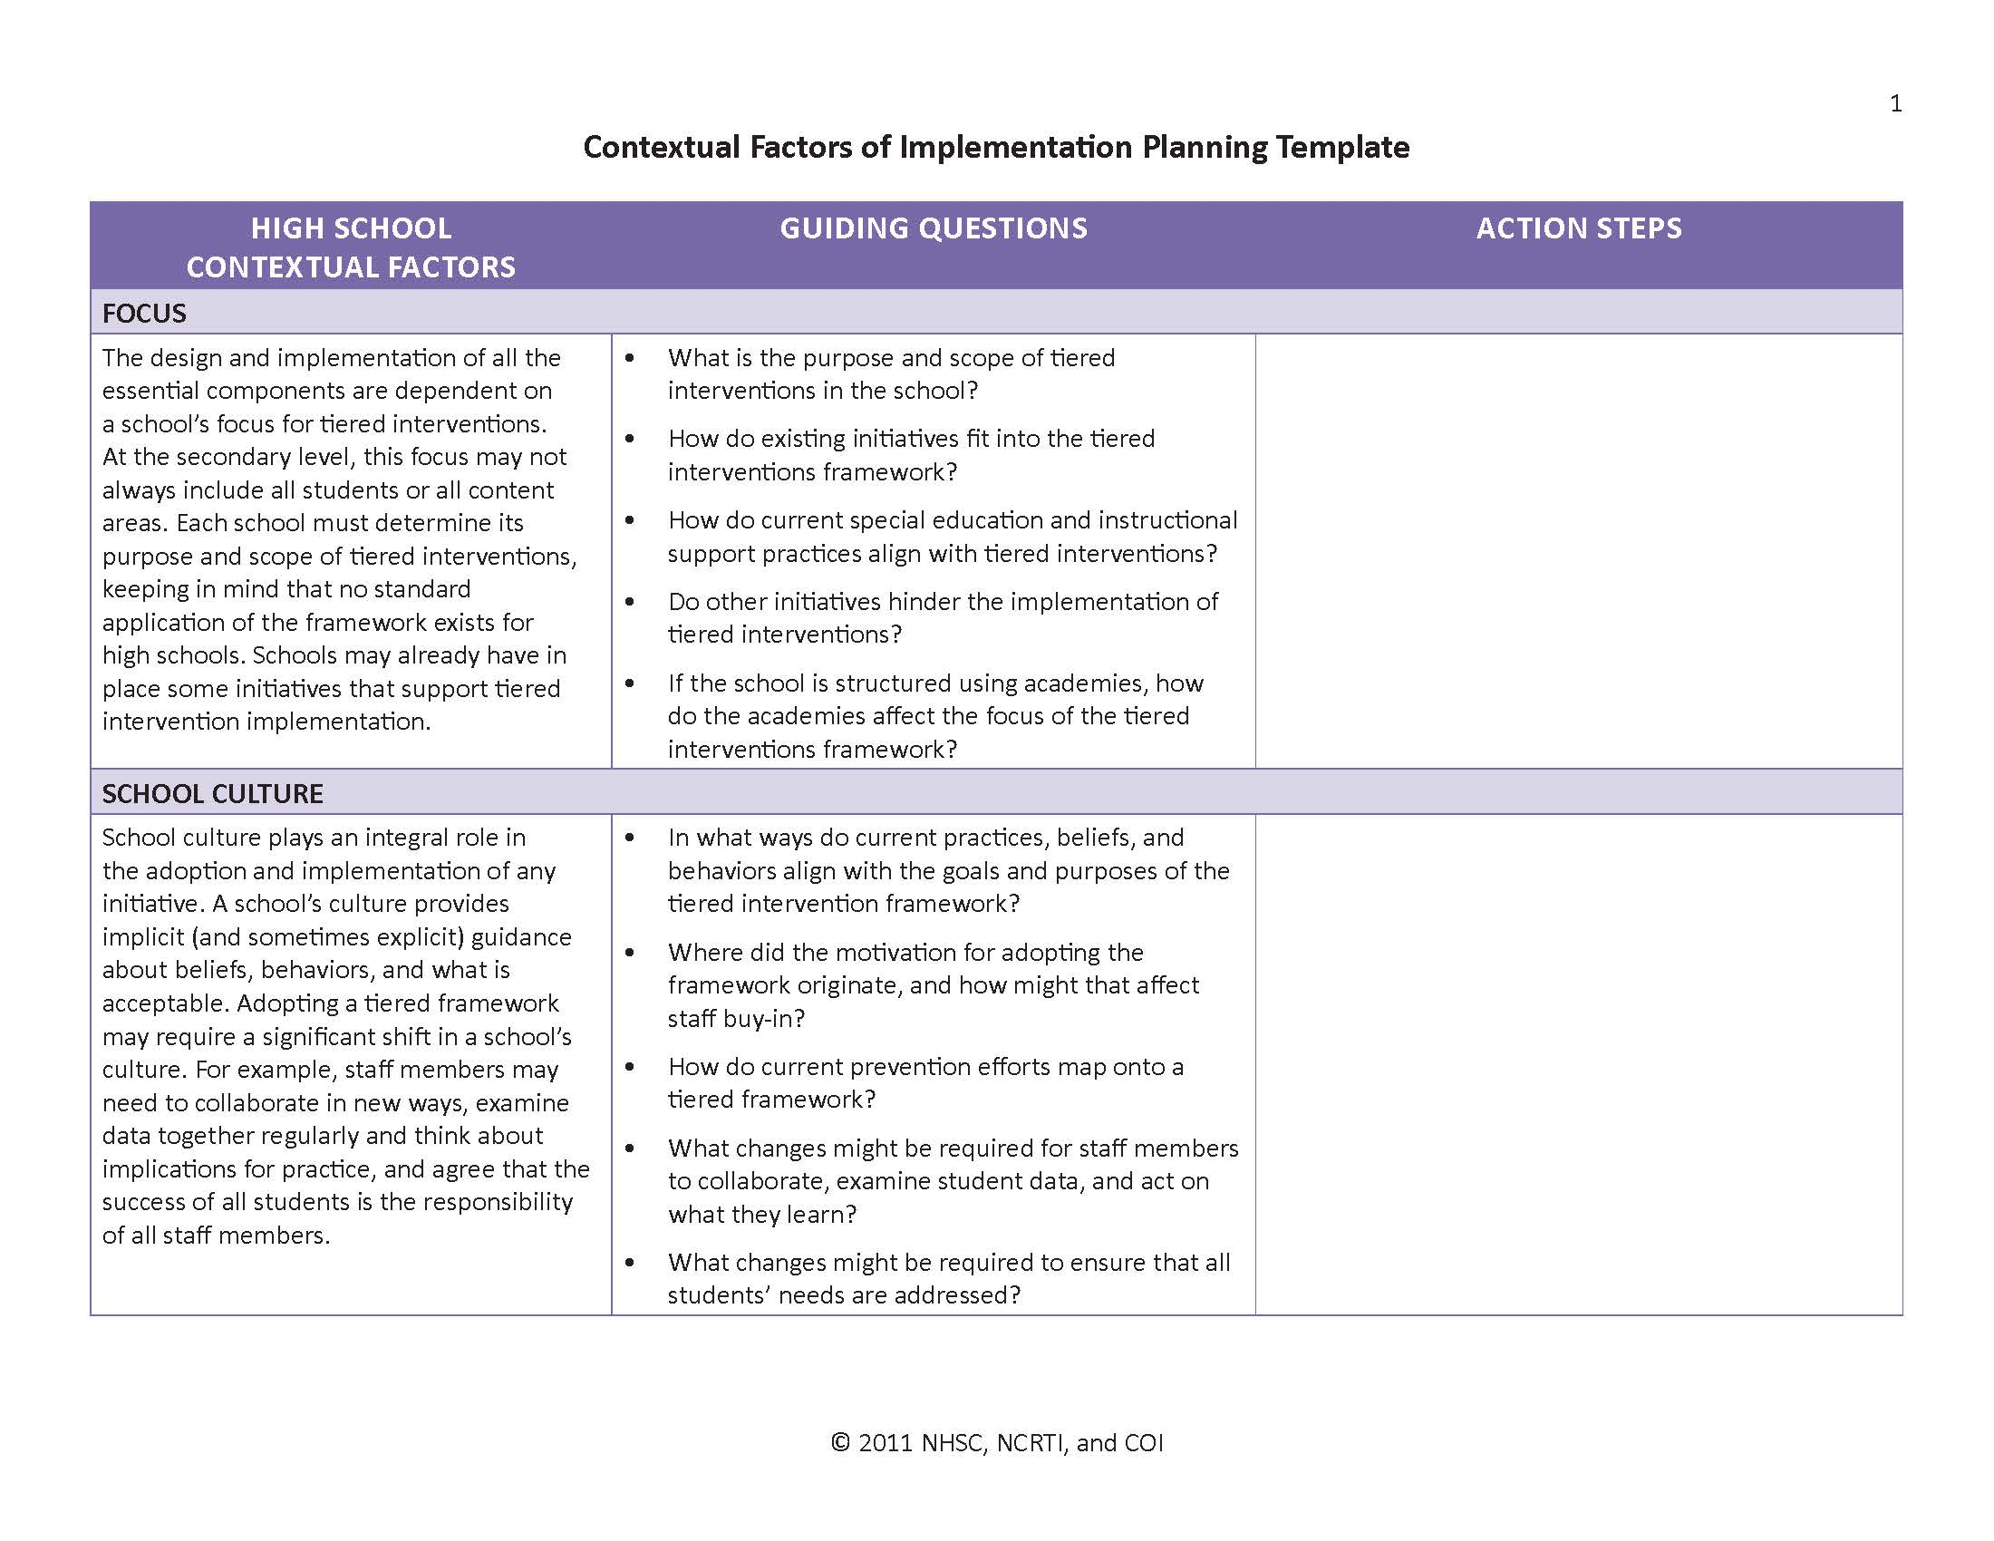
Participant Handout: Contextual Factors of Implementation Planning Template
Notes:
<Distribute the handout: Contextual Factors of Implementation Planning Template.>
This template is designed for technical assistance providers to guide teams of school staff members in addressing the contextual factors of implementation that affect tiered interventions in high schools. This process should be collaborative, in which all members of the team share their experiences, vision, and ideas to answer the guiding questions and establish action steps. To complete the handout, do the following:
Read and discuss the description of each high school contextual factor in the left column of the template to ensure that all members of the team understand the definition.
Review and discuss the guiding questions in the middle column of the template to help the team consider current resources and changes needed for successful tiered intervention implementation.
Use the answers from the guiding questions to develop concrete action steps. Consider including in the action steps the timeframe for completion and the name of the person who will follow up.
Let’s begin. Please complete the handout for the first five contextual factors: focus, school culture, implementation and alignment, instructional organization, and staff roles.
<Provide about 20 minutes. Then, answer questions with the whole group.>
Now, let’s complete the handout for the remaining contextual factors. Please begin.
<Provide about 15 minutes. Then, answer questions with the whole group.>

Slide 56
For More Information
National High School Center www.betterhighschools.org
National Center on Response to Intervention www.rti4success.org
Center on Instruction www.centeroninstruction.org

Slide 57
References
Batsche, G., Elliott, J., Graden, J. L., Grimes, J., Kovaleski, J. F., Prasse, D., . . . Tilly III, D. W. (2006). Response to intervention: Policy considerations and implementation. Alexandria, VA: National Association of State Directors of Special Education.
Caplan, G. (1964). Principles of prevention psychology. New York, NY: Basic Books.
Christenson, S. L., Reschly, A. L., Appleton, J. J., Berman-Young, S., Spanjers, D. M., & Varno, P. (2008). Best practices in fostering student engagement. In A. Thomas & J. Grimes (Eds.), Best practices in school psychology (5th ed., pp. 1099–1119). Bethesda, MD: National Association of School Psychologists.
Duffy, H. (2007). Meeting the needs of significantly struggling learners in high school: A look at approaches to tiered interventions. Washington, DC: American Institutes for Research, National High School Center.
Fuchs, L. S., & Fuchs, D. (1986). Effects of systematic formative evaluation: A meta-analysis. Exceptional Children, 53(3), 199–208.

Slide 58
References (cont.)
Fuchs, L. S., & Fuchs, D. (2002). Curriculum-based measurement: Describing competence, enhancing outcomes, evaluating treatment effects, and identifying treatment nonresponders. Peabody Journal of Education, 77, 64–84.
Jimerson, S. R., Reschly, A. L., & Hess, R. (2008). Best practices in increasing the likelihood of high school completion. In A. Thomas & J. Grimes (Eds.), Best practices in school psychology (5th ed., pp. 1085–1097). Bethesda, MD: National Association of School Psychologists.
Kurz, A., Elliot, S. N., Wehby, J. N., & Smithson, J. L. (2009). Alignment of the intended, planned, and enacted curriculum in general and special education and its relation to student achievement. The Journal of Special Education, 43(3), 1–15.
National Association of State Boards of Education. (2006). Reading at risk: The state response to the crisis in adolescent literacy. Alexandria, VA: Author.

Slide 59
References (cont.)
National Center on Response to Intervention. (2010). Essential components of RTI—A closer look at response to intervention. Washington, DC: U.S. Department of Education, Office of Special Education Programs, National Center on Response to Intervention.
National High School Center. (2008). Eight elements of high school improvement: A mapping framework. Washington, DC: American Institutes for Research, National High School Center. Retrieved from http://www.betterhighschools.com/docs/NHSCEightElements7-25-08.pdf
National High School Center, National Center on Response to Intervention, and Center on Instruction. (2010). Tiered interventions in high schools: Using preliminary ‘lessons learned’ to guide ongoing discussion. Washington, DC: American Institutes for Research.
Reschly, D. J., & Wood-Garnett, S. (2009). Teacher preparation for response to intervention in middle and high schools. Washington, DC: Learning Point Associates, National Comprehensive Center on Teacher Quality.

Slide 60
References (cont.)
Shapiro, E. S., & Ager, C. (1992). Assessment of special education students in regular education programs: Linking assessment to instruction. The Elementary School Journal, 92(3), 283–296.
Thurber, R. S., Shinn, M. R., & Smolkowski, K. (2002). What is measured in mathematics tests? Construct validity of curriculum-based mathematics measures. School Psychology Review, 31(4), 498–514.
VanDerHeyden, A. M., & Burns, M. K. (2005). Using curriculum-based assessment and curriculum-based measurement to guide elementary mathematics instruction: Effects on individual and group accountability scores. Assessment for Effective Intervention, 30(3), 15–31.
Vaughn, S., Wanzek, J., & Fletcher, J. M. (2007). Multiple tiers of intervention: A framework for prevention and identification of students with reading/learning disabilities. In B. Taylor & J. Ysseldyke (Eds.), Educational interventions for struggling readers (pp. 173–196). New York, NY: Teacher’s College Press.

