Slide 1
Effective Instruction for Adolescent Struggling Readers:
Bridging Research to Practice and
Supporting School Improvement Efforts
Debby Houston Miller –
Center on Instruction
Peggy Simon –
Doing What Works
April 14, 2011

Slide 2

The Center on Instruction is operated by RMC Research Corporation in partnership with
the Florida Center for Reading Research at Florida State University; Instructional Research Group;
the Texas Institute for Measurement, Evaluation, and Statistics at the University of Houston;
and The Meadows Center for Preventing Educational Risk at the University of Texas at Austin.
The contents of this PowerPoint were developed under cooperative agreement S283B050034 with
the U.S. Department of Education. However, these contents do not necessarily represent the policy of the Department of Education, and you should not assume endorsement by the Federal Government.
The Center on Instruction requests that no changes be made to the content or appearance of this product.
To download a copy of this document, visit www.centeroninstruction.org.
2011

Slide 3
During Today’s Session
Review of research and instructional practices in areas of:
  Instruction that ALL students need
  Instruction that SOME students need
Strong leadership
  Administrators
  Teachers
Planning & reflection activities
Introduction to useful tools
Notes:
3

Slide 4
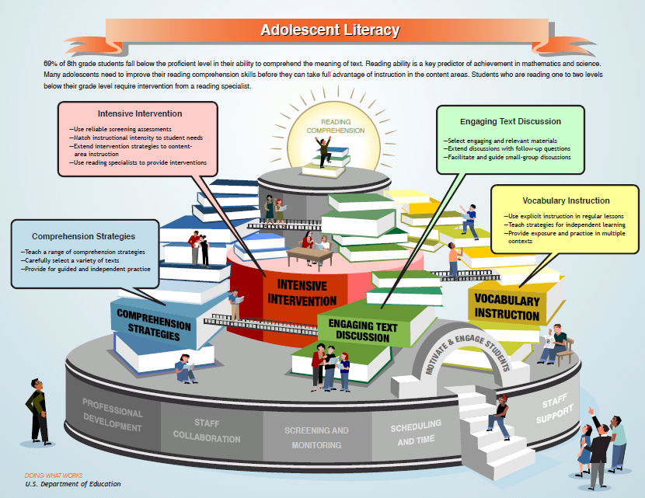
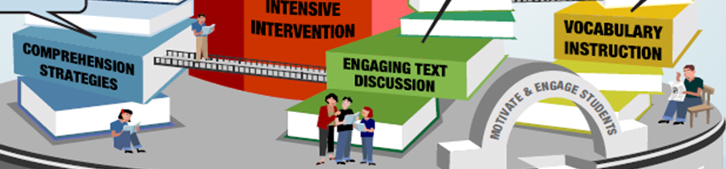
Notes:
4

Slide 5
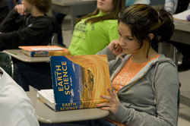

Literacy Proficiency for ALL Students
Literacy in
Content Areas
Struggling Reader
Development and
Intervention
Notes:
5

Slide 6
School Assessment
Which practices are used in the school(s) you work with?
Tool: Handout – Vocabulary and Comprehension Strategy School Assessment Chart

Slide 7
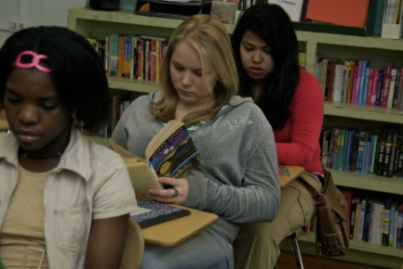
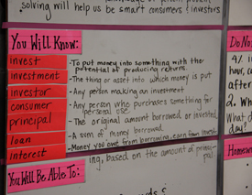
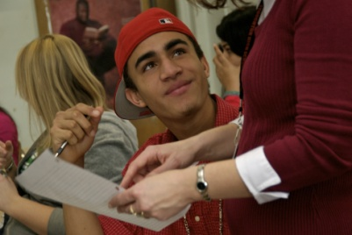
Vocabulary Research
Text demands
Incidental learning of
vocabulary is not sufficient
Notes:
7

Slide 8
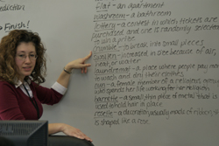
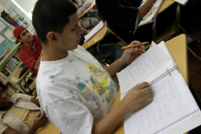
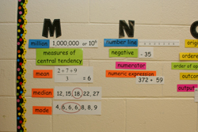
Research Findings: Explicit vocabulary instruction has a substantial effect on students’ vocabulary acquisition in ALL content areas and across a variety of texts, including narrative and expository texts.
Teachers across all content areas should…
  integrate vocabulary into regular classroom lessons
  provide repeated exposure and practice using new words
  teach strategies for independent learning
Explicit vocabulary instruction helps students…
  learn specialized words in content areas (e.g., science, math)
  develop strategies to become independent learners…
    analyzing word parts
    understanding relationships between new and familiar words

Slide 9
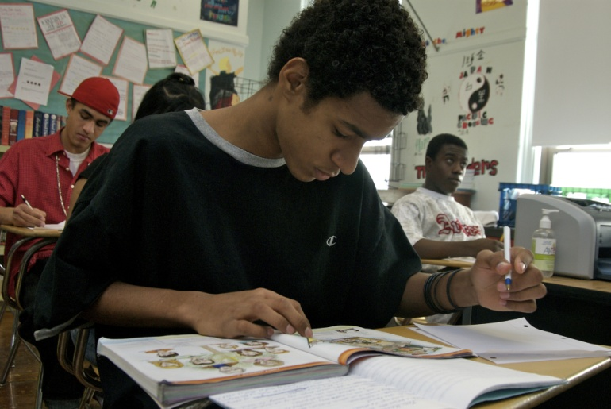
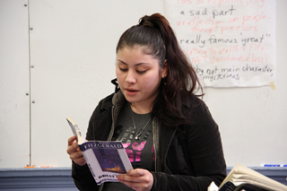
Comprehension Research
Wide variation in skills
Text complexity and disciplinary demands
Explicit strategy instruction
Notes:
9

Slide 10

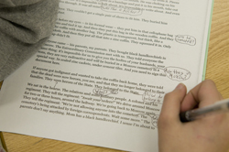
Comprehension Strategies
Effective strategies:
  Background knowledge
  Answer questions
  Generate and answer questions
  Summarization
  Graphic organizers
  Monitor comprehension
  Multiple strategy instruction
Notes:
10

Slide 11
Generic Graphic Organizer
Modified Graphic Organizer for Government Class

Slide 12
Writing to Improve Comprehension
Chart from Synopsis of Writing to Read: Evidence for How Writing Can Improve Reading – A Carnegie Corporation Time to Act Report. (See Handout)

Slide 13
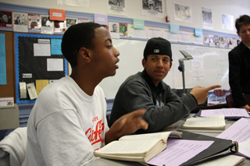
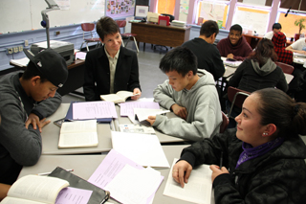
Text Discussion Research
Interpretations of text events or content
Critical analysis of text content
  Sustained exploration of topic or idea
  Specific selection of text to stimulate discussion
  Questions designed to allow exploration and discussion
  Exchanges to defend reasoning
  or provide evidence in text
Notes:
13

Slide 14
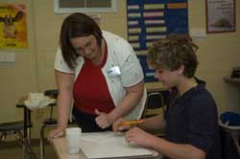
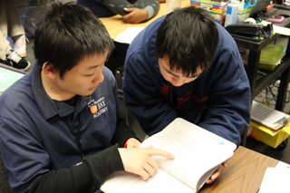
Motivation & Engagement Research
Authentic, meaningful learning goals
Informative feedback from teacher that includes details and explanations
Choices and opportunities for collaboration
Notes:
14

Slide 15
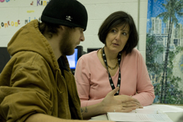
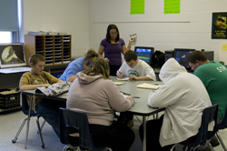
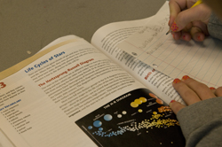
Intervention Research
Focus of instruction
Range of interventions
Content class support
Notes:
15

Slide 16

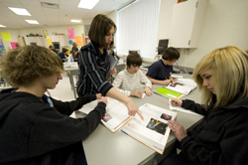
Research findings: Struggling readers require supplemental or intensive interventions often provided by a trained specialist in addition to the reading support students typically receive in their regular classrooms.
Provide interventions that…
  are based on screening and diagnostic assessment data
  match instructional focus and intensity to student needs
  involve collaboration between specialists and content area teachers
Struggling readers benefit from:
  explicit instruction targeted to meet their learning needs
  teacher modeling and feedback
  scaffolded activities
  teacher-guided instruction and peer interaction leading to a transfer of strategy control

Slide 17
Intervention Instructional Focus
Component | Elementary | Secondary
Phonemic Awareness | 
Word Study |  | (For SOME students)
Fluency |  | (For SOME students to promote comprehension)
Vocabulary |  | 
Comprehension |  | 
Word Study
Improves reading accuracy and comprehension
Fluency
Allows focus on meaning of text*
*A relationship between fluency and comprehension exists; need additional research to guide practice at secondary level

Slide 18
Planning In-Service Tool
Review and Discussion
Schools: Is this something you could see your school doing? Why or why not?
LEAs: Is this something you would recommend to your schools? Why or why not?
SEAs: Is this something you would recommend to your LEAs? Why or why not?
Tool: Handout – Learning Together About Tiered Instruction for Struggling Readers

Slide 19
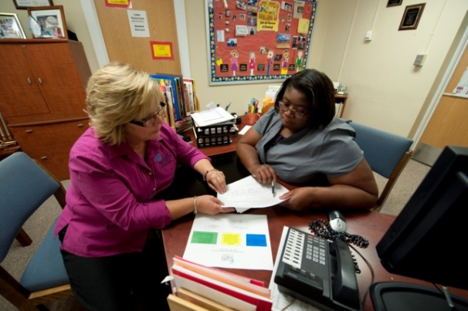
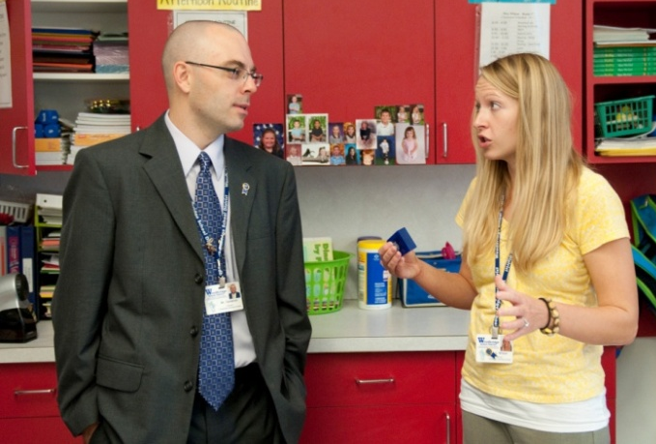

Strong Leadership
Align adolescent literacy improvement strategies and goals
Maintain visibility in classrooms
Communicate actions, expectations
and goals
Notes:
19

Slide 20
Classroom Leadership to Improve Literacy Outcomes
Ensure instruction meets student needs and is aligned to standards
Monitor progress and adjust teaching to strengthen learning
Participate in professional
development & collaborate
with colleagues
Notes:
20

Slide 21
Let’s Summarize!
What are some of the most important things you learned today?
What is some information you definitely want to share with your colleagues?
What will you do next?

Slide 22
What Will You Do Next?
Role Specific Planning Templates
  School
  District
Topical Resources to Consider
  Center on Instruction
  Doing What Works
Tools: Adolescent Literacy: Planning Template for Work With Schools & COI/DWW Adolescent Literacy Component Resources

Slide 23

Doing What Works
Builds on expert research reviews to identify effective practices
Uses a LEARNSEEDO model to translate research-based practices into practical tools to improve instruction
Provides media and resources that are evidence-based
Supports SIG grantees with practical implementation resources
Notes:
23

Slide 24
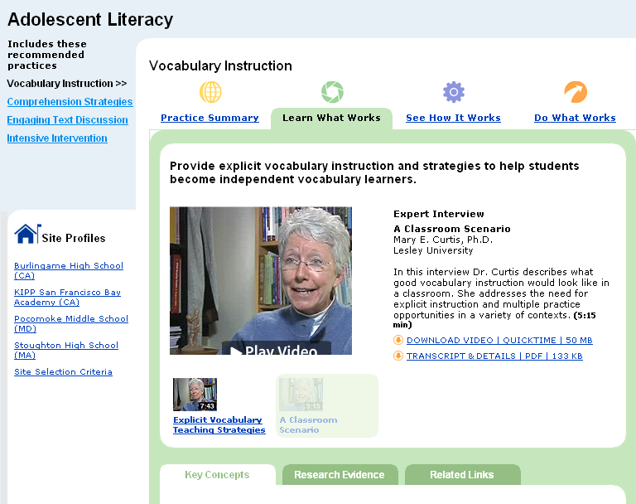
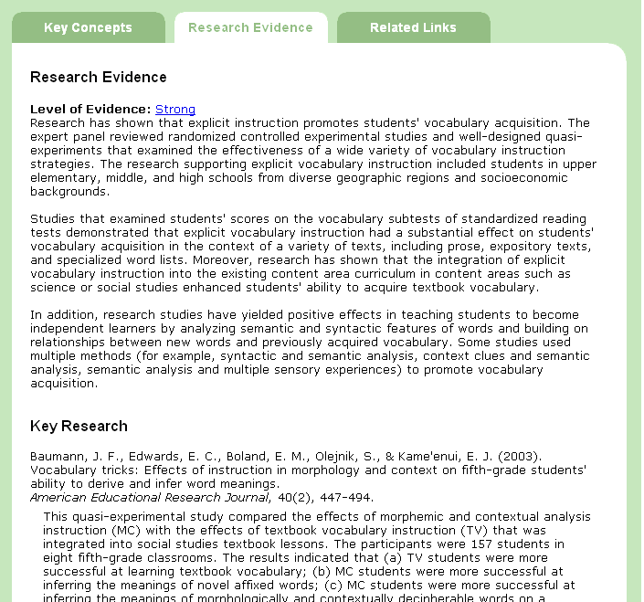
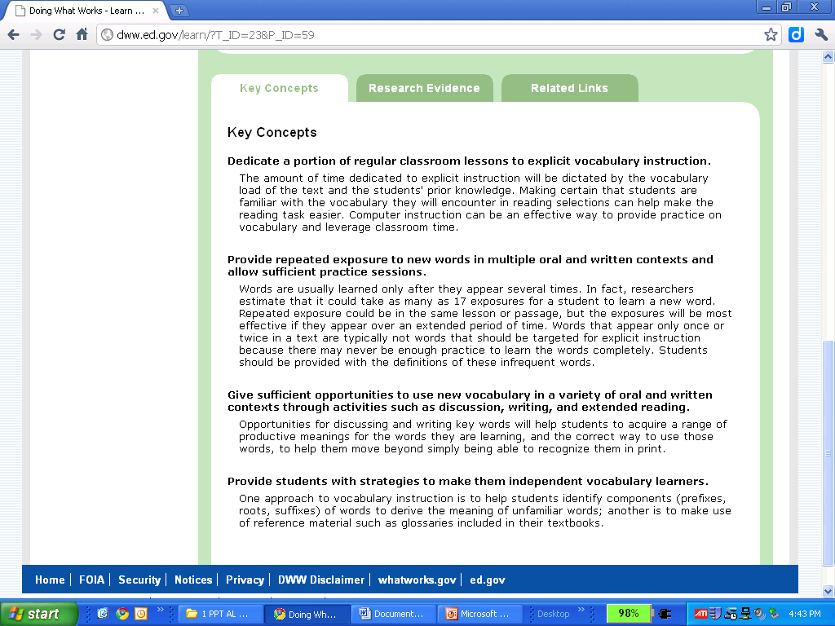
LEARN What Works
Research and Key Concepts
Notes:
24

Slide 25
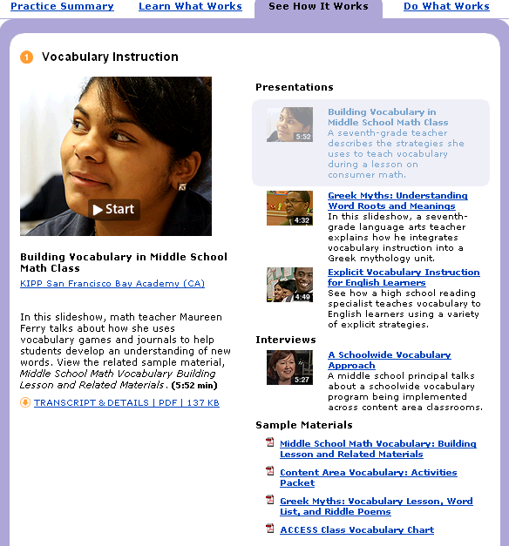
SEE
How It Works:
School
Examples
Notes:
25

Slide 26
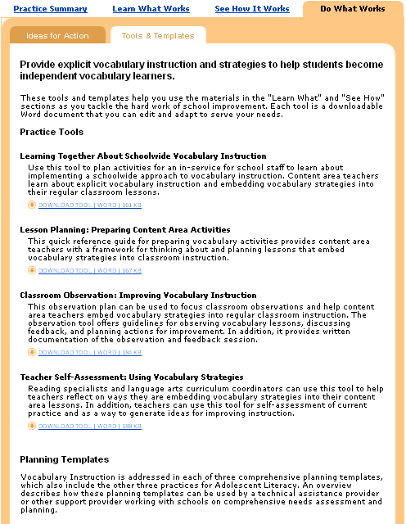
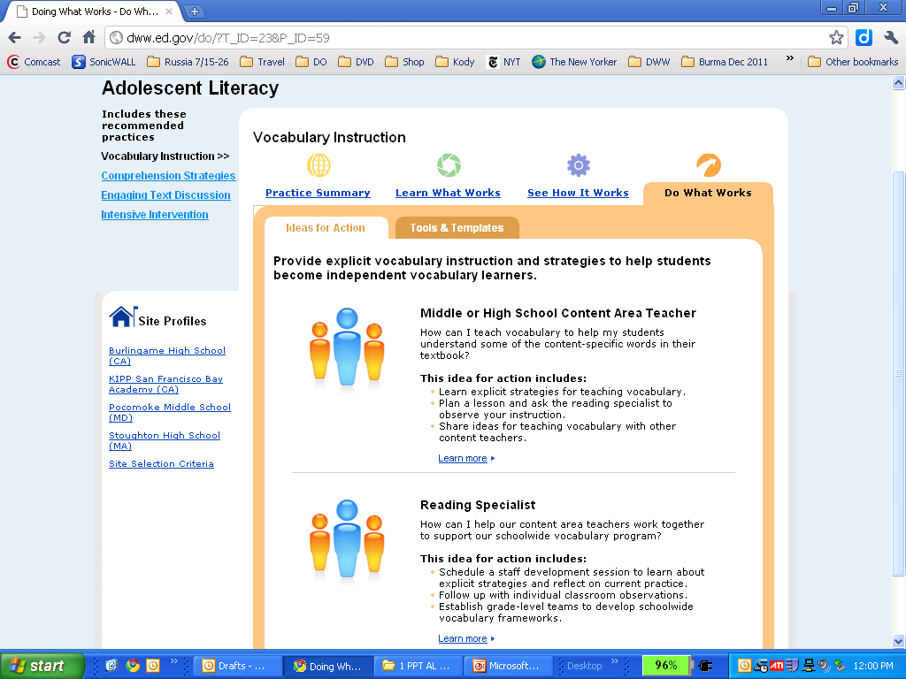
DO the Practice: Tools and Ideas
Implementation Tools
Notes:
26

Slide 27
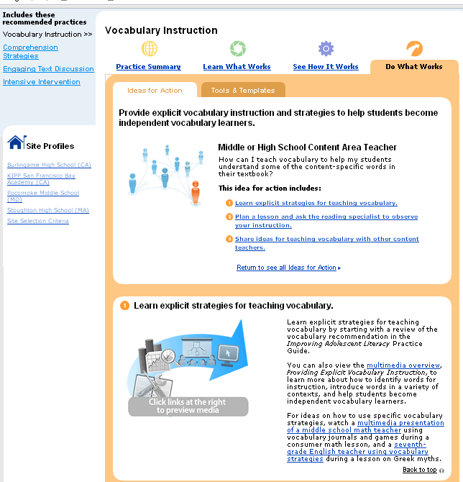
Ideas
for Action
Notes:
27

Slide 28
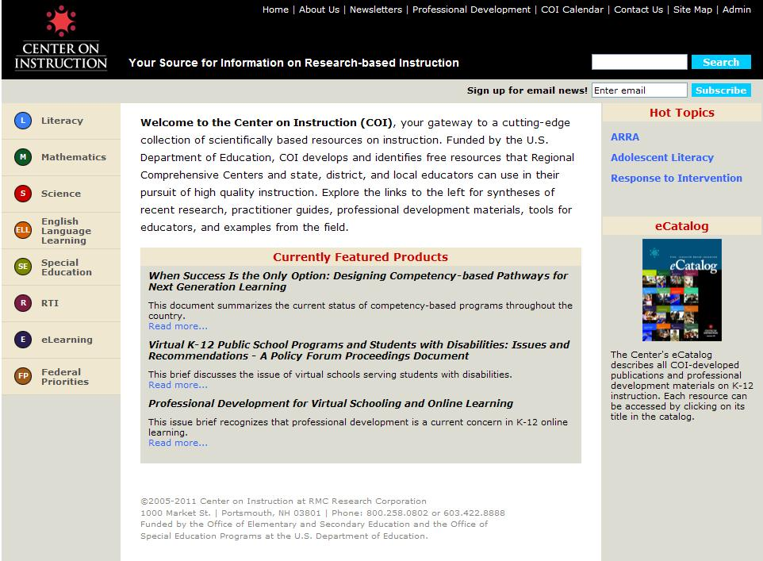
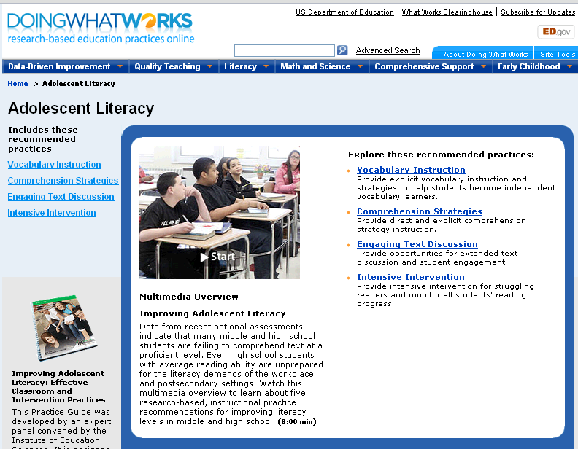
More adolescent literacy resources…
dww.ed.gov
Peggy Simon
psimon@rmcres.com
www.centeroninstruction.org
Debby Houston Miller
dhmiller@fcrr.org
Notes:
28

Slide 29

Contact: Center on Instruction
COI-Info@rmcres.com
Website Address: http://centeroninstruction.org
Notes:
29

