Slide 1
National Council of Teachers of Mathematics
Position on Intervention
Examples from One State

Slide 2
One State’s Response
The Texas Education Agency:
Adopted a framework for Response to Intervention for middle schools
Provided statewide professional development on Focal Points, WWC Practice Guide, and improving core classroom instruction
Developed a universal screener for grades 5-8 to determine intervention needs related to pre-algebra
Provided statewide professional development on screening and features of effective interventions
Is developing a diagnostic assessment to help teachers pinpoint students’ specific intervention needs.

Slide 3
Designing and Implementing a System for RtI in Mathematics
Notes:
Directions to trainer: Italics
Information for trainer to convey: Bold
Purpose
Provide participants an opportunity to demonstrate their understanding of key Response to Intervention (RtI) vocabulary for Tier I by designing a picture (visual display) and explaining the rationale for the picture
Handout
Response to Intervention: Multi-Tiered Model
Materials
For each participant:
VOCAB Cards (other concepts may be chosen for this activity as long as they have an interrelationship with the vocabulary words that can be depicted visually)
For each group:
Chart paper
Markers

Slide 4
RtI:Multi-Tiered Model
Focus
Program
Interventionist
Setting
Grouping
Time
Assessment
Notes:
Review the features on the chart.
This graphic further illustrates the features of Tier I instruction.
Focus: ALL students
Program: focused curriculum; scientific research-based mathematics instruction and curriculum (aligns with TEKS; Texas Response to Curriculum Focal Points, 2009)
Grouping: flexible grouping
Time: 45-90 minutes a day, depending on school’s schedule
Assessment: universal screener; beginning, middle, and end-of-year assessment
Interventionist: general education teacher through differentiated instruction
Setting: general education classroom

Slide 5
RtI: A Closer Look at Tier II
Focus
Program
Interventionist
Setting
Grouping
Time
Assessment
Notes:
***UPDATE THIS GRAPHIC***ADD EXIT TIER II BEFORE ENTER TIER III
<DISCUSS COMPONENTS HERE>

Slide 6
MSTAR Universal Screener
Notes:
Emphasize how this figure helps inform decisions about if interventions are needed and the degree of intensity of the intervention

Slide 7
Assessment Results Report By Administration
Notes:
Directions for Presenter: Italics
Information for Presenter to Convey: Bold
Review the information presented on the histogram and how to read the histogram (axes, key)
Discuss the purpose of the histogram and how it allows us to make the types of decisions we want to make with the MSTAR Universal Screener: (1) risk status and (2) degree of intensity of support (based on intensity of need)
Discuss how this information aligns with the pyramid and interpretation guide.
REPLACE WITH REPORT FROM LINDSEY; USE COLOR OVERLAY TO HIGHLIGHT TIERS; MAY WANT TO CREATE ICONS WITH POSSIBLE HANDOUTS

Slide 8
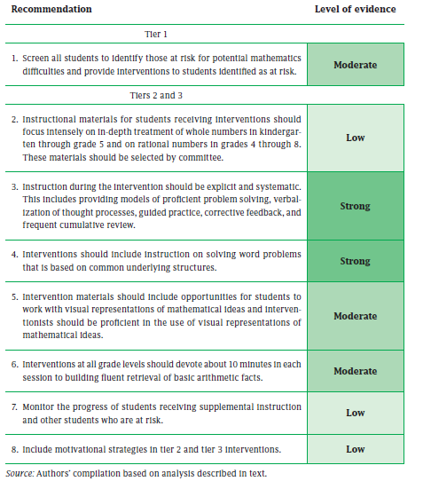
Notes:
Directions for Presenter: Italics
Information for Presenter to Convey: Bold
Refer participants to the IES practice guide.
This presentation will focus on recommendation 3. For a complete description of this recommendation, including how to apply it during instruction, some common roadblocks, and possible solutions, see the IES practice guide.

Slide 9
Some Cautionary Thoughts
Successful statewide training requires sustained attention from the state
District and school level personnel must carry the effort to improve intervention in mathematics
While intervention is consistent with NCTM’s interests in improving mathematics teaching and learning, successful implementation will depend on the quality of teaching
High quality professional development and teacher preparation are essential to improve outcomes

