Slide 1
IES Practice Guide - Response to Intervention in Mathematics A Focus on Assessment
Ben Clarke, Ph.D.
Research Associate - Center for Teaching and Learning, University of Oregon

Slide 2
The Center on Instruction is operated by RMC Research Corporation in partnership with the Florida Center for Reading Research at Florida State University; Instructional Research Group; the Texas Institute for Measurement, Evaluation, and Statistics at the University of Houston; and The Meadows Center for Preventing Educational Risk at the University of Texas at Austin. The contents of this PowerPoint were developed under cooperative agreement S283B050034 with the U.S. Department of Education. However, these contents do not necessarily represent the policy of the Department of Education, and you should not assume endorsement by the Federal Government. The Center on Instruction requests that no changes be made to the content or appearance of this product. To download a copy of this document, visit www.centeroninstruction.org.
2011

Slide 3
Assisting Students Struggling with Mathematics: Response to Intervention for Elementary and Middle Schools
The report is available on the IES website:
http://ies.ed.gov/ncee/wwc/publications/practiceguides/

Slide 4
What is Assessment?
Definition:
Assessment is the collection of data to make decisions.
(Salvia & Ysseldyke, 1997)
Assessment is useless if we don’t use it to guide our actions.

Slide 5
Assessment for Different Purposes
An effective, comprehensive mathematics assessment program includes assessments for four purposes:
Outcome
Screening
Progress Monitoring
Diagnostic

Slide 6
Outcome Assessment
Purpose: To determine level of proficiency in relation to norm or criterion.
When: Typically administered at end of year. Can be administered pre/post to assess overall growth.
Who: All students
Relation to instruction: Provides index of overall efficacy but limited timely instructional information.

Slide 7
Screening Assessment
Purpose: To determine children who are likely to require additional instructional support (predictive validity).
When: Early in the academic year or when new students enter school. May be repeated in the Winter and Spring.
Who: All students
Relation to instruction: Most valuable when used to identify children who may need further assessment or additional instructional support.

Slide 8
Progress Monitoring Assessment
Purpose: Frequent, timely measures to determine whether students are learning enough of critical skills.
When: Weekly or Monthly
Who: At-risk students
Relation to Instruction: Indicates student response to instruction.

Slide 9
Diagnostic Assessment
Purpose: To provide specific information on skills and strategy needs of individual students.
When: Following screening or at points during the year when students are not making adequate progress.
Who: Selected students as indicated by screening or progress monitoring measures or teacher judgment.
Relation to Instruction: Provided specific information on target skills; highly relevant.
Notes:
The purpose of Diagnostic Assessment is to provide more in-depth information on student’s skills and instructional needs to plan instruction.
Diagnostic assessment may include a variety of teacher-made or specialized assessments, but should be closely aligned to the accountability outcomes for the grade.
Ask participants to think about whether their school has assessments designed for this purpose.
Have participants reflect on the following:
When and how often is it administered?
Which students are given the measure?
How are the results used?
Does the measure have established reliability and validity?
Does the device focus on the essential early literacy skills in a time efficient manner?

Slide 10
Coherent Assessment Systems
Each type of assessment has a purpose
The design of the tool should match the purpose
What are the implications for screening tools used with all students?
Think purpose not tool
How do each of these purposes fit together?

Slide 11
Does your school collect data to make decisions or to collect data?
Common pitfalls
Focus is on procedure
Data collected don’t match purpose for collecting data (e.g. collecting diagnostic data on all students)
Layering of data sources
Different data for different programs (e.g. Title 1)

Slide 12
Activity: Do your current assessments function as a whole?
Talk with a colleague about how the four types of assessments work in one system at your school/district.
Does each assessment tool match the purpose it is used for?
Does the system link together in a logical manner?

Slide 13
Recommendation 1
Screen all students to identify those at risk for potential mathematics difficulties and provide interventions to students identified as at risk.
Level of Evidence: Moderate

Slide 14
Technical Evidence
Correlational design studies
Greater evidence in the earlier grades
Reliability typically included inter-tester, internal consistency, test-retest, and alternate form
Most fall between r=.8 to .9
Validity primarily focused on criterion related with an emphasis on predictive validity
Most fall between r=.5 to .7
Measures are beginning to report on sensitivity and specificity

Slide 15
Content
Content of Measures
Single aspect of number sense (e.g. strategic counting) – most common in earlier grades
Or Broad measures incorporating multiple aspects of number
Some measures are combination scores from multiple single aspect measures
Measures reflecting the computation and concepts and applications objectives for a specific grade level – most common later grades
Often referred to as CBM or General Outcome

Slide 16
Features
Short duration measures (1 minute fluency measures)
Note many measures that are short duration also used in progress monitoring.
Longer duration measures (untimed up to 20 minutes) often examine multiple aspects of number sense
Issue of purpose is critical to examine
Most research examines predictive validity from Fall to Spring.

Slide 17
Examples: Single aspect number sense
Example: Magnitude comparison
Example: Strategic counting
12 3
4 1
5 11
9 4
__ 13 14 6 __ 8 3 4 __

Slide 18
Example: Multiple aspects number sense
Number Knowledge Test
Level 1
If you had 4 chocolates and someone gave you 3 more, how many chocolates would you have?
Which is bigger: 5 or 4?
Level 3
What number comes 9 after 999?
Which difference is smaller: the difference between 48 and 36 or the difference between 84 and 73?

Slide 19
2nd grade and above: Examples
Number combinations
Word problems
Grade level computation objectives
Grade level concepts and applications
Measures tied to NMAP Focal Points

Slide 20
General Outcome Measures
For students in grades 1–6.
Student is presented with 25 computation or concept and application problems representing the year-long, grade-level math curriculum.
Student works for set amount of time (time limit varies for each grade).

Slide 21
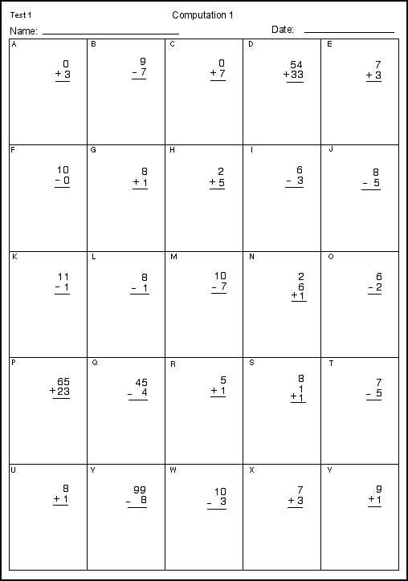

Slide 22
Example: Reflecting critical math content
easy-CBM
Items created according to NCTM Focal Points for grade level
48 items for screening (16 per focal point)
Ongoing research (not reviewed in practice guide)

Slide 23
Middle School
Algebra measures
Designed by Foegen and colleagues assess pre-algebra and basic algebra skills. Administered and scored similar to Math-CBM
Math CBM Computation and Concepts and Applications
Concepts and Applications showed greater validity in 6th, 7th, and 8th grade

Slide 24
Basic Skills (in Algebra)
60 items; 5 minutes
Problems include:
Solving basic fact equations;
Applying the distributive property;
Working with integers;
Combining like terms;
Simplifying expressions;
Applying proportional reasoning
Scoring: # of problems correct

Slide 25
Basic
Pre-algebra skills

Slide 26
Suggestions
Have a building level team select measures based on critical criteria such as reliability, validity and efficiency.
Team should have measurement expertise (e.g. school psychologist) and mathematics (e.g. math specialist)
Set up a screening to occur twice a year (Fall and Winter)
Be aware of students who fall near the cut scores

Slide 27
Suggestions
Select screening measures based on the content they cover with a emphasis on critical instructional objectives for each grade level.
Lower elementary: Whole Number
Upper elementary: Rational Number
Across grades: Computational Fluency (hallmark of MLD)

Slide 28
Suggestions
In grades 4-8, use screening measures in combination with state testing data.
Use state testing data from the previous year as the first cut in a screening system.
Can then use a screening measure with a reduced pool of students or a more diagnostic measure linked to the intervention program for a second cut.

Slide 29
Suggestions
Use the same screening tool across a district to enable analyzing results across schools
Districts may use results to determine the effectiveness of district initiatives.
May also be used to determine systematic areas of weakness and provide support in that area (e.g. fractions)

Slide 30
Roadblocks
Resistance may be encountered in allocating time resources to the collection of screening data.
Suggested Approach: Use data collection teams to streamline the data collection and analysis process.

Slide 31
Roadblocks
Questions may arise about testing students who are “doing fine”.
Suggested Approach: Screening all students allows the school or district to evaluate the impact of instructional approaches
Screening all students creates a distribution of performance allowing the identification of at-risk students

Slide 32
Roadblocks
Screening may identify students as at-risk who do not need services and miss students who do.
Suggested Approach: Schools should frequently examine the sensitivity and specificity of screening measures to ensure a proper balance and accurate decisions about student risk status.

Slide 33
Sensitivity and Specificity
 |  | Students at-risk
 |  | YES | NO
Students identified as at-risk | YES | True positive (A) | False positive (B)
 | NO | False negative (C) | True negative (D)
Sensitivity: Number of students correctly identified as at-risk or A/(A+C)
Specificity: Number of student correctly identified as not at risk or D/(D+B)

Slide 34
Sensitivity and Specificity
Set your cut score too high and
You have good sensitivity (all kids that need help are identified) but poor specificity (lots of kids who don’t need help are identified)
Set your cut score too low and
You have good specificity (most kids who don’t need help will not be identified as at-risk) but poor sensitivity (you may miss many kids who do need help)

Slide 35
Roadblocks
Screening may identify large numbers of students who need support beyond the current resources of the school or district.
Suggested Approach: Schools and districts should
Allocate resources to the students with the most risk and at critical grade levels
and
Implement school wide interventions to all students in areas of school wide low performance (e.g. Fractions)

Slide 36
Activity: What is your current screening process?
What measure(s) do you use?
What works well in your system?
What roadblocks have you encountered?

Slide 37
Contact: Center on Instruction
COI-Info@rmcres.com
Website Address: http://centeroninstruction.org

