Slide 1

Organizing for the Success of English Language Learners
David Francis, PhD
Director , English Language Learning,
Center On Instruction English Language Learning
Chair, Psychology Department,
University of Houston
Julie Russ, Ed.M.
Research Associate, Language Diversity and Literacy Development Group,
Harvard Graduate School of Education
Western SIG Regional Conference
Los Angeles, CA
April 6, 2011

Slide 2
The Center on Instruction is operated by RMC Research Corporation in partnership with
the Florida Center for Reading Research at Florida State University; Instructional Research Group;
the Texas Institute for Measurement, Evaluation, and Statistics at the University of Houston;
and The Meadows Center for Preventing Educational Risk at the University of Texas at Austin.
The contents of this PowerPoint were developed under cooperative agreement S283B050034 with
the U.S. Department of Education. However, these contents do not necessarily represent the policy of the Department of Education, and you should not assume endorsement by the Federal Government.
The Center on Instruction requests that no changes be made to the content or appearance of this product.
To download a copy of this document, visit www.centeroninstruction.org.
2011

Slide 3
Framework
The 21st Century America
Organizing For The Success Of ELLs
  Lessons Learned From Recent Research
  Linking Lessons-learned To The Design Of Effective Policies & Practices
Bringing It All Together

Slide 4
The 21st Century America
1 in 5 children is the child of an immigrant
Over 400 different native languages are represented
The immigrant population’s growth rate is 3 times as fast as that for the overall population
U.S. born children of Latino immigrants are the fastest growing segment of the school-aged population
  84% of Latino students are U.S. born
(Fry & Gonzales, 2008; NCES, 2006; US Census Bureau)

Slide 5
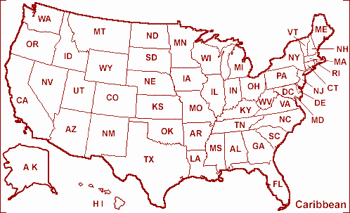

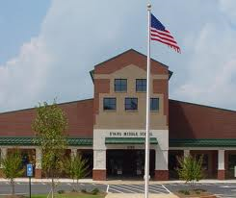

The 21st Century America
Cultural, linguistic, and economic diversity is a reality for the nation as a whole
  For all settings
  and all programs
  serving children

Slide 6
English Language Learners
Large gap in achievement between ELLs and their English-only peers
  50% of Latino fourth graders scored at the below-basic level in reading (NCES, 2007)
Almost twice as likely as their English-only peers to dropout
  Latinos account for nearly half (46%) of all high school dropouts (Snyder, Dillow, & Hoffman, 2007).
College remediation rates on the incline
Juxtaposed against family aspirations
  “Land of Opportunity”

Slide 7
Classrooms as a Setting for Development
Children and youth spend 15,000-20,000 hours of their lives in classrooms
  formal instruction occurs primarily in classrooms
For immigrant students and non-native speakers of English, the classroom is an especially important setting for cognitive, linguistic, and social-emotional development

Slide 8
Discussion
Who are the ELLs in your school, district, or state?
  Home language(s)?
  Populations’ rate of growth?
  Process of identification?
  Age of arrival (e.g., U.S. born, newcomers)?
  Socio-economic status?

Slide 9
Framework
The 21st Century America
Organizing For The Success Of ELLs
  Lessons Learned From Recent Research
  Linking Lessons-learned To The Design Of Effective Policies & Practices
Bringing It All Together

Slide 10
Spotlight: Recent Research on ELLs
Trends in their Reading Development
Effectively Serving Adolescent Newcomers
Accommodations for ELLs taking High-Stakes Tests

Slide 11
How we think about “reading”
A Primer for today’s purposes
Accuracy
Letter Names & Letter Sounds
Phonological
Awareness
Word Reading
Efficiency
READING COMPREHENSION
Background Knowledge
Oral Language
Interest
Vocabulary
Motivation
Word Learning Strategies
Knowledge of word function or type
Metalinguistic Skills
Understanding of Purpose
Text Characteristics
Organizational structure
Sentence structure

Slide 12
Trends in ELLs’ Reading Development
What’s working:
On average, young ELLs develop proficient code-based skills with the same efficiency as their peers
  they are getting the “mechanics” of reading
ELLs tend to develop basic communication skills with ease

Slide 13
Trends in ELLs’ Reading Development (cont.)
What we still need to work on:
Many ELLs struggle to develop sophisticated reading comprehension skills
  gets in the way of reading comprehension
More than an ELL issue
  Common profile for ELL and EO struggling readers in similar schools and classrooms.

Slide 14
Demonstration: The Gap Between Word Reading & Word Knowledge
Word Reading
National Average
Percentile Rank
Word Knowledge
Age 4.5 Age 8 Age 13

Slide 15
Demonstration: Gap between Reading Words & Comprehending Text
Crosson & Lesaux, 2010; Lesaux, Crosson, Kieffer & Pierce, 2010
Notes:
What data do you currently gather?
What would you do if these data represented your student population?
15

Slide 16
Prototype Case
In the Unified District, Rosa Parks is a K-8 School that serves 641 students from diverse ethnic and cultural backgrounds. 37.9% of students identify as Black, 58% Latino, 2.7% White, and 1.0% Asian. The great majority of children are U.S. born and enrolled at Rosa Parks in kindergarten. 80% of students receive free or reduced-price lunch. Classroom sizes are relatively small, the school culture is very positive, and at each grade level, teachers collect data on their students’ literacy skills. From K-3, the majority of students show significant progress in reading ability, but year-to-year about 50% of 3rd graders are in the needs improvement range. Rosa Parks’ middle-school students are not faring any better; only about 20% of 8th graders score in the proficient range while about 50% are in the needs improvement range and about 25% in the warning range. The feeder high school has just set up a summer remediation program to boost the reading skills of underprepared incoming 9th grade students. The district is working on a K-12 literacy plan.

Slide 17
Discussion
What do the issues at Rosa Parks and in Unified District mean for assessment?
If the data shown in previous slides represented your student population, what would your next steps be?
To what extent are you currently basing decisions on data?

Slide 18
The Link: Creating a Comprehensive Assessment Battery
Assessment tools…
have different capabilities
Understand score interpretations
serve different purposes
Understand relationship between type and function
even with outside benchmarks, measurements only provide a partial assessment of literacy skills
need measurements across areas
no one assessment is sufficient for screening or progress monitoring
Many skills go into what we call literacy

Slide 19
The Link: Creating a Comprehensive Assessment Battery
Preventing the gap between reading words & and understanding what is read
Word Reading
Word Knowledge
Assessment systems need to include a language component.

Slide 20
Assessments Can Create Instructional Imbalance
Relying on a single measure can “tip the scales.”
Code-related Measures
Meaning-related Measures
Instruction most often focuses on the domains and skills being measured.

Slide 21
Unintended Consequences of Unbalanced Assessment
Low scores
Emphasis on isolated skills
Poor Instructional Practice
Notes:
The last thing we want is for a teacher to spend hours on phonemic awareness

Slide 22
An Ideal Literacy Battery
Thorough: Includes different types of assessments
Comprehensive: Measure across literacy domains

Slide 23

Discussion
What current language and literacy measures are you using at your school, district, or in your state?

Slide 24
Matching Instruction to Today’s Students
Infuse language & reading into daily instruction, PK-12
  Curriculum is mediated with language, largely through teacher talk and text
  Cannot separate big ideas and critical thinking from language
  Increase in opportunities for academic productive talk, beyond providing responses
No longer feasible to rely on specialist/specialization models
  historically inefficient and ineffective, anyway
  universal design for learning (setting-level)

Slide 25
Knowledge-Based Reading Instruction
Big Ideas;
Abstract Concepts; Complex Academic Language
Code-Level Skills & Comprehension Skills
Notes:
Knowledge-Building Literacy Instruction
At its core, complex concepts to be studied
Rich-text and content-based literacy curricula are essential tools to accomplish even the best standards
support children & adults
platform for instruction
Academic language instruction- embedded in rigorous content - is a promising approach with ELs and their peers
Build students’ academic language using rich texts and discussions, word play and study, and writing

Slide 26
Standard Practice, Elementary to High School
Unintended consequences
So much to do (with little time & Support)
  Only about 10% of instructional time in classrooms is spent on explicit support for:
    vocabulary development
    writing development
  Classroom talk tends to focus on “basic” communication rather than rich, engaging discussion and debate to foster academic language
Pushing through the content
Focus on deep language and content learning
Notes:
Thinking about heterogeneity.

Slide 27
Building Language & Vocabulary
Average students add approximately 2,000-3,000 words a year to their reading vocabularies
This means:
Six to eight new words each day
50,000 words by the end of high school

Slide 28
Academic Language
Academic language is:
  the language used in the classroom and workplace
  the language of text
  the language of academic assessments
  the language of academic success
  the language of power
  Scarcella, 2003

Slide 29
Academic Language
The language of print (to be read or written) is different than conversational language:
Breadth and depth of vocabulary knowledge needed, including multiple meanings;
Wide range of vocabulary that appears far more often in text than in oral conversation;
Specific academic vocabulary;
Complex sentence structures;
Corresponding syntax

Slide 30
Academic Words are Abstract Concepts
Located
Major
Period
Puzzle
Site
According to
Average
Expert
Foundation
Media
Nearly
Percent
Survey
Awareness/aware
Civil
Documentary
Image
Inspire
Anticipate
Constantly
Contribute
Convince
Effect
Expanse
Generate
Inspire
Image
Releasing
Region
Survive
Issue
Research
Social
Survive
Vision
Challenge
Focus
Incentive
Motivate
Communicate
Identity / Identify
Incidents
Legally
Method
Policy
Research
Require
Survey
Affect
Culture
Affect
Culture
Contribute
Establish
Ethnic/ethnicity
Residents
Welfare
Ancient
Complex
Integrated
Located
Major
Period
Puzzle
Site
Community
Discrimination
Distinctions
Evidence
Gender
Options
Regulations
Research
Respond
Topic
Collapse
Conduct
Contribute
Crucial
Research
Resource
Seeking
Establish

Slide 31
What does it mean to know a word?
5 Levels of Word Knowledge:
Narrow-context bound knowledge
General sense
Enough knowledge to understand but not enough to recall and use appropriately
Rich, decontextualized knowledge of a word’s meaning, its relationship to other words, metaphorical use
Label
vs.
Concept
No
knowledge

Slide 32
So how do we teach vocabulary to promote literacy skills?
Targeting depth
of word knowledge
High utility
academic words
Multiple, planned
exposures
Anchored in text
Direct instruction & word-learning strategies

Slide 33
What are some key elements of the process?
Engaging, rich text that features academic vocabulary and complex ideas
Opportunities for quality academic discussions
  Focused on the abstract concept
Opportunities for word play and learning
  Meanings, parts, and transformations
Writing as a tool for reinforcing language development and critical thinking

Slide 34

Why Start with Print?
Source | Academic words per 1,000
Newspapers | 68.3
Adult books | 52.7
Comic books | 53.5
Children’s books | 30.9
Conversation between two college-educated adults | 17.3
Hayes & Ahrens (1998, p. 401)

Slide 35
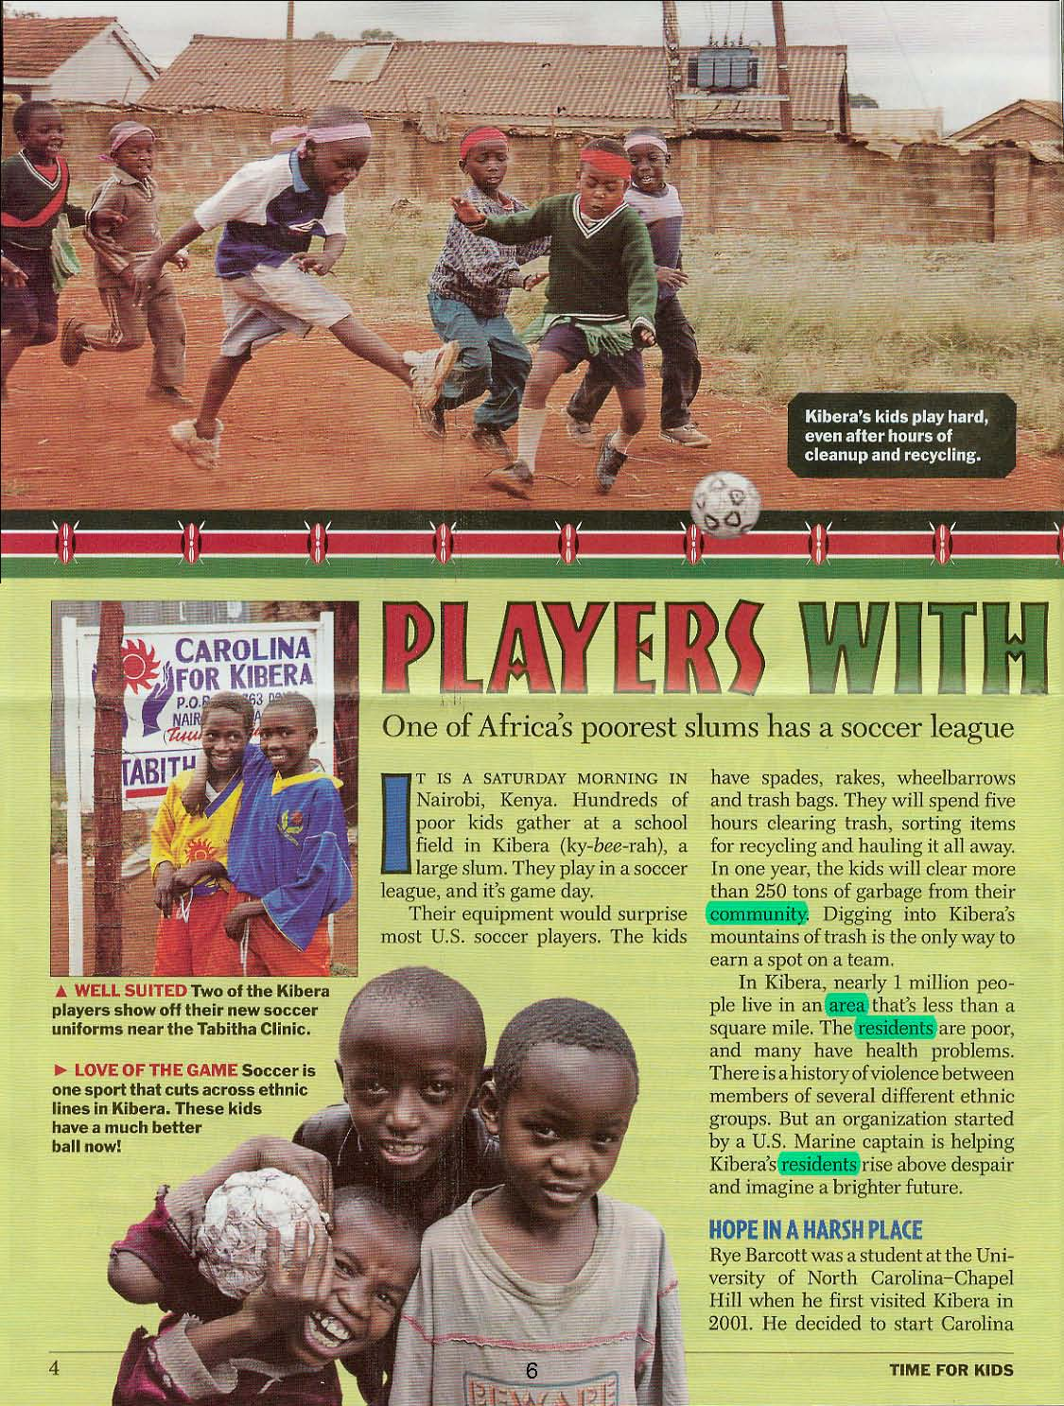
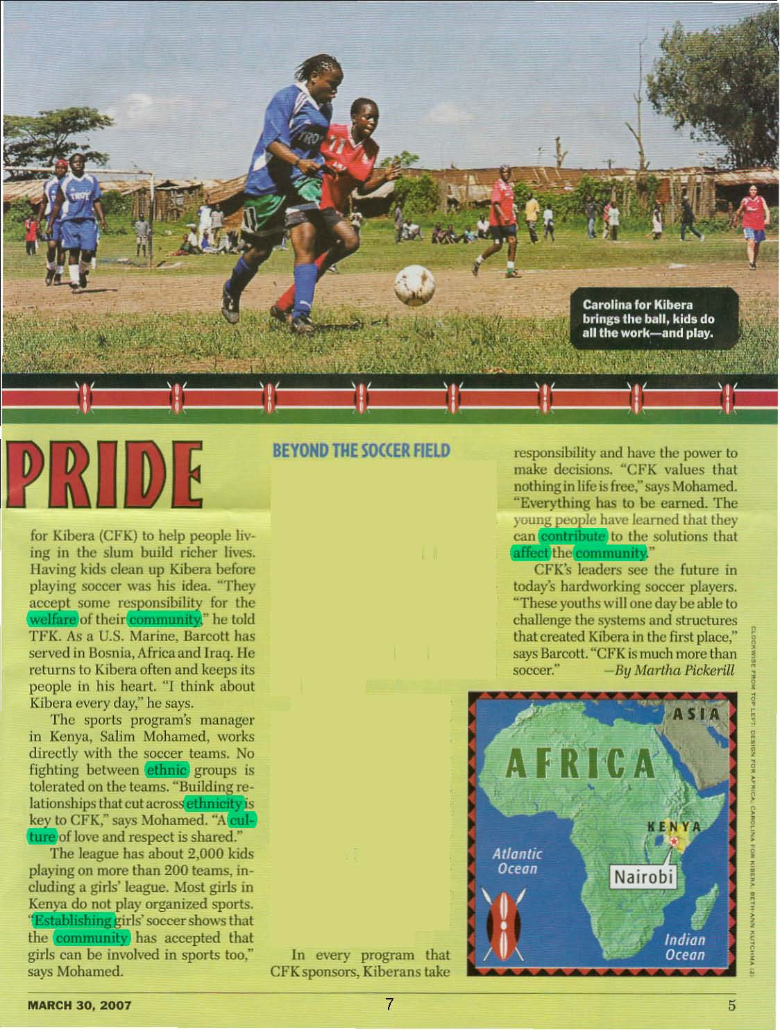


So, for example…
Words in Context of Engaging Text
Platform for Discussing Big Concepts:
community service
tolerance
Target Words:
affect, community, contribute, culture, establish, ethnic, resident, welfare

Slide 36
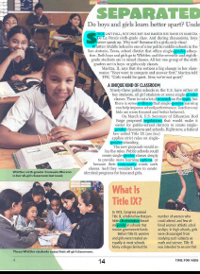
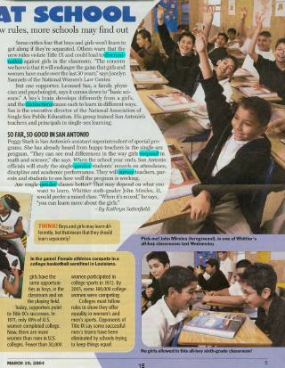


Or, how about…
Words in the Context of another Engaging Text
Platform for Discussing Big Concepts:
segregation
ethical policies
Target Words:
discrimination, distinctions, evidence, gender, options, regulations, respond, topic

Slide 37
Word Play and Learning
Word Consciousness
Target Word:
distinction
Name: Ms. Russ
Date: 2/24/10
I was watching The Devil Wears Prada and one character said that she couldn’t see the distinction between two belts.
Explanation:
discriminate
tion
Word Parts
(noun) an official rule or order
(noun) the act of controlling or adjusting something
Multiple
Meanings
regulation

Slide 38
What does this mean for K-12?
  Implement a comprehensive and thorough assessment system
  Use data to identify priorities for classrooms of learners
  Build students’ academic language using rich texts and discussions, word play and study, and writing
    This means choosing curricula wisely and building teachers’ capacity to do this hard work (assessment and instruction).

Slide 39
Discussion
What current instructional practices are common place at your school, in your district, or in your state?
  What kinds of language skills are targeted in your ELL support programs?
To what extent do your teachers recognize the language demands of their content area?
  What do they do to develop students’ content area language?
What steps will you need to take to implement knowledge-based reading instruction, with a particular focus on building students’ academic language?

Slide 40
Spotlight: Recent Research on ELLs
Trends in their Reading Development
Effectively Serving Adolescent Newcomers
Accommodations for ELLs taking High-Stakes Tests

Slide 41
  Adolescent Newcomers
Common Patterns
Just as common: Diversity
Faced with the challenge of simultaneously:
  acquiring basic proficiency
  acquiring grade-level academic skills
Tend to move quickly when acquiring basic/survival English
Local differences that bear on policy and practice:
age of arrival in U.S. schools
amount and degree of formal schooling
native language literacy skills

Slide 42
The link: Serving Newcomers
Local differences make a single instructional prototype unrealistic
Still, common characteristics of effective settings:
  assessment, ongoing progress monitoring
  mixed-level classrooms
  academic language & content-based literacy
  word-reading instruction just for the few who need it
    Small group or individual, intensive

Slide 43
The Link: Making reception centers & short-term academies work
Short-term means brief
Push on academic language instruction
  exclusive focus on basic skills & communication shortchanges newcomers
Testing out does not guarantee academic success for any of our ELLs, especially newcomers
  continued support is key!

Slide 44
Discussion
To what extent are newcomers a substantial proportion of your ELL population?
  Is this uniform across school levels?
What supports and/or programs do you have in place for addressing newcomers learning needs?
  What kinds of language skills are targeted in your newcomer programs?

Slide 45
Spotlight: Recent Research on ELLs
Trends in their Reading Development
Effectively Serving Adolescent Newcomers
Accommodations for ELLs taking High-Stakes Tests

Slide 46
What we’re learning about
Assessment Accommodations
Uncovering a Working Myth:
  The more accommodations the better?
    75 different accommodations currently in use with ELLs
Discovering the reality:
  The majority of accommodations in use are questionable or inappropriate for ELLs.

Slide 47
The Link: Using Accommodations Wisely
    Considerations for Matching the Accommodations to the Learner:
  Native language literacy proficiency?
  Instruction provided about how to use the accommodation (e.g., dictionaries)?
  Language of instruction? Proficiency level?
Combining Accommodations Judiciously
    e.g., dictionary use takes time, so complement with extended time

Slide 48
What we’re learning about
Assessment Accommodations
They don’t always make up the gaps:
  Central role of academic language in content assessment
  Mediating role of language in content learning
  Differential opportunities to learn

Slide 49
Discussion
What accommodations are allowable in your state for ELLs?
  Do these address EL student’s linguistic needs?
To what extent do students get an opportunity to use these accommodations during instruction?
How are decisions made regarding allowable accommodations for a specific student?

Slide 50
Framework
The 21st Century America
Organizing For The Success Of ELLs
  Lessons Learned From Recent Research
  Linking Lessons-learned To The Design Of Effective Policies & Practices
Bringing It All Together

Slide 51
Bringing it All together
ELLs educated entirely in the U.S., reclassified ELLs, ELL newcomers, and their English-only peers…
…need the oral and written language abilities to learn content-knowledge and to communicate what they learned.
Academic Success
Reading to Learn
Having the language to understand what you’re reading

Slide 52
Bringing it All together: Key Points
Knowledge based literacy instruction
  content goals
  knowledge gaps rather than skills gaps
  professional development plans
PK-12th grade assessment systems
  include a significant focus on oral language
Formal plan for continued support for reclassified ELLs
  universal design for learning

Slide 53
Action Steps
Improved Academic Outcomes
Lessons Learned
Linguistic diversity is characteristic of the K-12 population
Build capacity in all classroom teachers to serve all students
Common gap between word-reading and word-knowledge
Newcomers acquire basic English with relative ease
Use accommodations judiciously, in tandem with instruction that builds language
Accommodations during high-stakes tests are not a silver bullet
Significant focus on oral language in assessment and instructional practices
Increasing the quality of ELLs’
language and reading environments

Slide 54
Discussion: bringing it all Together
Where is your school/district/state on the continuum of development of a model educational system for ELLs?
What can you do to advance along this continuum?
    The demographics of your EL population
    Content area instruction
    Assessment and accommodations
    English language development
    Data-based decision making

Slide 55
Contact the Center on Instruction
COI-Info@rmcres.com
Website address: http://centeroninstruction.org

