Slide 1

Response to Intervention as a
Tool in School Turnaround:
The Situation in Mathematics
Central SIG Regional Education Conference
May 25, 2011

Slide 2
The Center on Instruction is operated by RMC Research Corporation in partnership with
the Florida Center for Reading Research at Florida State University; Instructional Research Group; the Texas Institute for Measurement, Evaluation, and Statistics at the University of Houston; and The Meadows Center for Preventing Educational Risk at the University of Texas at Austin.
The contents of this PowerPoint were developed under cooperative agreement S283B050034 with the U.S. Department of Education. However, these contents do not necessarily represent the policy of the Department of Education, and you should not assume endorsement by the Federal Government.
The Center on Instruction requests that no changes be made to the content or appearance of this product.
To download a copy of this document, visit www.centeroninstruction.org.
2011

Slide 4
Structure of the Practice Guide
Recommendations
How to carry out the recommendations
Levels of evidence
Potential roadblocks & suggestions
Available on IES web site (http://ies.ed.gov/ncee/wwc/publications/practiceguides/)
Notes:
Put website here

Slide 5

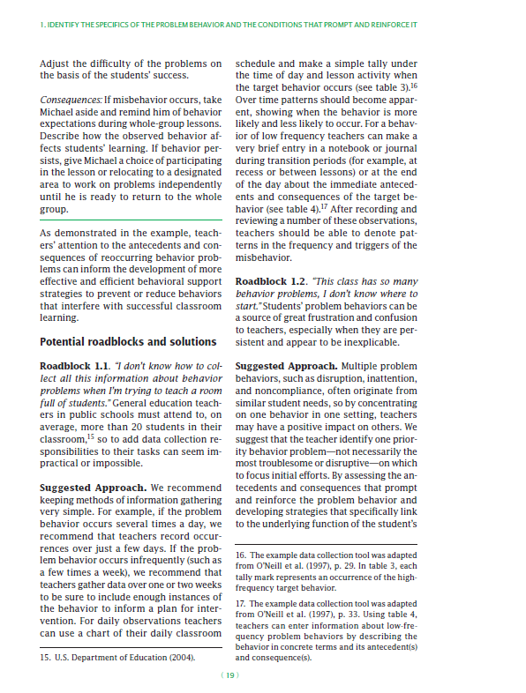
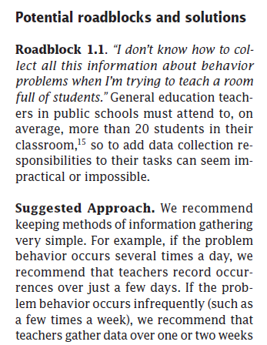
Practice Guides

Slide 6
The Research Evidence Rating
The panel considered:
  High quality experimental and quasi-experimental studies.
  Also examined studies of screening and progress monitoring measures for recommendations relating to assessment.
Each recommendation receives a rating based on the strength of the research evidence:
  Strong
  Moderate
  Minimal

Slide 7
Panelists
Russell Gersten (Chair), Instructional Research Group (IRG), Professor Emeritus University of Oregon
Sybilla Beckmann, University of Georgia
Ben Clarke, Pacific Institute for Research/Instructional Research Group
Anne Foegen, Iowa State University
Laurel Marsh, Howard Count Maryland School District
Jon R. Star, Harvard University
Bradley Witzel, Winthrop University

Slide 8
Recommendation | Level of Scientific Evidence | Applies to
Universal screening (Tier 1) | Moderate | Tier 1
Focus instruction on whole number for grades k-5 and rational number for grades 4-8 | Minimal | Tier 2, 3
Systematic instruction | Strong | Tier 2, 3
Solving word problems | Strong | Tier 2, 3
Visual representations | Moderate | Tier 2, 3
Building fluency with basic arithmetic facts | Moderate | Tier 2, 3
Progress monitoring | Minimal | Tier 2, 3
Use of motivational strategies | Minimal | Tier 2, 3

Slide 9
Recommendation 2
Instructional materials for students receiving interventions should focus in-depth on:
  Whole numbers in kindergarten through grade 6
  Rational numbers in grades 4 through 8
  Applications to geometry and measurement
  Level of Evidence: Minimal

Slide 10
What to Teach in Intervention (continued)
Instruction should include:
  procedures
  AND concepts
  AND word problems
Whole number work consistently links operations to number properties

Slide 11
Recommendation 3
Instruction during the intervention should be systematic and explicit. This includes providing models of proficient problem-solving, verbalization of thought processes, guided practice, corrective feedback, and frequent cumulative review.
  Level of Evidence: Strong

Slide 12
Evidence
Six randomized controlled trials met standards
Key themes
  Extensive practice with feedback
  Let students provide rationale for their decisions
  Instructors and fellow students model approaches to problem solving

Slide 13
Recommendation 4
Interventions should include instruction on solving word problems that is based on common underlying structures.
  Level of Evidence: Strong

Slide 14
Visual Representation for Change Problems
There are 18 ducks. Then 5 more swim over. How many ducks are there now?
Change
+ 5 ducks
Beginning
18 ducks
Ending
_____ ducks

Slide 15
Recommendation 5
Intervention materials should include opportunities for the student to work with visual representations of mathematical ideas, and interventionists should be proficient in the use of visual representations of mathematical ideas.
  Level of Evidence: Moderate

Slide 16


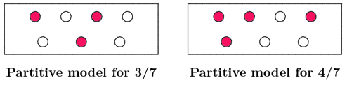
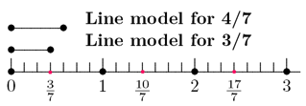
Suggestions
Use visual representations such as number lines, arrays, and strip diagrams.
If necessary, consider use of concrete manipulatives before visual representations. The goal should be to move toward abstract understanding.

Slide 17
Recommendation 6
Interventions at all grades should devote about 10 minutes in each session to building fluent retrieval of basic arithmetic facts.
  Level of Evidence: Moderate

Slide 18
Recommendation 8
Include motivational strategies in Tier 2 and Tier 3 interventions.
  Level of Evidence: Minimal

Slide 19
Roadblocks
Rewards can reduce genuine interest in mathematics by directing student attention to gathering rewards rather than learning math.
Suggested Approach: Rewards have not shown to reduce intrinsic interest. As students become more successful, rewards can be faded so student success becomes an intrinsic reward.

Slide 20
Resources
Center on Instruction (COI) http://www.centeroninstruction.org
Gersten, R. & Newman-Gonchar, R. (Eds.) (August, 2011). Response to Intervention in mathematics. Baltimore, MD: Brookes.
National Center on Response to Intervention http://www.rti4success.org
WWC Practice Guide http://ies.ed.gov/ncee/wwc/publications/practiceguides

Slide 21

Thank you
Contact Information
Website Address: http://www.inresg.org/
or
Center on Instruction
Email COI-Info@rmcres.com
Website Address: http://centeroninstruction.org

