Slide 1

Adolescent Literacy Instruction: Putting Research Into Practice
Vicki LaRock – Center on Instruction
Peggy Simon – Doing What Works
May 25, 2011

Slide 2


The Center on Instruction is operated by RMC Research Corporation in partnership with
the Florida Center for Reading Research at Florida State University; Instructional Research Group; the Texas Institute for Measurement, Evaluation, and Statistics at the University of Houston; and The Meadows Center for Preventing Educational Risk at the University of Texas at Austin.
The contents of this PowerPoint were developed under cooperative agreement S283B050034 with the U.S. Department of Education. However, these contents do not necessarily represent the policy of the Department of Education, and you should not assume endorsement by the Federal Government.
The Center on Instruction requests that no changes be made to the content or appearance of this product.
To download a copy of this document, visit www.centeroninstruction.org.
2011

Slide 3


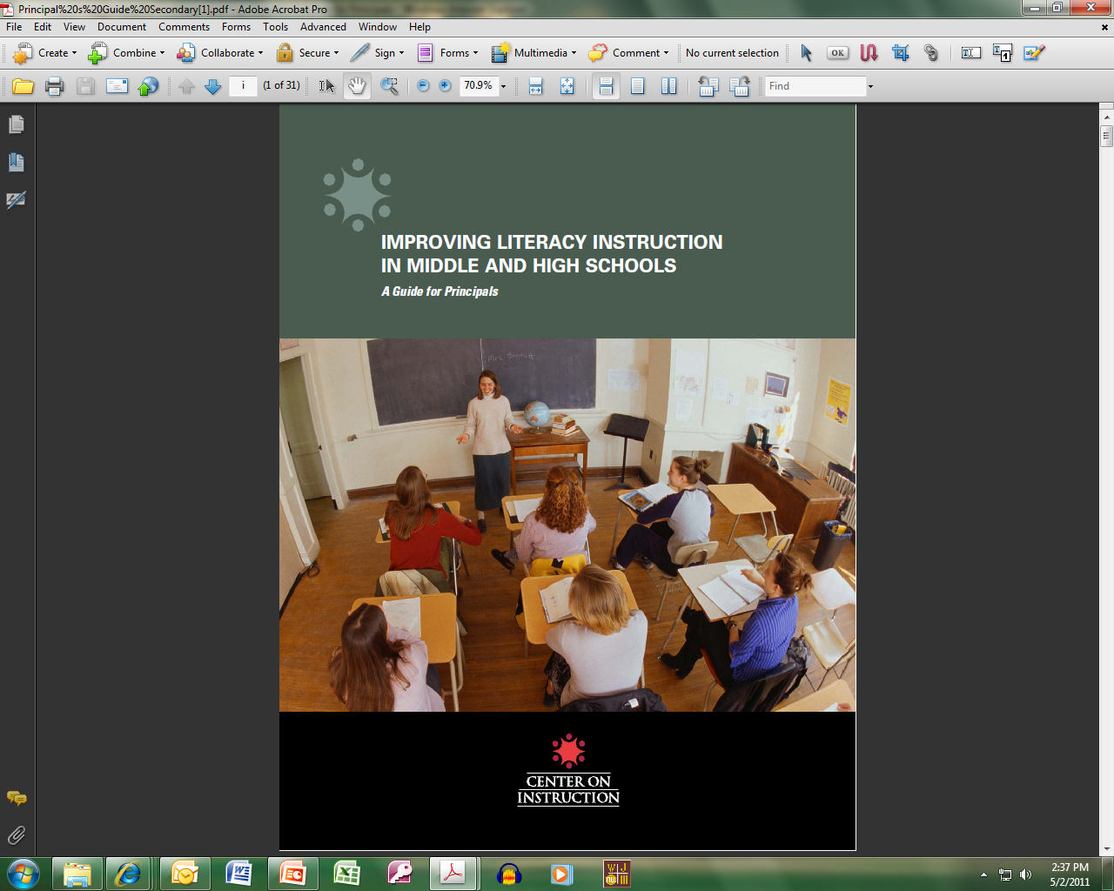
Resource Examples

Slide 4
Food for Thought
There are two ways to improve results: redesign the school based on best practices or get new kids.
-- Tim Westerberg, former high school principal in Littleton, CO

Slide 5
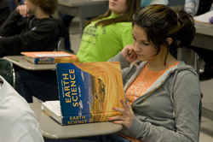
Literacy Proficiency for ALL Students
Raise overall literacy levels
Develop content area literacy
Provide interventions for struggling readers

Slide 6
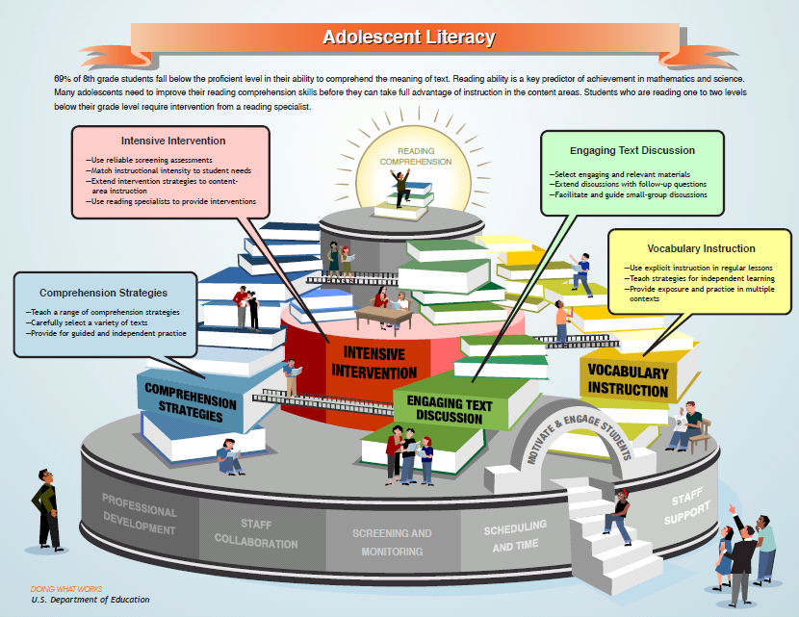
Notes:
6

Slide 7
Vocabulary Research: Explicit vocabulary instruction has a substantial effect on students’ vocabulary acquisition in ALL content areas and across a variety of texts. (Kamil et al., 2008)
Knowing the meanings of words relates strongly to comprehension and overall academic success.
(Baumann, Kame’enui & Ash, 2003, National Institute of Child Health and Human Development, 2000)
All content area teachers should…
  include explicit vocabulary instruction in regular classroom lessons
  provide repeated exposure to and practice in using new words in multiple contexts
  teach both word meanings and strategies for independent vocabulary acquisition

Slide 8
Comprehension Research : There is strong evidence to support the use of direct and explicit instruction in comprehension strategies and how to flexibly select and use them to improve students’ reading comprehension.
(Kamil et al., 2008)
Teachers should…
  provide direct, explicit strategy instruction
  understand cognitive demands for reading texts in their disciplines
  help students become better readers of context area texts
Effective strategies include:
  Answer questions
  Generate and answer questions
  Monitor comprehension
  Multiple strategy instruction
  Background knowledge
  Summarization
  Graphic organizers
Motivation and engagement tips:
  Establish learning goals
  Provide feedback, choice, and collaboration opportunities

Slide 9
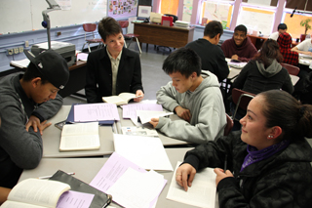
Research Finding: Classrooms that frequently incorporate extended discussions show greater literacy gains than classes that have little or no opportunity for discussion.
(Kamil et al., 2008)
Teachers should…
  select engaging and relevant materials
  create discussion-rich classroom environment
  develop questions that require reflection, deep thinking , and making connections
  ask follow up questions to extend the discussion
  facilitate small group discussions

Slide 10
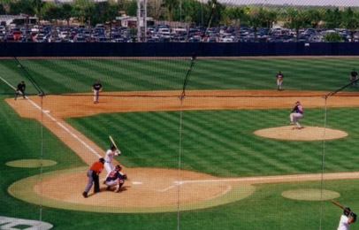
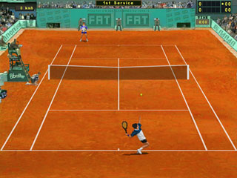
A good discussion looks more like . . .
a baseball game than
a tennis match

Slide 11
Research findings: Struggling readers require supplemental or intensive interventions often provided by a trained specialist in addition to the reading support students typically receive in their regular classrooms.
Struggling readers benefit from:
  explicit instruction designed to meet specific learning needs
  teacher modeling, extended practice with feedback
  scaffolded instruction
  teacher-guided instruction and peer interaction
Provide interventions that…
  are based on screening and diagnostic assessment data
  match instructional focus and intensity to student needs
  involve collaboration between specialists and content area teachers

Slide 12
Strong Leadership
Knowledgeable about all aspects of literacy
  — Components of reading
  — Reading and writing data
  — Nature of effective classroom instruction
  — Resources needed and available to support student and teacher needs
Aligns literacy goals, resources, and actions
Maintains visibility, accountability, and communication around literacy

Slide 13

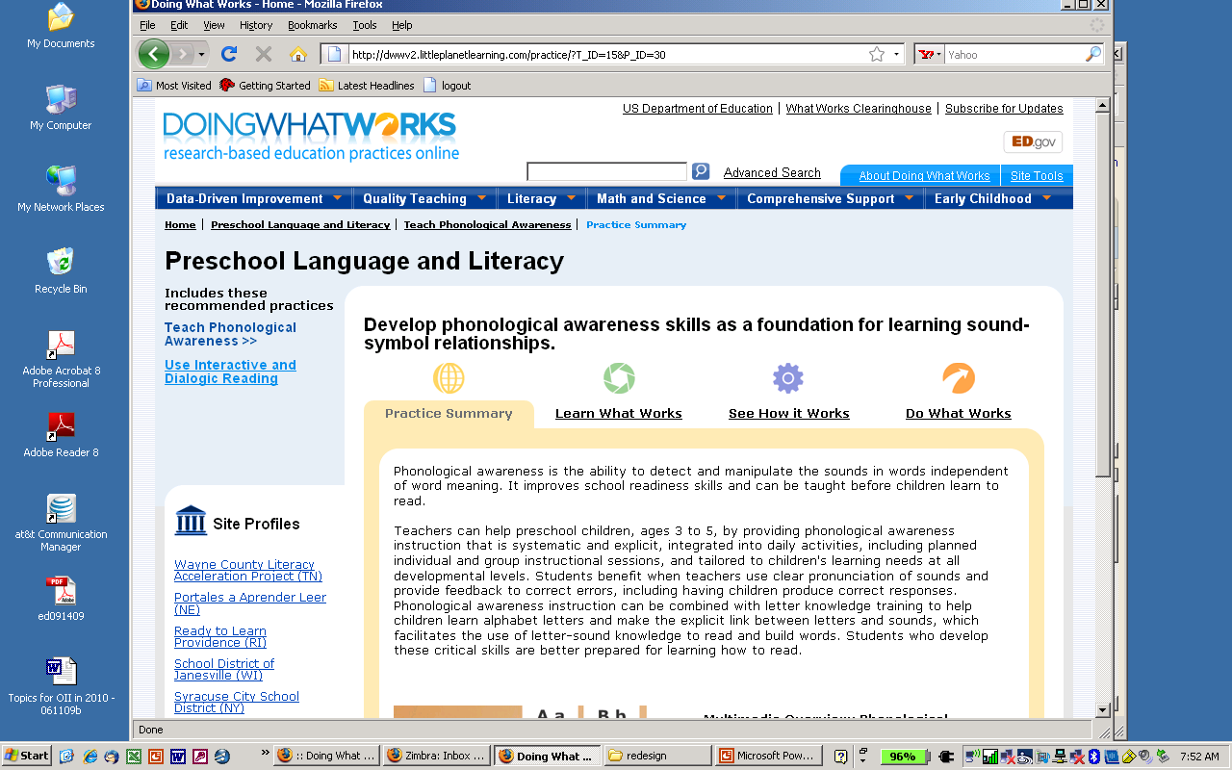
Doing What Works
Research base/Instructional presentations
Expert interviews
School site videos and slideshows
Interviews and sample materials from schools
Tools and templates to implement practices
Ideas for action
Notes:
13

Slide 14
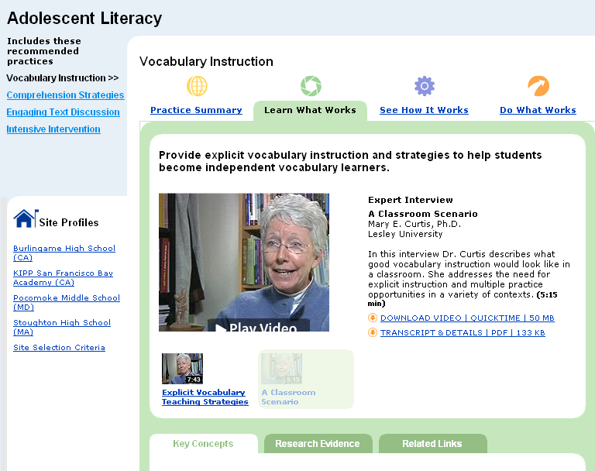
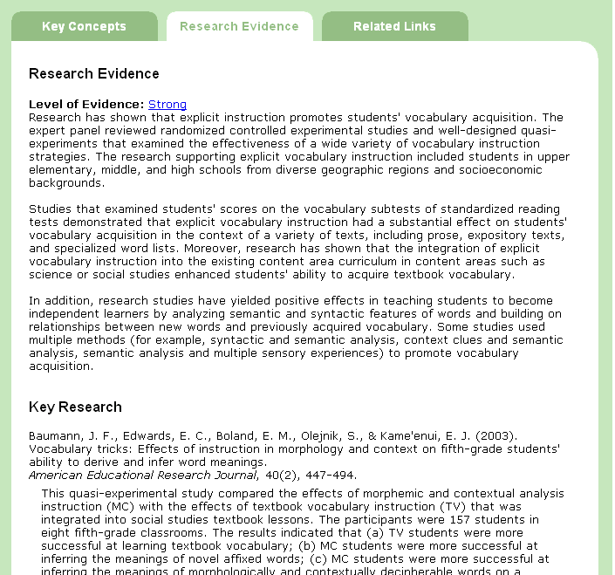
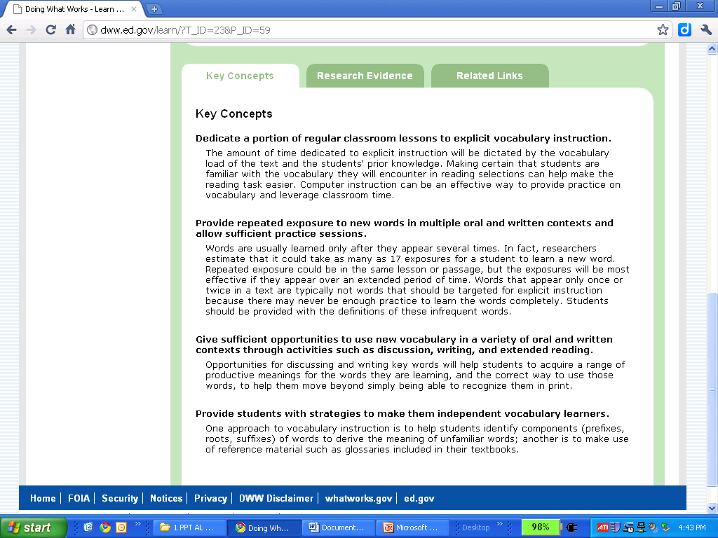
LEARN What Works
Research and Key Concepts
Notes:
14

Slide 15

SEE
How It Works:
School
Examples
Notes:
15

Slide 16
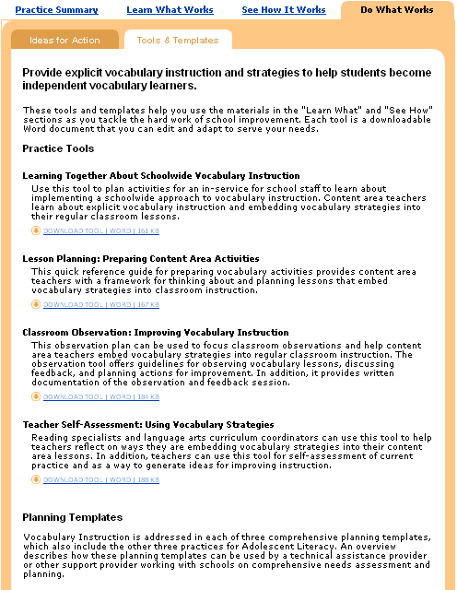
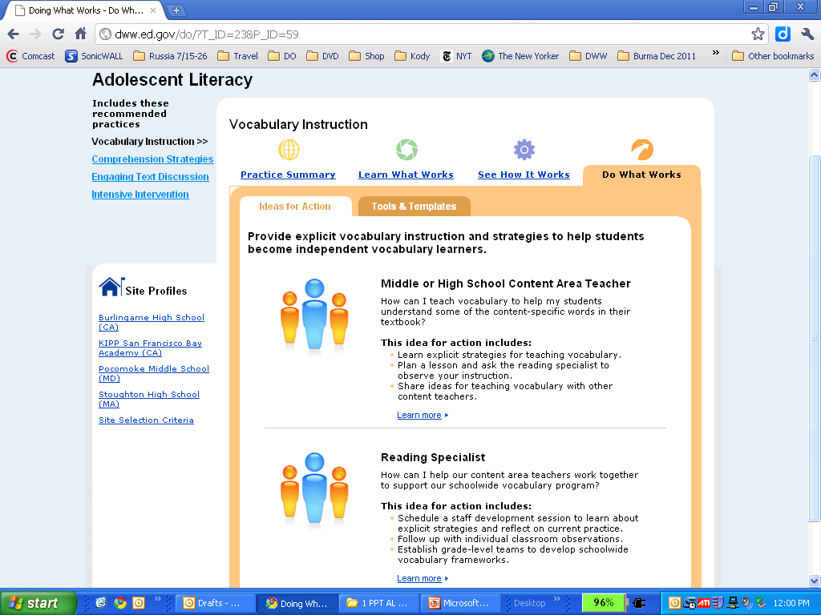
Treasure Hunt What can help you? | LEARN | SEE | DO
 | Research base Links to research articles Narrated power point presentations Explanations of practice and key actions Expert interviews | School sites: videos audios slideshows Sample materials from schools: curriculum plans student assignments lesson plans protocols | Ideas for action by different role groups (e.g. principals, coaches, teachers) Tools: observations workshops checklists Planning templates: state district school
DO the Practice: Tools and Ideas
Notes:
16

Slide 17
What Comes Next?
Questions?
Use a Tool to:
    Process today’s learning
    Reflect on current practice
    Identify areas for improvement
    Discuss ideas with colleagues

Slide 18
Your Turn Again
Use a Planning Template to:
    Assess current status of adolescent literacy
    Guide your work plan for strengthening the instructional program

Slide 19
Final Thoughts
1 “ah-ha” about adolescent literacy (AL)
Greatest challenge to improving AL in rural areas or in schools serving ELL students
1 effective strategy you use for strengthening A L instruction or leadership
1 critical area for development you would start with and why

Slide 20
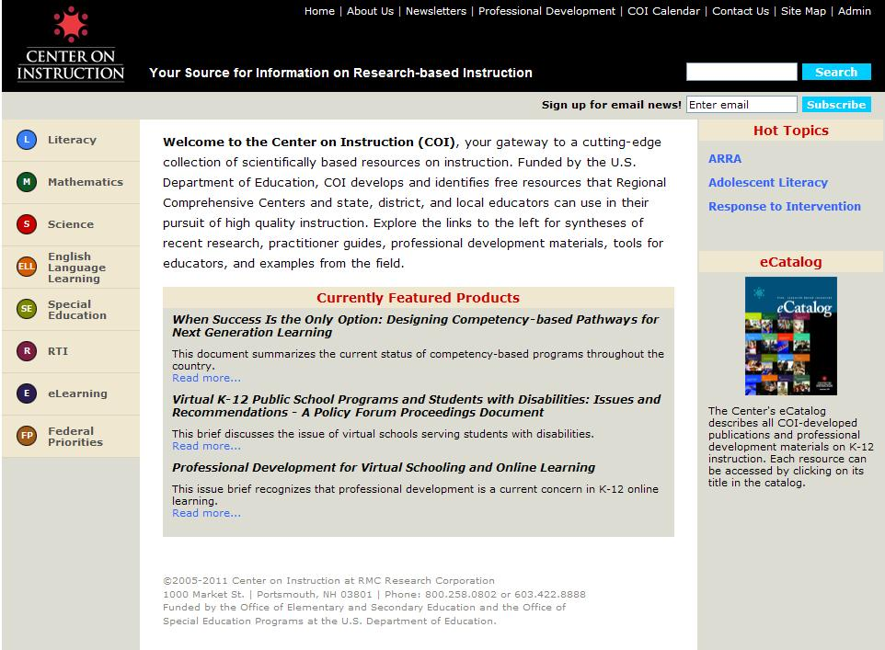
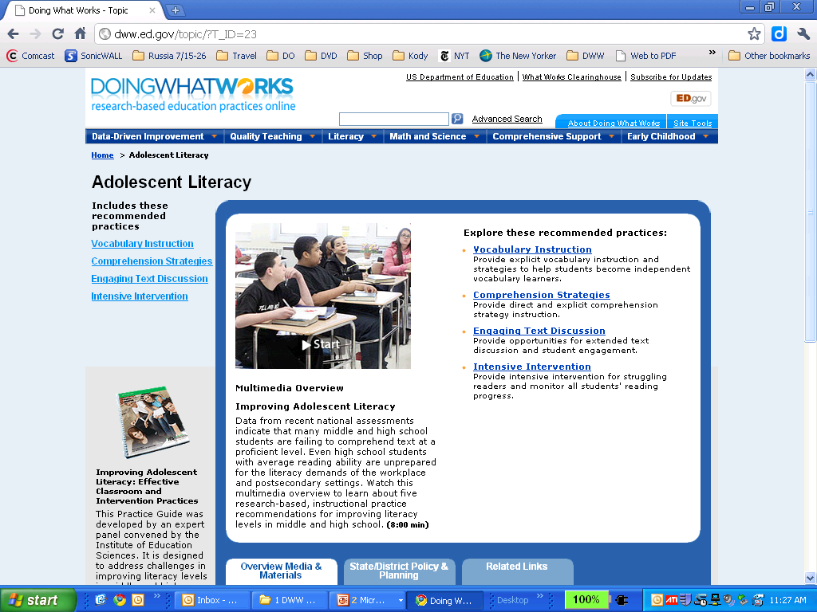
Adolescent literacy resources…
dww.ed.gov
Peggy Simon
psimon@rmcres.com
www.centeroninstruction.org
Vicki LaRock
vlarock@rmccorp.com
Notes:
20

